Slide 1

As you join us, please type into the Chat a movie or show you’re currenly watching or recently watched that you’d recommend.
Notes:
Link to sign-in sheet
https://forms.gle/wVdxH1ZXp1nRj3kU6

Slide 2
Designing Instructional Services to Align to the State Service Delivery Plan
February 25, 2022
Melissa Mallory, Education Programs Consultant
Migrant Education Office
Teresa Palomino, Education Programs Consultant
Migrant Education Office
Notes:
Before the webinar starts (5 min. and 1 min. before)
Good afternoon! Thank you for joining us. We are going to get started in just a few minutes. While you wait, please complete the attendance sign-in sheet at:
Teresa
Good afternoon! Welcome to the “Designing Instructional Services to Align to the State Service Delivery” webinar.

Slide 3

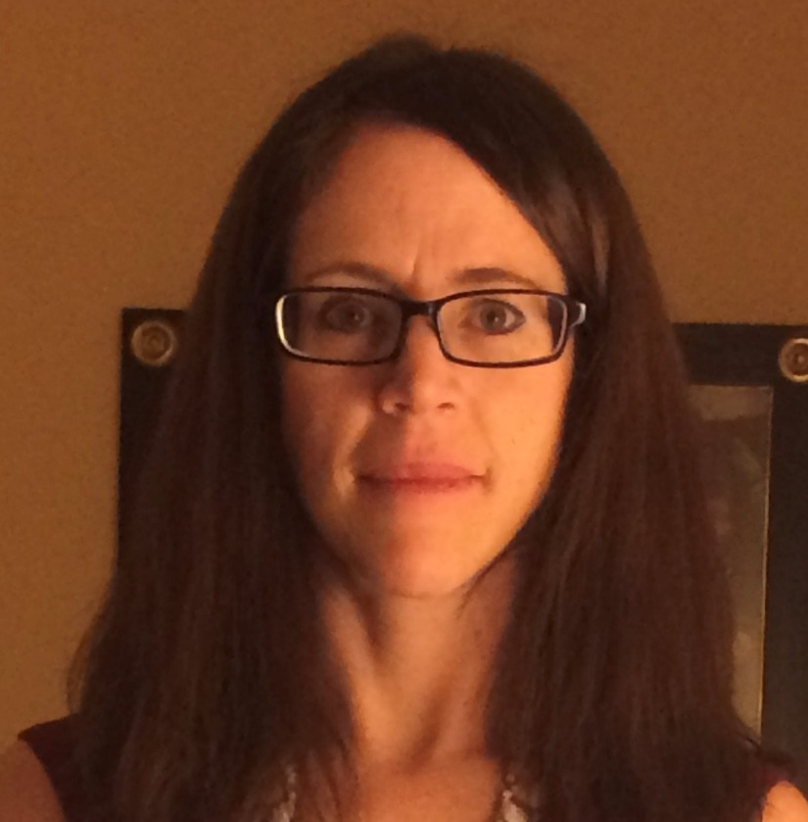
Presenters
Teresa Palomino
Melissa Mallory
Notes:
My name is Teresa Palomino, an Education Programs Consultant, for the Migrant Education Office and I am the lead for the Migrant Education Program grant application. Joining me today is Melissa Mallory, the lead for the State Service Delivery Plan.

Slide 4
Audience
SSDP Leads
Directors
Coordinators and Program Managers
Other Migrant Education Program (MEP) staff who develop services in the grant application.
Notes:
Teresa
The audience for this presentation includes Directors, Coordinators/Program Managers, and Other Migrant Education Program, or MEP, staff who develop services in the grant application.

Slide 5
Agenda
Review webinar objectives
Resources to complete the grant application
Walk through a sample service
Break
Practice reviewing a sample service
Identify common missteps
Review best practices
Conclusion
Notes:
Teresa
During the webinar today we will review webinar objectives, resources necessary to complete the grant application, review a sample service and discuss the SSDP requirements based on the selected SSDP Strategies as well as practice reviewing a service and identifying common missteps and best practices.

Slide 6
Webinar Objectives
Participants will review how to develop services in the grant application that align to the State Service Delivery Plan (SSDP).
Participants will be able to identify what needs to be included in services that map to specific measurable program objectives (MPOs).
Notes:
Teresa
For our webinar today:
Participants will review how to develop services in the grant application that align to the State Service Delivery Plan (SSDP).
Participants will identify what needs to be included in services that map to specific measurable program objectives (MPOs).
During the webinar today we will review resources necessary to complete the grant application, review a sample service and discuss the SSDP requirements based on the selected SSDP Strategies as well as practice reviewing a service and identifying common missteps and best practices.
Now I will turn it over to my colleague, Melissa Mallory, who will continue with the presentation.

Slide 7

Pretest Poll
Let’s take a quick poll to assess our knowledge of the SSDP and specific MPOs. Please choose the BEST answer.
Notes:
Let’s take a quick poll to assess our knowledge of the SSDP Strategies and MPOs. Please choose the BEST answer.
1. What elements are required for MPO 7.0?
a. A pre-K certificated teacher
b. Inclusion of students in ages P3-P5
c. A focus on primary and secondary language development
d. 15 hours for the performance period
e. Held at a time when parents are available
f. Includes integrated ELD
f. All of the above (Correct answer)
2. Where can I find the SSDP requirements for personnel, duration of service, or grade levels?
The SSDP MPOs identify this information (correct answer)
In the grant application
The SSDP Strategies identify this information
4. If I select SSDP Strategies in the application, I MUST address them in the grant application narrative.
a. True (correct answer)
b. False
c. I don’t know
If I select SSDP Strategy 13.1, which statements are true?
a. I must identity what students will learn from the self-pride lesson in the Key Skills field.
b. I must select Strategy 13.1 in the SSDP Strategies tab in the grant application.
c. Self-pride may be implicitly taught through activities like Speech and Debate where students can naturally build self-confidence.
d. Self-pride must be taught through direct instruction of a lesson to build self-pride.
e. a, b, and c
f. a, b, and d (correct answer)

Slide 8
Resources for Designing Instructional Services
SSDP (Section III General Framework)
MPO Reports: identifies the size of the student population and specifically who needs to serve
MPO Tracking Tool: identify the SSDP strategies implemented by various districts to ensure the region as a whole is planning on implementing all strategies and to ensure services reach a large number of students
Subgranting Report: identifies the districts that should complete a DSA
Notes:
To develop your grant application you’ll need a few resources. Section III of the SSDP identifies the SSDP Strategies and the MPOs that will guide service development. Now that the Academic Risk Report also includes the English Learner indicator, you should use MPO Reports 1.0 and 2.0 to identify the number of students who are not proficient in ELA and math. The MPO Reports focus specifically on those students who are not proficient on the CAASPP. Additionally, because early intervention is necessary, the MPO Reports also include children in grades K-2 who are identified as not proficient on the English Language Proficiency Assessment for California, or ELPAC.
The MPO Tracking Tool provides a way to track where SSDP Strategies are being implemented to ensure that all strategies are implemented and all individual MPO requirements are met. This includes aggregating the number of students who are below proficiency planned to be served by the region and reimbursable districts. Finally, the Subgranting Report identifies the number of migratory students in each district. If a district has 200+ students, they should have a district service agreement (DSA).

Slide 9
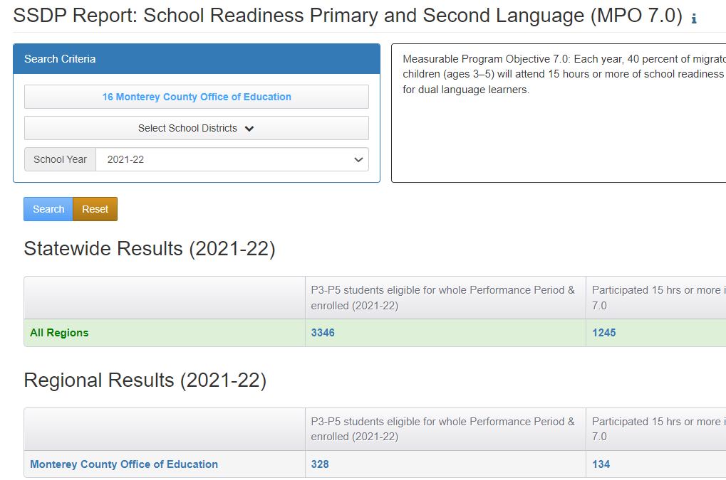
Using the MPO Report
Notes:
When using the MPO reports to plan to serve children in school readiness, you’ll identify the number of pre-k children in the denominator and then multiply that number by .4 to identify your target number of students to serve. Regional staff should note that when staff review DSA and MOU applications, it would be good to run the MPO report to verify that the region and its reimbursable districts are collectively serving a sufficient number of students.

Slide 10
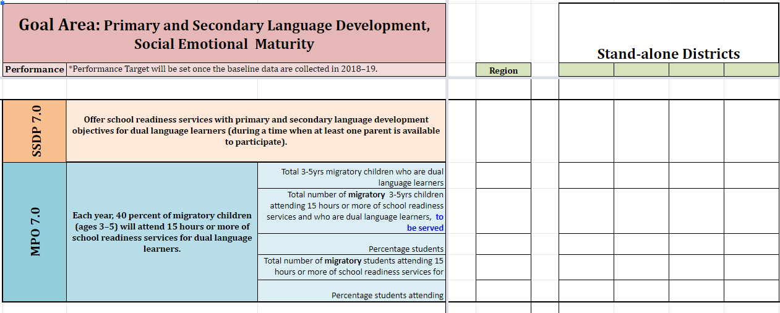
Measurable Program Objectives Tracking Tool
Notes:
As noted in previous trainings, Region 10 created an MPO Tracking Tool that has been shared with the field. It is set up for regions, but can be easily used for direct-funded districts, or DFDs, by removing the reimbursable district columns and replacing the word “region” in the fifth column with “district.” This tool has a tab for each of the focus areas and includes what is required for each strategy and MPO. Subgrantees should use this tool, or a tool that serves the same purpose, to track implementation of strategies and to strategically plan to meet all MPOs for each focus area as you review your regional and reimbursable districts’ applications. For regional subgrantees, you’ll want to identify the strategies being implemented at each of your reimbursable districts as well as the region. Please be sure to check that your districts and the region as a whole are meeting the requirements in the MPOs.
This slide shows a piece of the SSDP Monitoring Log, or MPO Tracking Tool for SR focusing on SSDP Strategy and MPO 7.0. While developing services in the application, subgrantees should keep track of students served for all services aligned to MPO 7.0 which include a time, staff, and grade requirement. The same should be done for ELA and math. As previously noted, subgrantees can revise this tool to best meet your needs.

Slide 11
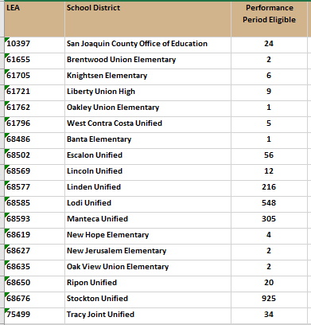
Checking for Understanding:
Subgranting Report
Notes:
Let’s take a quick break to check for understanding on the Subgranting Report. Remember that the Subgranting Report is provided to you every spring and it identifies the number of students you are receiving funding for in the next funding cycle. This report identifies the number of students who were eligible in the performance period, number of PFS students, number of out of school youth and other factors included in the state funding formula that many of you use. So, the Subgranting Report is to be used to make funding allocations to districts.
Districts need to have a certain number of students to enter into a district service agreement. Using the Chat, please identify the districts who should be offered migrant funds for a DSA.
Answer: Linden, Lodi, Manteca, and Stockton

Slide 12
Measurable Program Objectives
All MPOs should be considered and reviewed as the grant application is being developed.
The MPOs provide additional information on SSDP Strategy implementation as well as identify implementation targets or goals for the local MEPs.
  For example, some MPOs identify a percentage of children who need to be served, service duration, staffing, and grades. Other MPOs identify the number of workshops that need to be offered by the local MEP.
  Link to the SSDP: https://www.cde.ca.gov/sp/me/mt/statesrvcdelivrypln.asp
  Link to other SSDP trainings/resources: https://drive.google.com/drive/folders/1XbK2v4eNbv4Wg2O4tLZe5AjZkiGacrKx?usp=sharing
Notes:
Before developing and writing services in the grant application, it’s important to know what is required for each program as a whole. All MPOs should be considered and reviewed as the grant application is being developed.
The MPOs provide additional information on SSDP Strategy implementation as well as identify implementation targets or goals for the local MEPs. For example, some MPOs identify a percentage of children who need to be served, service duration, staffing, and grades. Other MPOs identify the number of workshops that need to be offered by the local MEP.

Slide 13
Measurable Program Objective 7.0
Measurable Program Objective 7.0: Each year, 40 percent of migratory children (ages 3–5) will attend 15 hours or more of school readiness services for dual language learners.
Students are included in this report if they meet the following criteria:
Are enrolled in grades P3-P5 (i.e., school readiness range), and
Turned 3 years old on or before 9/1 of the selected school year, and
Were eligible and present for the whole performance period

Slide 14
Example Service: SSDP Strategies
The example service selected the following SSDP Strategies:
Strategy 7.0: Offer school readiness services with primary and secondary language development objectives for dual language learners (during a time when at least one parent is available to participate).
Strategy 7.1: Provide training and resources to parents:
Workshops to increase awareness of school readiness skills including the importance of and strategies to develop primary language skills
Workshops to teach strategies that support early learning at home
Workshops to increase social emotional learning at home
Strategy 8.0: Include social emotional development strategies in school readiness services.
Notes:
When reviewing services, the first section I look at is the SSDP Strategies tab. This way I know exactly what to look for in all the other fields in the application. The strategies selected will inform the narrative written in the application. This service selected all the strategies for school readiness and the Student Engagement focus areas; therefore, I know the service description should include information about primary and secondary language service for pre-k students as well as the parent workshops. The Key Skills field will identify student outcomes for literacy, math, building cultural and self-pride; other key skills may be included for other content areas like science and art, but application reviewers need to ensure that they see key skills for the SSDP strategies selected. Parent outcomes for the workshops should also be included in the Key Skills field.

Slide 15
Example Service: SSDP Strategies (2)
The example service selected the following SSDP Strategies:
Strategy 13.0: Services offered to migratory students need to have a cultural component.
Strategy 13.1: Increase student engagement by incorporating activities into services that build migratory students’ self-pride (e.g., confidence, self-worth, etc.).
Strategy 13.2: Provide professional development to staff on cultural competency.
Notes:
Specific information on staff development for Strategy 13.2 should also be included in the Staff Development tab.

Slide 16
Example Service: Service Description
Service Description
Provide migrant children ages three to five a home-based to provide experiences that support their social-emotional, cognitive development through increased literacy and numeracy, and primary and secondary language development. Encourage parents to take on their role as their child's first teacher, our program will support parents to understand child development and gain skills to support the learning at home.
This program will consist of one 7-week (the other five weeks of this program take place during the summer) and one 12-week session, where each child receives a home visit per week for 1.25 hours to complete a total of 8.75 and 15 hours of service, respectively.
In addition, the Region will provide 2 site-based experiences (Family Literacy Nights) to provide workshops for parents to learn more about their child's cognitive and social development. They will receive resources and ideas on how to support and continue the learning at home that is age-appropriate.

Slide 17
What’s Missing?
Please use the Chat feature and identify which SSDP Strategies were not included in the Service Description.
Notes:
Please use the Chat feature and identify which SSDP Strategies were not included in the Service Description.
Answer: That is correct building cultural and self-pride as well as the two professional developments, or PD, were not included in the Service Description. That’s okay as long as text supporting these strategies are included elsewhere. I don’t expect to see PD in the Service Description field because there is a separate tab for PD. It varies on whether I see Strategies 13.0 and 13.1 in the Service Description, but I should definitely see them in the Key Skills field under the Plan tab.

Slide 18
Example Service: Key Skills
The home/site-based programs will provide the opportunity for preschool students to:
recognize upper case letter names and sounds
number concepts and quantities 1–10
colors
gain more vocabulary
to develop their social-emotional skills
gain the school readiness skills needed to enter kindergarten
grow in primary and secondary language skills
Student and parents will learn to incorporate their own cultural - including songs, art, food, literature, among others - and primary language assets in ways that lead to increased self-confidence and self-pride.
Notes:
Here we see the skills to be learned by the students most of which are written as content objectives.
Poll:
Which strategies align with MPO 7.0?
recognize upper case letter names and sounds
number concepts and quantities 1–10
colors
gain more vocabulary
to develop their social-emotional skills
gain the school readiness skills needed to enter kindergarten
grow in primary and secondary language skills
Student and parents will learn to incorporate their own cultural - including songs, art, food, literature, among others - and primary language assets in ways that lead to increased self-confidence and self-pride.
None of the above
2. Which strategies align with Strategy 8.0?
recognize upper case letter names and sounds
number concepts and quantities 1–10
colors
gain more vocabulary
to develop their social-emotional skills
gain the school readiness skills needed to enter kindergarten
grow in primary and secondary language skills
Student and parents will learn to incorporate their own cultural - including songs, art, food, literature, among others - and primary language assets in ways that lead to increased self-confidence and self-pride.
None of the above
3. Which strategies align with Strategy 13.0?
recognize upper case letter names and sounds
number concepts and quantities 1–10
colors
gain more vocabulary
to develop their social-emotional skills
gain the school readiness skills needed to enter kindergarten
grow in primary and secondary language skills
Student and parents will learn to incorporate their own cultural - including songs, art, food, literature, among others - and primary language assets in ways that lead to increased self-confidence and self-pride.
None above
3. Which strategies support the inclusion of Strategy 13.1?
recognize upper case letter names and sounds
number concepts and quantities 1–10
colors
gain more vocabulary
to develop their social-emotional skills
gain the school readiness skills needed to enter kindergarten
grow in primary and secondary language skills
Student and parents will learn to incorporate their own cultural - including songs, art, food, literature, among others - and primary language assets in ways that lead to increased self-confidence and self-pride.
None of the above
2. Which strategies align with Strategy 13.0?
recognize upper case letter names and sounds
number concepts and quantities 1–10
colors
gain more vocabulary
to develop their social-emotional skills
gain the school readiness skills needed to enter kindergarten
grow in primary and secondary language skills
Student and parents will learn to incorporate their own cultural - including songs, art, food, literature, among others - and primary language assets in ways that lead to increased self-confidence and self-pride.
None above (what’s written is more of an implicit teaching of self-pride. Application reviewers need to look for explicit teaching on self-pride, so I would expect to see the content objective for the self-pride lesson included in the service.

Slide 19
Example Service: Key Skills (2)
The whole family will have the opportunity to learn, grow, explore and have fun together as parents build their capacity and gain strategies to support their child's development.
Parents will have the opportunity to practice their role as their child's first teacher by giving them the opportunity to learn and practice effective strategies to support learning at home.
The Site-based Family Literacy program will provide the following workshops to parents:
Strategies to develop/build primary language
Workshops to teach strategies that support early learning at home to support their children to acquire school readiness skills
Workshops about social-emotional development
Notes:
We have some additional key skills for this service and we’ll have a poll after to identify which strategies align to which key skills.
Which strategies align to MPO 7.1?
The whole family will have the opportunity to learn, grow, explore and have fun together as parents build their capacity and gain strategies to support their child's development.
Parents will have the opportunity to practice their role as their child's first teacher by giving them the opportunity to learn and practice effective strategies to support learning at home.
Strategies to develop/build primary language
Workshops to teach strategies that support early learning at home to support their children to acquire school readiness skills
Workshops about social-emotional development

Slide 20
Example Service: Instructional Strategies
Pre-k teachers and associate teachers will focus on vocabulary-building, letter and color recognition strategies in both the primary and secondary language, along with basic code-focused instruction.
Additionally, socio-emotional skills will be developed through the use of storybooks and pictures.
The curriculum will be built upon the child's identity and the California Preschool Learning Foundations. The program will focus on providing opportunities to gain skills in the following domains: Cognitive, social-emotional, fine motor, gross motor, language and self-help.
Notes:
Please read the text in the instructional strategies field and respond to the following question: Is this sufficient for the strategies reviewed? Please unmute your microphone to add your comments or type them into the Chat.

Slide 21
Example Service: Instructional Strategies (2)
Teachers will target and enhance the child's level of thinking skills, multiple exposures to new words to support children's language acquisition primarily the home language and introducing effective English language development.
Resource for culturally and linguistically responsive teaching: https://drive.google.com/drive/folders/1whPv3BPGVD7EiPJ5IrSyErv0b2OyH_tW?usp=sharing
Notes:
Please read the text in the instructional strategies field and respond to the following question: Is this sufficient for the strategies reviewed? Please unmute your microphone to add your comments or type them into the Chat.

Slide 22
Example Service: Staff Development
Name of Training | Dates | Minutes | Description | Strategy Being Met
Culturally and Linguistically Responsive Teaching | 09/2022 | 90 | Develop understandings of cultural competence and critical consciousness and learn how to apply them when working with migratory students. Includes practical ways of integrating CLRT and reimagine the classroom environment, instructional design, and relationships with students and families | 13.0, 13.1, 13.2

Slide 23
Example Service: Staff Development
Name of Training | Dates | Minutes | Description | Strategy Being Met
Preschool Learning Foundations | 08/2022 | 180 | Assessments, best practices, CPIN and Preschool Learning Foundations *Social-emotional development *Positive Social interactions *Math Number sense *Language Development | 7.0, 7.1, 8.0, 8.1

Slide 24
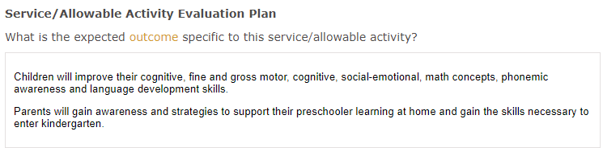
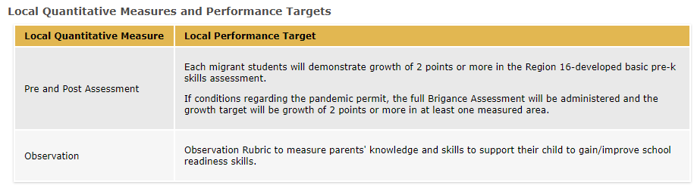
Example Service: Expected Outcome and Local Measures
Notes:
For the Expected Outcome, we should see a change in knowledge, skills, abilities, and/or behaviors. The outcome is a simple broad statement and is the foundation for your local measures and performance target. The outcome identified here, is perfect. We see a change, or increase, in knowledge and skills for the skills identified in the Key Skills tab for both students and parents.
The CDE expects to see pre and posttest assessments for most instructional services. This sample service shows a pre and posttest for skills taught during the service. It quantifies the change that is expected by the region by identifying a two-point increase on the regional assessment or the Brigance Assessment.
Just a reminder that if you have a quantitative measure, you do not also need a qualitative measure and vice versa.

Slide 25
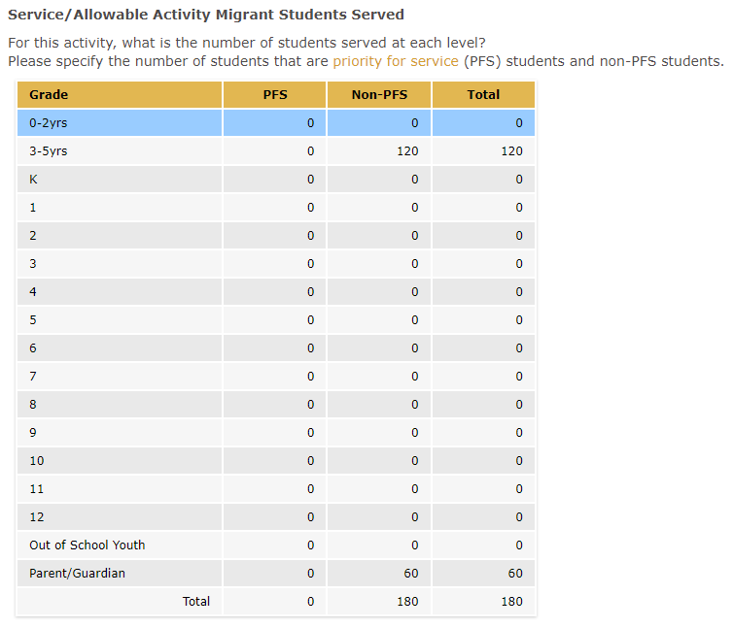
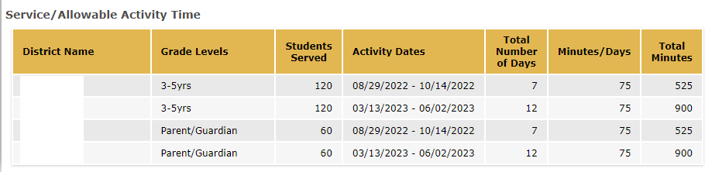
Example Service: Migrant Students Served and Activity Time

Slide 26
Check for Understanding
Let’s take a quick poll to assess our knowledge of the content covered so far during this presentation. Please choose the BEST answer.
Notes:
Do all the SSDP Strategies need to be addressed in the Service Description?
a. Yes.
b. No. Some strategies may be addressed in other fields like Key Skills, Instructional Strategies, Staff Development, etc. (correct answer)
2. If a service includes SSDP Strategies 7.0, 8.0 and 13.1 which skills would you include in the Key Skills field?
a. Students will write for two genres and use student friendly rubrics.
b. Students will build self-confidence by recognizing their strengths during the “All About Me” project instruction.
c. Students will improve their social emotional development by learning how to take turns and respecting physical boundaries.
d. Students will build their vocabulary in both English and Spanish through the use of bilingual books used during instruction.
e. b, c, d (correct answer)
3. True or False? Each SSDP Strategy selected for Staff Development should include a moderately detailed description of the PD to be offered. Details may include title of PD, description of PD, and key objectives for the PD.
True (correct answer)
False

Slide 27
Measurable Program Objective 2.0
Each year, 60 percent of K-10 migratory students who are not proficient in math will participate in at least 30 hours (1800 minutes) of supplemental math instruction focused on concepts and procedures and problem solving and modeling data during the regular school year and at least 20 hours (1200 minutes) of summer school instruction if present.
Notes:
MPO 2.0 states that “each year, 80 percent of K-10 migratory students who are not proficient in math will participate in at least 30 hours (1800 minutes) of supplemental math instruction focused on concepts and procedures and problem solving and modeling data during the regular school year and at least 20 hours (1200 minutes) of summer school instruction if present.”
During the next section of our webinar, we will review a service that aligns to MPO 2.0 in breakout rooms.

Slide 28
Practice
Directions:
Select a facilitator, note taker, and volunteer to report out.
Open the Google doc link via the Chat or Outlook.
Your Breakout Room group number will be the group number for your slides.
In your Breakout Room, review each field in the service for alignment to the SSDP. Start by reviewing the SSDP Strategies selected.
Take notes on your group’s slides in Google Docs. Notes should consist of evidence that the service met the requirements for selected strategies or information that is still needed.
After the 20 minutes, we will reconvene the whole group and share what was discussed in the Breakout Rooms.
Notes:
Attached to the Outlook meeting invitation, participants have access to another sample service. This time, participants will review the service in small groups in a breakout room and discuss whether the service narrative includes all of the necessary information based on the SSDP Strategies selected.
Directions:
Select a facilitator, note taker, and volunteer to report out.
Open the Google doc link via the Chat or Outlook.
In your Breakout Room, review each field in the service for alignment to the SSDP.
Your Breakout Group number will be the Group Number for your slides.
Take notes on your Group’s slides in Google docs. Notes should consist of evidence that the service met the requirements for selected strategies or information that is still needed.
After the 20 minutes, we will reconvene the whole group and share what was discussed in the Breakout Rooms.
Once we reunite as a whole group, I will share each groups slides when they share their insights on the review of the grant application service.
Link to group slides: https://docs.google.com/presentation/d/1GZoYwt2ElyzuWkPinRqHt3XYya6eFu-iDI_Q9SdGmVY/edit?usp=sharing

Slide 29
Breakout Rooms
Please note your group number. Your group number corresponds to the group slides that you will use.
Notes:
Link to group slides:

Slide 30

Whole Group: Share Findings
Notes:
Now that we all have rejoined the whole group, I’m going to share the slides created by each group and we’ll review the activity together.

Slide 31
Common Missteps
Ensuring selected strategy/MPO requirements are included within the application narrative and tables (e.g., Key Skills, Staff Development, Migrant Students Served, Activity Time, etc.).
Not calculating the percentage of SSDP Components (MPOs 3.0, 8.0, 13.0, and 13.1) included in instructional services.
Common errors specific to regional subgrantees:
Not reviewing district service agreements to ensure that the local MEP, as a whole, plans to meet the MPOs.
Not tracking what strategies are being implemented at reimbursable districts.
Notes:
Common missteps in application development when it comes to the SSDP include:
Ensuring selected strategy/MPO requirements are included within the application narrative and tables (e.g., Key Skills, Staff Development, Migrant Students Served, Activity Time, etc.).
Not calculating the percentage of SSDP Components (MPOs 3.0, 8.0, 13.0, and 13.1) included in instructional services.
Common errors specific to regional subgrantees include:
Not reviewing district service agreements to ensure that the local MEP, as a whole, plans to meet the MPOs.
Not tracking what strategies are being implemented at reimbursable districts.

Slide 32
Best Practices
Ensure selected strategy/MPO requirements are met by identifying where the strategies are addressed in the application narrative for each service including a percentage of students served.
Use the MPO Reports to calculate the number of students who need to be served by the region/DFD and reimbursable districts (each district has its own number of students that should be reviewed).
Notes:
Now I’d like to review some best practices for ensuring that services are properly aligned to the SSDP and that all necessary information is included.
Ensure selected strategy/MPO requirements are met by identifying where the strategies are addressed in the application narrative for each service including a percentage of students served.
Use the Academic Risk Report to calculate the number of students who need to be served by the region/DFD and reimbursable districts (each district has its own number of students that should be reviewed).

Slide 33
Best Practices (2)
Track SSDP Components for instructional services and identify if the subgrantee as a whole has met the targets for MPOs 3.0, 8.0, 13.0, and 13.1.
Use a monitoring/tracking tool to ensure that the local MEP as a whole plans to meet the MPOs when reviewing the regional and reimbursable district applications.
Notes:
Track SSDP Components for instructional services and identify if the subgrantee as a whole has met the targets for MPOs 3.0, 8.0, 13.0, and 13.1.
Use a monitoring/tracking tool to ensure that the local MEP as a whole plans to meet the MPOs when reviewing the regional and reimbursable district applications.

Slide 34
Posttest Poll
Let’s take a quick poll to assess our knowledge of the SSDP and specific MPOs. Please choose the BEST answer.
Notes:
Let’s take a quick poll to assess our knowledge of the SSDP Strategies and MPOs. Please choose the BEST answer.
1. What elements are required for MPO 7.0?
a. A pre-K certificated teacher
b. Inclusion of students in ages P3-P5
c. A focus on primary and secondary language development
d. 15 hours for the performance period
e. Held at a time when parents are available
f. Includes integrated ELD
g. A, B, C, D, E (Correct answer)
h. All of the above
2. Where can I find the SSDP requirements for personnel, duration of service, or grade levels?
The SSDP MPOs identify this information (correct answer)
In the grant application
The SSDP Strategies identify this information
4. If I select SSDP Strategies in the application, I MUST address them in the grant application narrative.
a. True (correct answer)
b. False
c. I don’t know
If I select SSDP Strategy 13.1, which statements are true?
a. I must identity what students will learn from the self-pride lesson in the Key Skills field.
b. I must select Strategy 13.1 in the SSDP Strategies tab in the grant application.
c. Self-pride may be implicitly taught through activities like Speech and Debate where students can naturally build self-confidence.
d. Self-pride must be taught through direct instruction of a lesson to build self-pride.
e. a, b, and c
f. a, b, and d (correct answer)
Thank you for your participation. Teresa will share some additional information before we conclude today’s webinar.

Slide 35
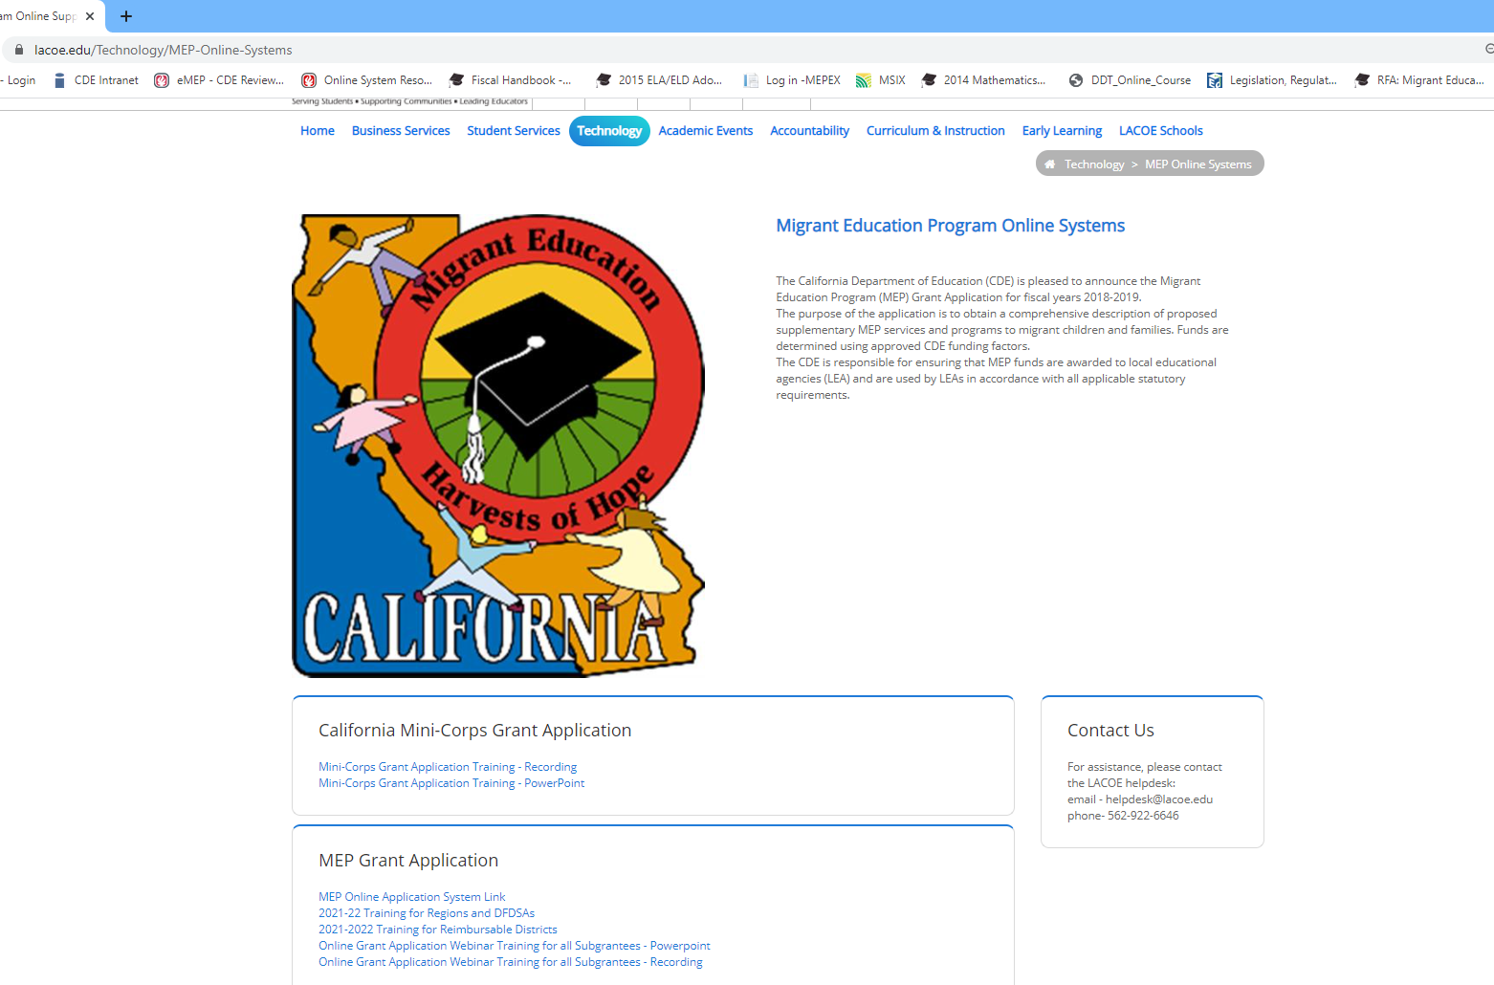
System Resources
https://www.lacoe.edu/Technology/MEP-Online-Systems
Notes:
Teresa
Thank you Melissa for all the great information you have provided to us today.
If you need to access this presentation and recording, please use the link provided on this slide to access the LACOE resources website. This presentation and recording will be posted within the next few weeks.
You can also access the presentations on how to use the online application system. These presentations have been posted to the site.

Slide 36
Thank you!
Teresa Palomino, Education Programs Consultant
Migrant Education Office
Phone:916–319–0678
Email: tpalomino@cde.ca.gov
Melissa Mallory, Education Programs Consultant
Migrant Education Office
Phone: 916–319-0730
Email: mmallory@cde.ca.gov
Notes:
Teresa
Thank you for joining us today. If you have specific questions about the grant application, please contact me by phone or email. For question about the SSDP, you can contact your CDE consultant or Melissa Mallory. Have a wonderful rest of your day!

