Slide 1
Welcome!
We are on standby and will start at 9:30 a.m.
In the meantime, use the chat function to answer the following question: What is one of your favorite summer vacation spots?
Roll Call: Please complete the brief google form to confirm your attendance (the link is provided in the chat box). https://forms.gle/w8RuQZGhC7K1uMrV6
Notes:
Facilitator: Teresa
Time: Slide will be up 15min prior to start time.
Notes:
Stand-by slide
This slide will be on display as participants log in.
Do a few sound-checks prior to starting.
Ask participants to follow the roll call instructions.
https://forms.gle/w8RuQZGhC7K1uMrV6

Slide 2
2023–24 Migrant Education Program Budget Revision System Training August 3, 2023
Notes:
Facilitator: Teresa
Say the following:
Good morning and welcome to the 2023–24 Migrant Education Program, Budget Revision Webinar. This training is a two-part training. The first half will cover the Budget Revision System, and the second half will cover the MEPEX System, also knows as the expenditure report system.

Slide 3
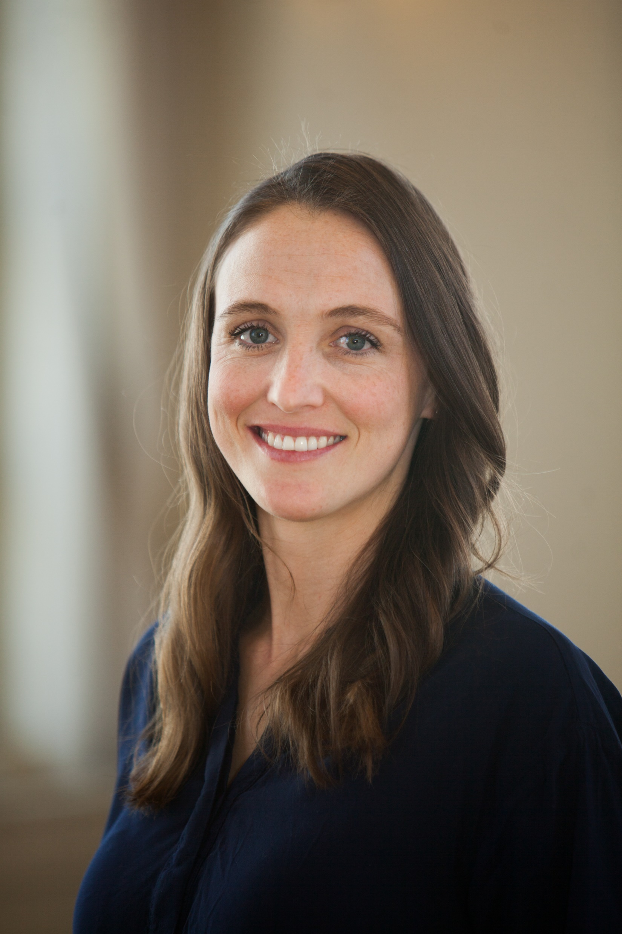
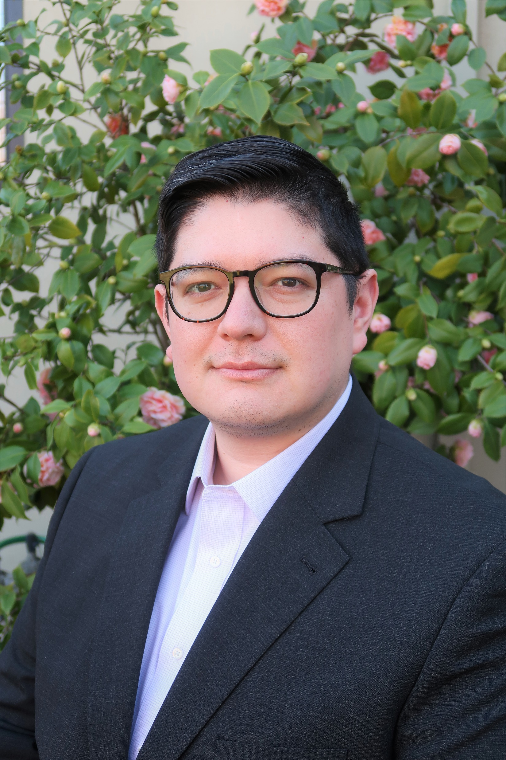
Presenters:
Emily Smith
Education Programs Assistant
Migrant Education Office (MEO)
California Department of Education (CDE)
Alex Leguizamo
Education Programs Consultant (EPC), MEO, CDE
Notes:
Facilitator: Teresa
Say the following:
Today’s presenters are:
Emily Smith. She is an Education Programs Assistant, in the Migrant Education Office. She is the lead for the eMEP system which consists of the grant applications and budget revisions.
And Alex Leguizamo. He is an Education Programs Consultant within the Migrant Education Office and the lead for the MEPEX system.
Joining us from the Los Angeles County Office of Education Technology services division are Brian Yamamoto and Ruby Querubin.
[Click to advance slide]

Slide 4
Meeting Agreements
Please raise your hand or use the chat function to enter your questions
Presentation materials will be posted to Los Angeles County Office of Education Resources website
Notes:
Facilitator: Teresa
Say the following:
Before we get started, we have a few meeting agreements:
If you have any questions, please enter them into the chat box or at certain times during the presentation, we will ask you to use the features in Zoom to raise your hand if you’d like to answer verbally. I will be monitoring the chat for any questions.
If your question is not answered during the meeting today, the MEO will email you directly.
Presentation materials will be posted to the LACOE Resources website. QR code to the website is on slide 98.
Thank you for your time. I will now pass the microphone to my colleague Emily to discuss the budget revision process.

Slide 5
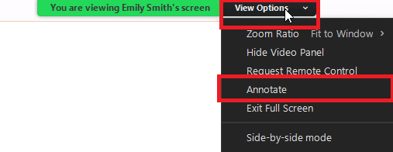
How familiar are you with the MEP budget revision process?
Use the Zoom annotate button to place a stamp near level 1, 2, or 3.
(1) I’m new to the MEP Budget Revision process
(2) I’m somewhat familiar, but I need a refresher
(3) I’m a MEP Budget Revision pro!
Notes:
Facilitator: Emily
Say the following: Before we jump into our training, we’d like to get a sense of your level of familiarity with the Migrant Education Program Budget Revision process.
Using the Zoom Annotate button, please place a stamp somewhere along the continuum from level 1, if you’re brand new to this process, to level 3, if you already have a lot of familiarity.
You can find the “stamp” button by clicking on the “View Options” dropdown button, then clicking on “Annotate”. Once the annotate toolbar appears, click on “Stamp.” Feel free to choose any stamp shape you like, and place your stamp directly inside of the long oval shape. We’ll be using the annotate feature later on in our training, so take a few moments to locate this feature now.
If you have trouble locating the Zoom annotate feature, you can enter a number 1,2, or 3 in the chat.

Slide 6
Budget Process Overview
The eMEP system is comprised of the Grant Applications and Budget Revisions (BR).
The original budget created during the grant application process is used to populate the first BR created by the subgrantee.
Once the BR is approved in the eMEP system, the numbers are populated in the MEPEX system.
Notes:
Facilitator: Emily
Say the following: Before review our agenda for today we’d like to quickly discuss the Budget Process Overview.
The eMEP system is comprised of the Grant Applications and Budget Revisions.
The original budget created during the grant application process is used to populate the first BR (or Budget Revision) created by the subgrantee. The subgrantee will make edits to the original numbers during their first BR creation. Please note, this does not necessarily mean BR 1, but the first BR that is created. For example, if a subgrantee does not complete BR 1, but creates and submits BR 2 (due December 15th), the original budget numbers from the grant application will populate BR 2.
Once the BR is approved in the eMEP system, the numbers are populated in the MEPEX system.

Slide 7
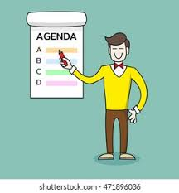
Agenda
System Access
Creating a Budget Revision
Submitting a Budget Revision
Budget Revision Review
Approving a Budget Revision
MEPEX System
Notes:
Facilitator: Emily
Say the following: This webinar’s focus is to provide step-by-step guidance for MEP subgrantees on how to create and review a budget revision, using the BR system.
In today’s webinar we will cover the following:
How to Access the System
How to Create a Budget Revision
How To Submit a Budget Revision
How to Review a Budget Revision
Approving a Budget Revision
And lastly, how the BR system aligns to the MEPEX System

Slide 8
Roles
Reimbursable Districts
Program Coordinators/managers create budget revisions
Fiscal staff review for accounting purposes
Program Coordinators/managers will submit for approval
Regional Coordinators/Managers/Directors review and approve
Region or DFDs
Managers/Coordinators/Directors create budget revisions
Fiscal staff review for accounting purposes
Managers/Coordinators/Directors will submit for approval
CDE staff review and approve
Notes:
Facilitator: Emily
Say the following:
Now let’s go over the BR user roles, which can vary between reimbursable districts, direct funded districts, and regions.
At the District level, program coordinators and managers will create the budget revisions.
The fiscal staff will review for accounting purposes.
The program coordinators and managers will submit to the region for approval.
And the regional coordinators and/or managers will review and approve
At the Region or direct funded district level, the managers, coordinators, and/or directors will create the budget revisions
The fiscal staff will review for accounting purposes
The managers, coordinators, and/or directors will submit to CDE for approval.
And the CDE staff will review and approve

Slide 9
I. System Access
Notes:
Facilitator: Emily
Say the following:
Moving on to the first item in our agenda. How to access the system.

Slide 10
I. System Access (2)
Create an Account
System Access
BR Menu
Notes:
Facilitator: Emily
Say the following:
During the System access review, we will discuss three areas, these areas are:
Create an Account (only pertains to new eMEP users)
System Access (or how to log in)
And the BR Menu

Slide 11
I. System Access (3) A. Create an Account
2023–24.
http://cdemep.lacoe.edu/mep
Notes:
Facilitator: Emily
Say the following:
To access the online Budget Revision System, you will use the same website as the Migrant Education Grant Application System.
The link to access the system is provided to you on this slide.
If you do not have an eMEP account, please ensure you sign up for an account by selecting the “sign up for an account” link as shown by the arrow.

Slide 12
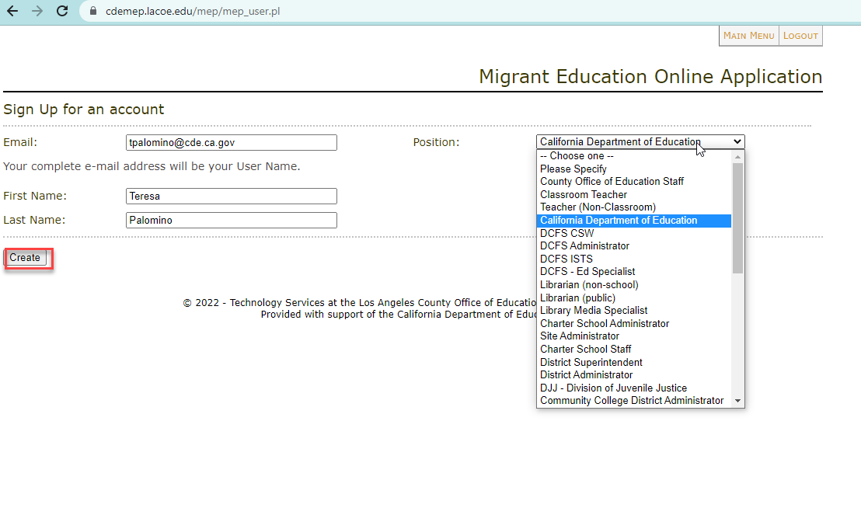
I. System Access (4) A. Create an Account
Notes:
Facilitator: Emily
Say the following:
Once you select the “sign up for an account” link, you will be directed to the screen shown on this slide.
Enter your email address, your first name, last name, and select your position from the dropdown menu. In this example, we see Teresa’s name, email, and she selected CDE as her position. If you select COE staff, teacher or any other position, you will be prompted to include additional information. Once you have entered all the requested information, select the create button to create your user account.
Please note, it usually takes around 24 hours for your account to be activated.

Slide 13
I. System Access (5) B. System Access
2023–24.
Notes:
Facilitator: Emily
Say the following:
Once you have created an account, you will be able to access the eMEP system. To access the system, you will:
Select the “Login” link
And then Enter your email and password.
Select sign in

Slide 14
I. System Access (6) C. BR Menu
District User Menu
Regional User Menu
Notes:
Facilitator: Emily
Say the following:
Once you are logged in, you will be directed to the main menu.
The view of the menu will vary depending on what level user you are in the system.
If you are a District, the sections include: Create Budget Revisions and Read or Edit an Existing Budget Revision.
If you are a Region or Direct Funded District, the sections include: Create Budget Revisions, Read or Edit an Existing Budget Revision, as well as the sections that apply to the review process, which are List Budget Revisions for Review and List Budget Revisions Submitted for Review.

Slide 15
II. Creating a Budget Revision
Notes:
Facilitator: Emily
Say the following:
Moving on to how to create a budget revision. Please note, some of the examples/screenshots provided in this training pertain to previous fiscal years, please ensure you select the appropriate fiscal year when creating your budget revisions.

Slide 16
II. Creating a Budget Revision (2)
Notes:
Facilitator: Emily
Say the following:
To create a Budget Revision, you will start by selecting the Create Budget Revision link. This will take the user to the Create Budget Revision screen.

Slide 17
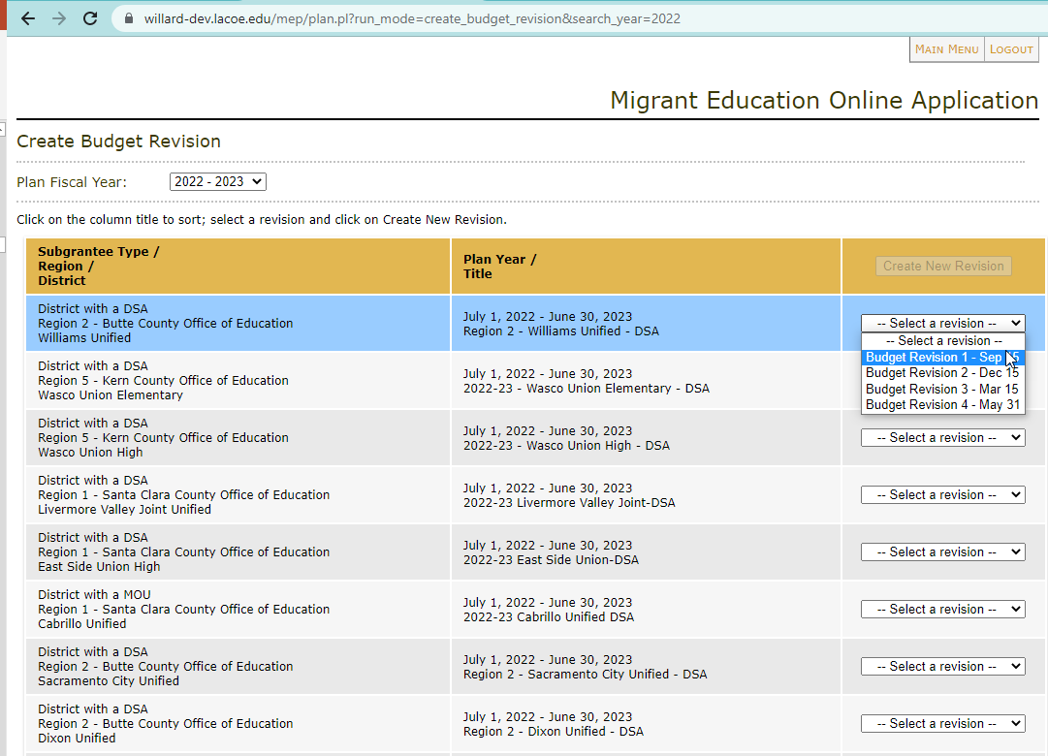
II. Creating a Budget Revision (3)
Create Budget Revision
Notes:
Facilitator: Emily
Say the following:
This is the Create Budget Revision Screen.
Only Grant Applications assigned to the user for the current fiscal year will be listed in the Create Budget Revision screen. In this example, the user has eight plans assigned to them. Please ensure you select the correct plan fiscal year.

Slide 18
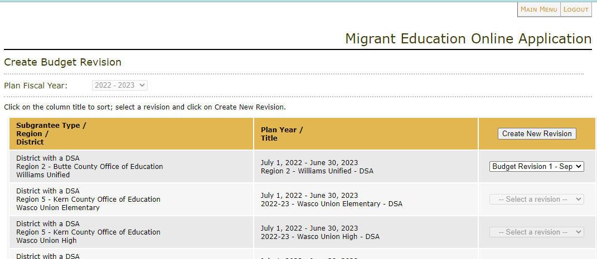
II. Creating a Budget Revision (4)
Create Budget Revision
3
1
2
Notes:
Facilitator: Emily
Say the following:
To start the creation of a Budget Revision, the user will do the following:
Select Plan
Select the appropriate Budget Revision Number and Date. For example, Budget Revision 1-Sep 15.
Click the Create New Revision button

Slide 19
II. Creating a Budget Revision (5)
Create Budget Revision
Notes:
Facilitator: Emily
Say the following:
In this example, Budget Revision 1 dated Sep 15 was selected.
Please Note: The Create New Revision button will become available only when the user selects a revision date from the dropdown list. Once you select the Create New Revision button, you will be directed to the Plan Index Page.

Slide 20
Plan Index Page Components
Plan Index
4
1
2
3
Notes:
Facilitator: Emily
Say the following:
This is what the Plan Index Page for a new Budget Revision looks like. Let’s take a few moments to discuss the components included in the Plan Index.
Item 1 is the Delete Plan button. Only select this button if you wish to delete your newly created BR.
Then we have Item 2, which are the sections that are editable during a Budget Revision. These sections will have their status automatically set to Completed and Read Section. Sections marked as Completed and Read Section, can be altered during a Budget Revision. However, the “Read” only items can not be altered during a BR. As you can see, for this specific subgrantee those sections are sections 1, 2, 4, 14 and the Budget Summary. These sections vary by subgrantees, regions will also have section 3 as “Read” only.
Item 3 is section 15- Budget Revision Attachments. Here subgrantees will upload supporting documentation. Some examples of supporting documentation are: contract agreements, pre-approval emails, and quotes.
And lastly, item 4 is the Manage Users tab. All users assigned to the current year Grant Application will automatically be assigned and have access to the Budget Revision. If users need to be added or removed, this can be done by selecting the Manage Users Tab. We will discuss this tab more in detail during the next slide.

Slide 21
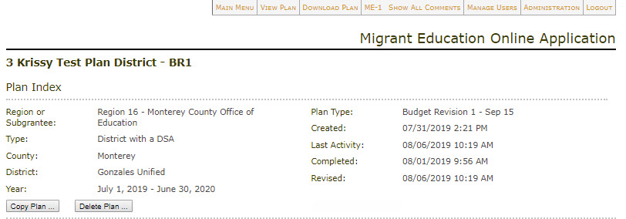
Manage Users Tab
Manage Users
1
2
Notes:
Facilitator: Emily
Say the following:
Manage Users Tab
If users need to be added or removed, the Manage Users tab will be available for the plan’s Approved Submitter.
By selecting the Manage Users tab, the user will be directed to the Manage Users screen, as seen in graphic 2. This screen works in the same manner as in the Grant Application.
Since the authorized submitter for budgets may not be the same as the Grant Application, the user may need to request approval to be added as a submitter.

Slide 22
Check for Understanding
Notes:
Facilitator: Emily
Say the following: It is time to check for understanding.

Slide 23
Check for Understanding (2)
Using the Zoom annotate button, place a stamp in either TRUE or FALSE.
Question 1: true or false, you need to create a new user account to create a BR, even if you already have an account for the eMEP and MEPEX systems?
TRUE
FALSE
Notes:
Facilitator: Emily
Say the following: Using the Zoom annotate button, place a stamp in either TRUE or FALSE
Question 1: True or False: You need to create a new user account to create a BR, even if you already have account for the eMEP and MEPEX systems?
Answer 1: False, you only need to create a new user account if you don’t have access to the eMEP or MEPEX systems. BRs are created in the eMEP system.
To do: Teresa
Add the following to the chat: Zoom annotate: (1) click on “View Options”, (2) click on “Annotate” in the dropdown menu, (3) in the annotate toolbar that appears, click on “Stamp”

Slide 24
Check for Understanding (3)
Using the Zoom annotate button, place a stamp in either TRUE or FALSE.
Question 2: true or false, the first step to creating a BR is to delete the plan?
TRUE
FALSE
Notes:
Facilitator: Emily
Say the following:
Question 2: True or False: The first step to creating a BR is to delete the plan?
Answer 2: False, you only want to select the delete button if you want to delete your newly created BR.

Slide 25
Check for Understanding (4)
Using the Zoom annotate button, place a stamp in either TRUE or FALSE.
Question 3: true or false, all sections are editable during a BR?
TRUE
FALSE
Notes:
Facilitator: Emily
Say the following:
Question 3: True or False: All sections are editable during a BR?
Answer 3: False, only sections 5-13 and 15 are editable. Sections 1-4 and 14 are set as read only.

Slide 26
II. Creating a Budget Revision (6)
Funding Allocations
1
2
Notes:
Facilitator: Emily
Say the following:
Now let’s take a deeper look at some of the sections within the Budget Revision. We’ll start with Section 1, Funding Allocations.
Please note this portion pertains to Regions and DFDs only.
Box 1 will display your original allocation amounts listed in your 2023–24 grant application.
Your final allocations provided by the CDE will automatically be rolled over upon the first created BR as you see in box 2. The LACOE TSD programmers update this information with the final numbers received from CDE.

Slide 27
II. Creating a Budget Revision (7)
Plan Index
Notes:
Facilitator: Emily
Say the following:
To start making edits to your services, the first step is to click the Read Section next to the section you wish you edit.
If the Service/Activities sections are selected, which are sections 5 through 9, the user will be directed to the program’s Service/Activity List as shown in the next slide.
If sections 10 through 13 are selected, the user will be directed into the program service tabs.
It is important to remember that this system was created to make modifications to your budgets. If you don’t have any changes to your budgets, you will not be able to submit a budget revision to your region. If you are a reimbursable district, or if you are a DFD or region, you won’t be able to submit to CDE. Budget revisions should only be created if you plan to make a change to your budget.

Slide 28
II. Creating a Budget Revision (8)
Service/Allowable Activity List
2
1
Notes:
Facilitator: Emily
Say the following:
Let’s take a deeper look at Section 5: Regular School Year services & activities. Once Section 5 has been selected, the user will be directed to the Service/Activity list page as seen in this slide.
To start editing the section, the user will need to:
Change the status from “Completed” to “Draft” in the dropdown menu.
And then select the “Update Status” button
This will change the appearance of the screen as seen in the next slide.

Slide 29
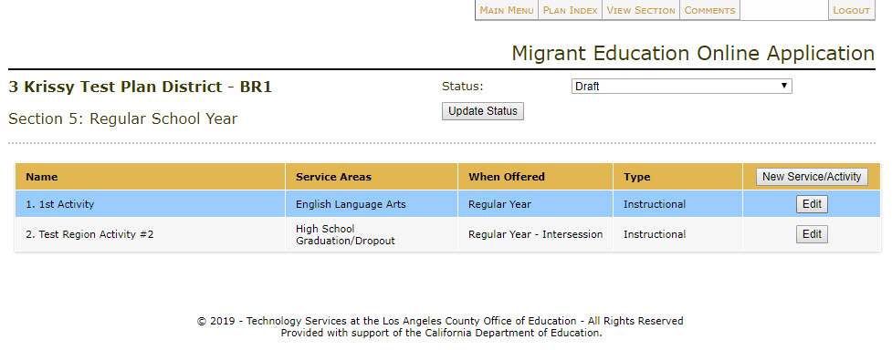
II. Creating a Budget Revision (9)
Service/Allowable Activity List
Notes:
Facilitator: Emily
Say the following:
Now that the status has changed to Draft.
Select the Edit button for the service or activity you wish to modify.
Doing this will take the user inside the individual Service or Activity.
If you want to create a new Service or Activity, you will select the “New Service/Activity button” instead of the “Edit” button. By selecting the “New Service/Activity button”, you will be directed inside the service/activity. You must then complete all the tabs including the budget tab to create a new service or activity.
However, for this example we will be selecting an existing service. In this example, we will be working on a budget revision in the Service/Activity labeled “1st Activity”.

Slide 30
II. Creating a Budget Revision (10)
Service Activity
Notes:
Facilitator: Emily
Say the following:
Once you select the “edit” button as discussed in the previous slide, you will be directed to the actual service or activity as demonstrated on this slide.
Please note:
All service or activity tabs are open during the Budget Revision.
Any changes to the budget that affect the information located within the other tabs in that Service or Activity will also need to be updated. An example would be changing the budget because you are hiring additional teachers. The change in budget for teacher increase would require the user to support this budget change in the migrant student served, staff, activity time, and possibly the service/allowable activity description and plan tabs. Please make sure that all tabs for one service are aligned.
NOTE: The user should only select any of the Save buttons if actual changes have been made to the activity.
Clicking any of the SAVE buttons will flag the section in red to indicate the section as having a budget revision within the service or activity and will require the service or activity to be reviewed even if no changes have been made.
Also: Only add a NEW service or activity if the user is confident that the Service or Activity will be executed. If you create a Service or Activity and then delete it, the section will still be flagged in red as having a revision.

Slide 31
II. Creating a Budget Revision (11)
Budget Tab
1
2
Notes:
Facilitator: Emily
Say the following:
Budget Revision Entries in the Budget Tab:
Within an activity or service, the Budget Tab will originally display all existing budget entries in the Service or Activity Budget Detail as shown in this slide.
At the bottom of the Service or Activity Budget Detail Table, the user will see the:
New Total: this will show the new total after budget revision entries have been made, and it will be displayed in green text.
Previous Total: this will show the total of the most recent approved budget, and it will be displayed in black text.

Slide 32
II. Creating a Budget Revision (12)
Budget Tab
2
3
1
Notes:
Facilitator: Emily
Say the following:
To add a Budget Revision entry into the Service or Activity Budget Detail, the user will:
Click the Add Item button.
Enter the Object Code, Description & Itemization of Costs, and the Amount to be adjusted (+/-).
Click the Add Budget Item.
The Add Budget Item button acts as a Save Button within the Service or Activity for the budget item only, and will flag the section in red which will require the Service or Activity to be reviewed.

Slide 33
II. Creating a Budget Revision (13)
Budget Tab
Notes:
Facilitator: Emily
Say the following:
The new budget entry will now appear in red underneath its appropriate object code.
The New Total will reflect any changes in the Budget Table and will be in green text. Under the New Total, the user will find the Previous Total of the most recent approved budget.
The Service or Activity is now flagged red in the table, indicating that there has been a budget revision in this Service or Activity, as pointed out by the bottom arrow.
Please note: In order to keep an audit record, services originally created will not be able to be deleted. If you are planning to cancel a service, please make a note in the service or activity description tab, and zero out all the budget items in the budget section.
An example of the budget section of a canceled service will be provided toward the end of the webinar.

Slide 34
Questions?
34
Notes:
Facilitator: Teresa
Say the following:
Time for questions. Please enter your questions in the chat box or feel free to unmute yourself.

Slide 35
II. Creating a Budget Revision (14)
Budget Tab
Notes:
Facilitator: Emily
Say the following:
Here is a Budget Revision Entry Example:
In this example:
Object Code 2900 has been reduced by $10,000. (select enter to activate PPT animation)
Object Code 3700 has also been reduced by $3,700. (select enter to activate PPT animation)
Object Code 3200 has been increased by $500. (select enter to activate PPT animation)
The net adjusted change for this service/activity was -$13,200.
Subsequently, the total amounts at the bottom of the Service or Activity Budget Detail Table should reflect these adjustments:
The new total for this service is now $21,600 (as displayed in green text). (select enter to activate PPT animation)
The previous total for this service was $34,800. (select enter to activate PPT animation)
This confirms the net difference of -$13,200.
It is important that you only decrease object codes with budget line items. In this example, the subgrantee only had budgets in object codes 1100, 2900, and 3700, therefore, we should not see a decrease in other object codes such as 1300, 4300, 5800, etc.
It is also important to note, that you should not decrease the object code by more than what it was previously budgeted. For example, on this slide, object code 1100 only has a budget of $11,100, we should not see a reduction of $12,000 in object code 1100 as this can cause an issue when entering your expenditure reports.

Slide 36
II. Creating a Budget Revision (15)
Staff Tab
Notes:
Facilitator: Emily
Say the following:
As mentioned before, any object codes that have been adjusted in the Budget Tab and relate to other tabs within the Service or Activity also require adjustments in the appropriate tabs.
In this example, we made changes for staff salary reduction in the Budget Tab, and this requires an adjustment in the Staff Tab to support this change.
In the budget, we described a reduction of an assistant counselor which required the classified staff to be reduced by 1.
To complete this task, the user will click the Edit Button for the appropriate Staff item.

Slide 37
II. Creating a Budget Revision (16)
Staff Tab
Notes:
Facilitator: Emily
Say the following:
By clicking the Edit button, the field will open for adjustments in the staff item and allow the user to reflect the budget changes in the staff table.
Once finished, click the Update Staff button.
Please Note: The ‘Update Staff’ button acts as a Save Button within the Service or Activity for the staff item only and will flag the section in red and require the Service or Activity to be reviewed. Please select Update Staff only if the changes are needed.

Slide 38
II. Creating a Budget Revision (17)
Staff Tab
Notes:
Facilitator: Emily
Say the following:
Changes made in any table will display in red font once Updated or Saved.
Once all changes have been made, the user will click on Save and Return to Activity List to get back to the sections’ Service/Activity List.

Slide 39
II. Creating a Budget Revision (18)
Save Buttons
Notes:
Facilitator: Emily
Say the following:
Please remember to either:
Select the Save and Continue Editing button, if you want to save any changes you have made and want to continue in that area or,
Select Save and Return to Activities List, if you want to save your changes and want to go back to the Activity List.
Just a friendly reminder. The user should only select any of the Save buttons if actual changes have been made to the activity.

Slide 40
II. Creating a Budget Revision (19)
Service Activity List
Notes:
Facilitator: Emily
Say the following:
Once back in the Service/Activity List and if there are no further changes to be made in the Service or Activity, the user must update the Status back to Completed in order to submit the Budget Revision for Review.
The user will continue the process we’ve just covered for ALL sections that require a budget revision. Please remember that the PAC and I&R budgets are located in section 13. If you need to make any staff changes to I&R and/or PAC, you will do so in Section 10 for I&R and Section 11 for PAC. Then, you will update the budget for I&R and/or PAC in section 13.
Lastly, the user will then click the Plan Index tab located in the top menu in order to return to the Plan Index.

Slide 41
II. Creating a Budget Revision (20)
Section 15: Attachments
Notes:
Facilitator: Emily
Say the following:
Once the user is inside the Plan Index, the user will see that section 5: Regular School Year has changed to a red font to indicate that budget revisions have been made within that section.
Now let’s talk about Section 15, - Budget Revision Attachments
To access this section, the user will select the Read Section link to be directed to Section 15.

Slide 42
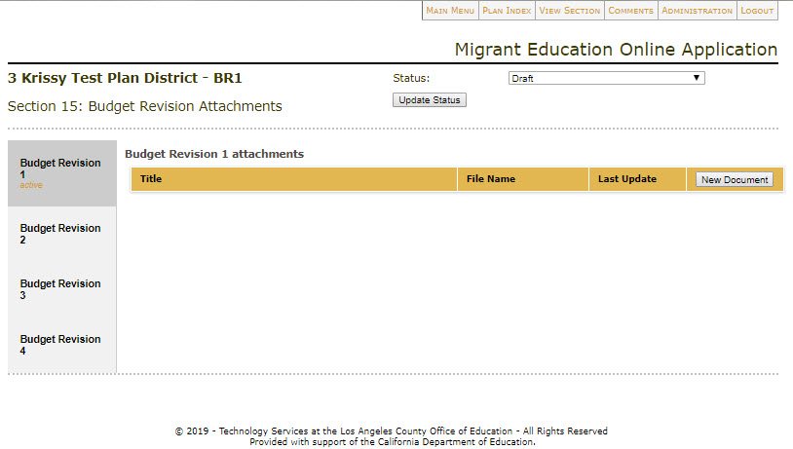
II. Creating a Budget Revision (21)
Section 15: Attachments
Notes:
Facilitator: Emily
Say the following:
Once the user is directed to the section, the section status will need to be updated from Completed to Draft, which will allow you to upload documents.

Slide 43
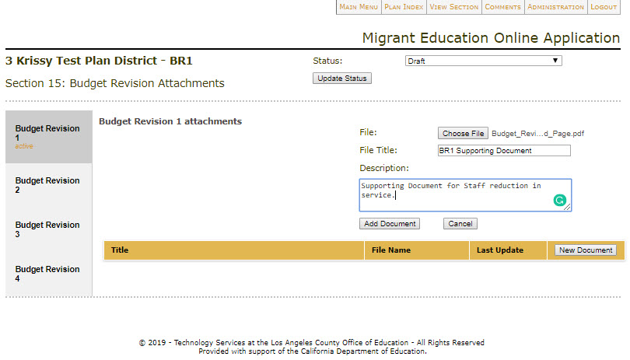
II. Creating a Budget Revision (22)
Section 15: Attachments
1
2
1
2
3
Notes:
Facilitator: Emily
Say the following:
Once the section is set to Draft, the tab for the specific BR number will open and will be set to Active (as displayed in arrow 1).
Within this tab, the user will select the New Document button (as displayed in arrow 2).
This will open the field as shown in graphic 2 and allow the user to:
Attach any document in a PDF format.
Include a File Title.
And provide a description. For example, Supportive document for staff reduction in service.
User must select the Add Document button (as seen in arrow 3) to upload document(s).

Slide 44
II. Creating a Budget Revision (23)
Section 15: Attachments
Notes:
Facilitator: Emily
Say the following:
Once the document has been uploaded into Section 15, the file will be found in the Budget Revision number Attachment Table (as shown in this slide).
Please ensure you upload all corresponding pre-approval emails to ensure the we save any supporting documentation within the system.

Slide 45
II. Creating a Budget Revision (24)
Section 15: Attachments
Notes:
Facilitator: Emily
Say the following:
Finally, once all supporting documents have been attached, the user will need to update the status from Draft to Completed.
The user will then click the Plan Index tab to return to the Budget Revision Index.

Slide 46
II. Creating a Budget Revision (25)
Plan Index
Notes:
Facilitator: Emily
Say the following:
Once back in the Plan Index, the user can see that each section that contains a budget revision is flagged in red for easy identification.
At this time, the users should check the Budget Summary and ME-1 prior to submitting the Budget Revision, to ensure all the numbers align.
To access the Budget Summary, the user will select the Read Only link on the Budget Summary section at the bottom of the list. Please remember this section is not editable.
To access the ME-1, the user will click the ME-1 button located in the top menu (as indicated by the red text box).

Slide 47
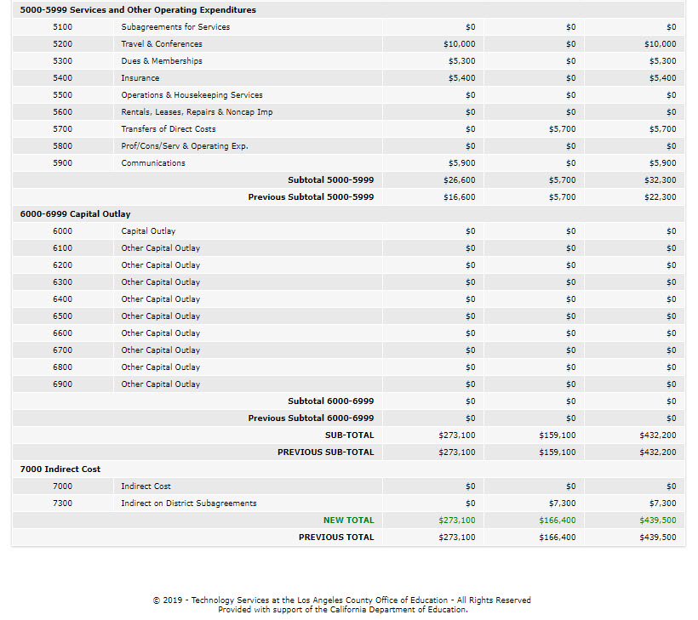
II. Creating a Budget Revision (26)
Budget Summary
2
1
Notes:
Facilitator: Emily
Say the following:
Let’s look at the budget summary first. The Budget Summary will only show the budget totals by Object Code for Direct Service and Admin, and the total budget for that specific object for the current Budget Revision, as you can see in graphic one.
The user will be able to view the Previous Total and New Total at the bottom of the Budget Summary. The New Total is displayed in green text. The Previous Total is displayed below the New Total in black text.

Slide 48
II. Creating a Budget Revision (27)
ME-1
Notes:
Facilitator: Emily
Say the following:
Now let’s look at the ME-1 Excel Download.
By clicking the ME-1 tab, the system will provide a download that is like the ME-1 in the Grant Application. The difference is that the ME-1 downloaded from a Budget Revision will have the Budget Revision and Amendments automatically entered and calculated.
The District Summary Budget tab of the excel workbook will now show the Budget Revision tabs populated, in addition to the Grant Applications Approved Budget. Each Program Component tab displays the changes we have made in this budget revision.

Slide 49
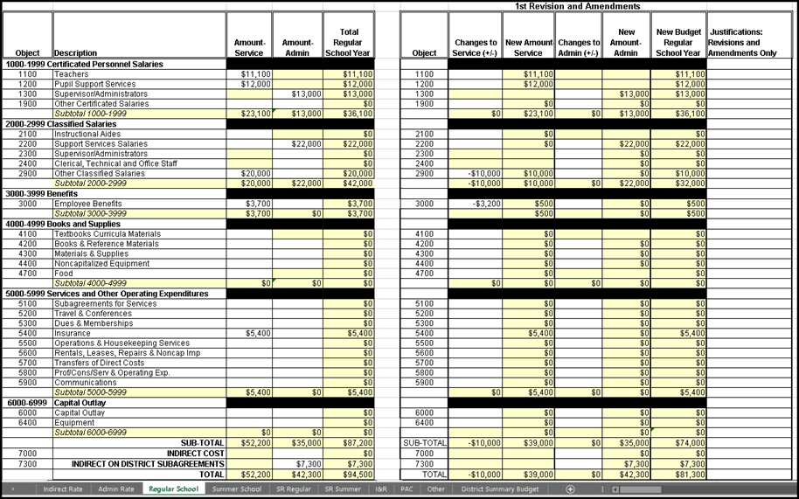
II. Creating a Budget Revision (28)
ME-1
-
-
-
-
Notes:
Facilitator: Emily
Say the following:
The ME-1 contains program component sheets. In every sheet, the Budget Revision columns are populated as well as the Changes to Service columns.
When reviewing your ME-1, you want to ensure that each object code total under the “New Budget Column” does not include a negative number. In this example, you will see that for object code 5400, the subgrantee reduced this code in regular school year by $5,400. This created a negative balance because the subgrantee reduced this code without having a budget. When revising your budget sections for each of your service, you want to ensure that you reduced object codes with existing budgets and not exceed the existing budget for each object code. As mentioned before, creating negative balances could cause issues when you submit your expenditure reports.

Slide 50
Check for Understanding (5)
Notes:
Facilitator: Emily
Say the following: It is time to check for understanding again.

Slide 51
Check for Understanding (6)
Using the Zoom annotate button, place a stamp in either TRUE or FALSE.
Question 1: true or false, only the budget tabs need to be modified during a BR?
TRUE
FALSE
Notes:
Facilitator: Emily
Say the following: Using the Zoom annotate button, place a stamp in either TRUE or FALSE
Question 1: True or False: Only the budget tabs need to be modified during a BR?
Answer 1: False, make sure the tabs that have been affected by your budget revision are also updated. For example, staff tab if you are adding or reducing teachers.
To do: Teresa
Add the following to the chat: Zoom annotate: (1) click on “View Options”, (2) click on “Annotate” in the dropdown menu, (3) in the annotate toolbar that appears, click on “Stamp”

Slide 52
Check for Understanding (7)
Using the Zoom annotate button, place a stamp in either TRUE or FALSE.
Question 2: true or false, you must make changes to the service budget if you would like to make changes to a service description?
TRUE
FALSE
Notes:
Facilitator: Emily
Question 2: true or false, you must make changes to the service budget if you would also like to make changes to a service description?
Answer 2: True, the system will not allow you to submit a BR if there are no changes to the budget sections.

Slide 53
II. Creating a Budget Revision (29)
Plan Index
Notes:
Facilitator: Emily
Say the following:
Now that you have ensured that all your numbers are aligned in the budget summary and ME-1, it is time to submit your plan for review.
Going back to the Plan Index page. The Submit Plan for Review button will only display if the user has saved a change in the Budget Revision and every section’s status has been set to Completed. If these actions have been completed, the “Submit Plan for Review” button will appear in the Plan Index page, and you will be able to submit your plan.

Slide 54
III. Submitting a Budget Revision
Notes:
Facilitator: Emily
Say the following:
Let’s discuss how to submit a budget revision.

Slide 55
III. Submitting a Budget Revision (2)
Plan Index
Notes:
Facilitator: Emily
Say the following:
Once the user has reviewed all Budget Revision Entries and made the necessary changes, the Budget Revision Plan is ready to submit. Only the authorized submitter will have access to select the Submit Plan for Review button.
The Region Review Administrator will receive emails for District/MOU districts’ Budget Revisions that have been submitted for review.
The CDE Review Administrator will also receive an email advising that a Region or DFD’s Budget Revision has been submitted for review.

Slide 56
III. Submitting a Budget Revision (3)
Email Notification
Notes:
Facilitator: Emily
Say the following:
After the Submit Plan button has been selected, two system emails will go out:
The first email is to the submitter of the Budget Revision confirming that the plan has been submitted for review. An example of the email is provided to you on this slide.

Slide 57
III. Submitting a Budget Revision (4)
Email Notification
Notes:
Facilitator: Emily
Say the following:
The second email is sent to the Region Administrator(s) advising them a District Budget Revision has been submitted for review. An example of the email is provided to you on this slide.
If you are a Region or DFD, an email will go to CDE Administrator, Emily Smith, who will assign it to the pertinent CDE consultant.

Slide 58
IV. Budget Revision Review
Notes:
Facilitator: Emily
Say the following:
For those in attendance who review submitted Budget Revisions, we will now discuss how to review a budget revision.
Please note, the next few slides only pertain to regional and CDE staff, since they will be reviewing the DSAs, MOUs, DFDs and Region Budget revisions.

Slide 59
IV. Budget Revision Review (2)
Menu
Notes:
Facilitator: Emily
Say the following:
Once the Regional Administrator receives the email notification, they will log in to the system and go to the Regional Administration Menu.
The first step is to select List Budget Revisions Submitted for Review (please see red text box). This is where the Regional Administrator assigns Reviewers for the DSA/MOU Subgrantees’ Budget Revisions. At the CDE level, the CDE Administrator will assign Budget revisions to the corresponding CDE reviewers.

Slide 60
IV. Budget Revision Review (3)
Budget Revision List
Notes:
Facilitator: Emily
Say the following:
Assigning Budget Revision Plan Reviewers:
The Regional Administrator will be directed to the Review Administrator’s Budget Revision List, as seen on this slide.
In this list, the Regional Administrator can filter the plans within their region by the following:
Subgrantee Type
Review Status
Reviewer (this is the reviewer assigned to a plan). This filter is only valid if a reviewer has been assigned to a plan.
Plan Fiscal Year (this is always set to the current fiscal year)
Once the criteria is identified, the administrator will click the List Budget Revisions for Review button.
Once the administrator identifies the specific plan they wish to assign to the Reviewer and Plan Approver, they will select the Manage Reviewers Button.
Again, please Note: The default Plan Fiscal Year will always default to the most current fiscal year.

Slide 61
IV. Budget Revision Review (4)
Budget Revision List
Notes:
Facilitator: Emily
Say the following:
By selecting the Manage Reviewers button, the system will open an area for the region administrator to assign Reviewers and a Plan Approver for the district budget revision.
Once all reviewers and the approver are assigned, the Region Administrator will select the Update Reviewers button. This Budget Revision Plan now has Reviewers and an Approver assigned. The Budget Revision is ready for review.
To return to the main menu, the user will click the Main Menu tab at the top of the screen.

Slide 62
IV. Budget Revision Review (5)
Email Notification
Notes:
Facilitator: Emily
Say the following:
Once the Administrator has assigned the reviewers and an approver to the Budget Revision Plan, the Reviewers and Regional Administrator will receive an email confirming that they have been assigned to a plan (an example of the email is provided to you on this slide).

Slide 63
Check for Understanding (8)
Notes:
Facilitator: Emily
Say the following: It is time to check for understanding.

Slide 64
Check for Understanding (9)
Using the Zoom annotate button, place a stamp in either TRUE or FALSE.
Question 1: true or false, budget revisions are automatically assigned to a reviewer once they are submitted?
TRUE
FALSE
Notes:
Facilitator: Emily
Say the following: Using the Zoom annotate button, place a stamp in either TRUE or FALSE
Question 1: True or False: budget revisions are automatically assigned to a reviewer once they are submitted?
Answer 1: False, the Region’s system administrator will have to assigned the BR to the Region’s reviewers and approver once the reimbursable district submits their BR.
To do: Teresa
Add the following to the chat: Zoom annotate: (1) click on “View Options”, (2) click on “Annotate” in the dropdown menu, (3) in the annotate toolbar that appears, click on “Stamp”

Slide 65
Check for Understanding (10)
Using the Zoom annotate button, place a stamp in either TRUE or FALSE.
Question 2: true or false, reimbursable districts cannot approve their own budget revisions?
TRUE
FALSE
Notes:
Facilitator: Emily
Question 2: True or False: true or false, reimbursable districts cannot approve their own budget revisions?
Answer 2: True, the region must review and approve all its reimbursable districts’ budget revisions.

Slide 66
IV. Budget Revision Review (6)
Menu
Notes:
Facilitator: Emily
Say the following:
Once the reviewers are assigned by the system administrator. The assigned Reviewer will sign into the system to access the submitted and assigned Budget Revisions Plans.
To do this, the reviewer will select the List Budget Revisions for Review link, under the Regional Reviewer Menu, (as displayed in the red text box).

Slide 67
IV. Budget Revision Review (7)
Budget Revision List
Notes:
Facilitator: Emily
Say the following:
The reviewer will be directed to the Reviewer’s Budget Revision List, as seen on this slide.
Please Note: The list will only display Budget Revision plans assigned to you.
To start a Budget Revision Review, the reviewer needs to select the specific plan they wish to review. To do this, double click on the plan you wish to review.

Slide 68
IV. Budget Revision Review (8)
Plan Index
Notes:
Facilitator: Emily
Say the following:
The reviewer will be directed to the Reviewer’s Plan Index:
The Reviewer will see that all sections that require their review are identified by the following:
The section will be flagged in a red text.
The section’s review status will be marked as Not Reviewed or In Progress.
Please Note: Any section that did not have Budget Revisions edits will be in a black text and marked as approved.
To start the review, the reviewer will click the Review link for the section they wish to review as shown by the arrow on the right.

Slide 69
IV. Budget Revision Review (9)
Rubric
Notes:
Facilitator: Emily
Say the following:
As an example, we will select Section 5: Regular School Year to Review.
The rubrics used in the Budget Revision Review process are identical to the rubrics used in the Grant Application.

Slide 70
IV. Budget Revision Review (10)
Service Activity List
Notes:
Facilitator: Emily
Say the following:
Section 5: Regular School Year Review:
After clicking the Section 5 review button, the reviewer will be directed to the Service/Allowable Activity List.
The reviewer will notice that ONLY the sections that have budget revisions will have a Review Status of Not Reviewed. The Service/Allowable Activity will also be flagged in red to indicate that the service needs review.
All Services/Allowable Activities with no budget revision edits will remain in black text and its Review Status will be marked as Approved.
To start the review of the red flagged Service/Allowable Activity, the reviewer will select the Not Reviewed link (as identified by the red text box).

Slide 71
IV. Budget Revision Review (11)
Service Activity
Notes:
Facilitator: Emily
Say the following:
Section 5: Regular School Year Review (Continued):
Upon going into the Service/Activity, the Reviewer will provide a score in the Budget tab; however, the reviewer should review all tabs to make sure they support and are aligned with the changes in the budget tab.
All new budget items are identified in red. Specifically, the Object Code, Description & Itemization of Costs, and the Amount.
At the bottom of the Service/Activity Budget Detail Table:
The New Total is displayed in green text.
The Previous Total is displayed below the New Total in black text.
The Budget Revision Reviewer will only need to score the Budget tab within the Service/Activity, since all other tabs are combined within the budget tab rubric. Therefore, if the district made a change to the service/allowable activity description tab, and it does not meet the reviewers needs, the budget tab section should be scored as limited. The reviewer should indicate where they want the additional clarification/change. For example: the reviewer's comment would state the following: 8/26/2023: Please provide more detail of the changes that are being made to this service in the service/allowable description tab.

Slide 72
IV. Budget Revision Review (12)
Service Activity
Notes:
Facilitator: Emily
Say the following:
Section 5: Regular School Year Review (Continued):
Once the rubric within the Service/Activity has been scored as comprehensive, the specific Service/Activity review status will update to Approved in the Service/Activity List (as identified by the bottom red text box).
Please Note: If any rubric is marked Limited or Incomplete, the review status for the Service/Activity will update to Not Approved.
To return to the Review Index, the Budget Revision Reviewer will click the Review Index tab at the top of the page.

Slide 73
IV. Budget Revision Review (13)
Plan Index
Notes:
Facilitator: Emily
Say the following:
Section 5: Regular School Year Review (Continued):
In the Plan Index, Section 5: Regular School Year now has an Approved Status (as identified by the arrow).
The Budget Revision Reviewer will continue this review process for All the editable sections (5-11 & 13) that have been modified.

Slide 74
IV. Budget Revision Review (14)
Section 15: Attachments
Notes:
Facilitator: Emily
Say the following:
The last section to review is Section 15: Budget Revision Attachments (as identified by the arrow).

Slide 75
IV. Budget Revision Review (15)
Section 15: Attachments
Notes:
Facilitator: Emily
Say the following:
Section 15: Budget Revision Attachments Review.
Section 15: Budget Revision Attachments section is where all supporting documents will be uploaded by the subgrantee and downloadable by the Budget Revision Reviewer to review.
The Budget Revision Reviewer will update this rubric accordingly.

Slide 76
IV. Budget Revision Review (16)
Plan Index
Notes:
Facilitator: Emily
Say the following:
Once all sections have been marked to Approved, the assigned Budget Revision Approver will see the Approve Plan button in the Plan Index Section.

Slide 77
Questions? (2)
77
Notes:
Facilitator: Teresa
To do:
Time for questions. Again, please enter your questions in the chat box or feel free to unmute yourself.

Slide 78
V. Approving a Budget Revision
Notes:
Facilitator: Emily
Say the following:
Moving on to how to approve a budget revision. Like the grant applications, only regional and CDE staff will be approving a budget revision.

Slide 79
V. Approving a Budget Revision (2)
Plan Index
Notes:
Facilitator: Emily
Say the following:
Approving a budget revision is a two-step process.
The First Approval:
The First Budget Revision Approval is done within the eMEP Budget Revision System.
The assigned Approver will click the Approve Plan button located in the plan index page. This will complete the Budget Revision process in the eMEP Budget Revision System.
An email will be sent to the plan submitter advising them that plan has been approved or disapproved (see examples in the next slides).

Slide 80
V. Approving a Budget Revision (3)
Email Notification
Notes:
Facilitator: Emily
Say the following:
Once the Region Approver completes the first approval, the systems sends an automatic Approval email to the plan users.
Please Note: Once the Budget Revision Plan is Approved by the assigned Approver, the subgrantee can create the subsequent Budget Revision in the eMEP Budget Revision System.

Slide 81
V. Approving a Budget Revision (4)
Email Notification
Notes:
Facilitator: Emily
Say the following:
If the Region disapproves the Budget Revision, the systems sends an automatic email to confirm with users that the plan has been disapproved. The approval in the eMEP is the first approval. To complete the approval process, the user must also approve the BR in the MEPEX system. I will now pass the mic to my colleague Alex, to talk to you about how to the MEPEX system is aligned to the BR system.

Slide 82
VI. MEPEX
Notes:
Facilitator: Alex
Say the following: Thanks Emily. Moving on to the MEPEX system.

Slide 83
MEPEX Diagram for District to Region
VI. MEPEX (2)
Notes:
Facilitator: Alex
Say the following:
If you recall. We indicated earlier that the budget revision approval process was a two-step process. The first approval happens in the eMEP system, and the second in the MEPEX system. Let us discuss the overview budget revision approval process for reimbursable districts in the eMEP.
The reimbursable districts create a budget revision plan in eMEP.
The Budget Revision Entries and Adjustments are entered in the eMEP.
The District Director/Coordinator Submits the Budget Revision to the Region Office.
The Region Assigns Reviewers to the District’s budget revision. The Region either approves the changes or disapproves the changes.
If the region approves the changes, the Region approver will approve the plan in the eMEP system. This will be the first step of the two-step approval process.
Now let us discuss how the first approval in the eMEP impacts the MEPEX system.
The first approval in eMEP System Automatically Submits Budget Entries into MEPEX. The MEPEX System Displays Budget Revisions Automatically in the Summary By Object and Summary by Program Screens.
The MEPEX Displays the Budget Revision Submission as District Submitted and the Budget Revision is in Region Pending mode.
To complete the second approval in MEPEX, the Region must select the approve button in MEPEX (we will describe this process in the next slides).
Once the second approval is completed in the MEPEX Budget Revision tab under the Submit/Review/Approve Screen, the MEPEX Expenditure Screens are updated according to the Budget Revision Number.
The Budget Revision is Approved in the MEPEX System. As before, the MEPEX System will generate automatic Approval Emails.
Note, the region and direct funded districts would follow this same process, however, the steps for the region would be substituted by the CDE staff. Also, upon the CDE selecting the Approval button, the Business Rules will automatically run.
The Business Rules include:
Checking that District Budget Revisions have been Finalized or Approved. We will discuss when and how to finalize a BR in MEPEX in the upcoming slides.
Checking that previous Quarterly Expenditure Report has been Approved.
Please Note: This business rules run automatically, there is no effort required from user.
Once the Business Rules are cleared, the Budget Revision is approved in MEPEX and the MEPEX Expenditure Screens are updated according to the Budget Revision Number.

Slide 84
MEPEX Budget Revision Submission Screen
VI. MEPEX (3)
Notes:
Facilitator: Alex
Say the following:
As we stated before, once the Budget Revision has been approved in the eMEP System, the Budget Revision entries will automatically populate in the MEPEX – Revision screens. The Districts do not have to manually enter any Budget Revisions into the MEPEX System or submit anything in the MEPEX System.
The numbers will populate in the appropriate summary screens, and the status will change to Region Pending as pointed out by the purple arrow. In the sample above, the District is waiting for the Region Budget Approver to complete the second approval.
The Approval History box displays an entry with a date and time log, of when the Budget Revision numbers came from the eMEP System. As seen on the first red box.
The purple area, is the area for the Region Approver to complete the second approval. The Region Approver will select the Accept button (red text box) to complete the second level approval.
Please Note: The Region Approver in the MEPEX System is assigned using the Account Form as in previous years.

Slide 85
MEPEX Summaries Updated
VI. MEPEX (4)
Notes:
Facilitator: Alex
Say the following:
This is an example of the summary screens before the budget is approved.
The second approval in the MEPEX System also serves as a final fiscal check before the expenditure screens are updated. Reminder: The Revision Summary by Object and Revision Summary By Program displays the numbers at a program level and service/admin level.
Please note: the total allocated budget should match to the application and the grant award notification.
Also, districts should have all the funds provided to them, allocated.

Slide 86
Submit/Review/Approve Budget Revision
VI. MEPEX (5)
Notes:
Facilitator: Alex
Say the following:
Once the Region has completed the second approval, the Submit/Review/Approve screen under the Budget Revision tab will be updated. The screen displays a workflow history of the Submission from the eMEP System and the approval from the Region.
There is also a label at the top right-hand corner that updates to: Region Approved and the Approval History log is updated with the Date, Name of the Region Approver, and Approval Action.

Slide 87
MEPEX Budget Revision Complete
VI. MEPEX (6)
MEPEX System Email Notification
Notes:
Facilitator: Alex
Say the following:
Once the Budget Revision submission is approved, the system generates a confirmation email (email sample shown here).
This completes the Budget Revision approval process.

Slide 88
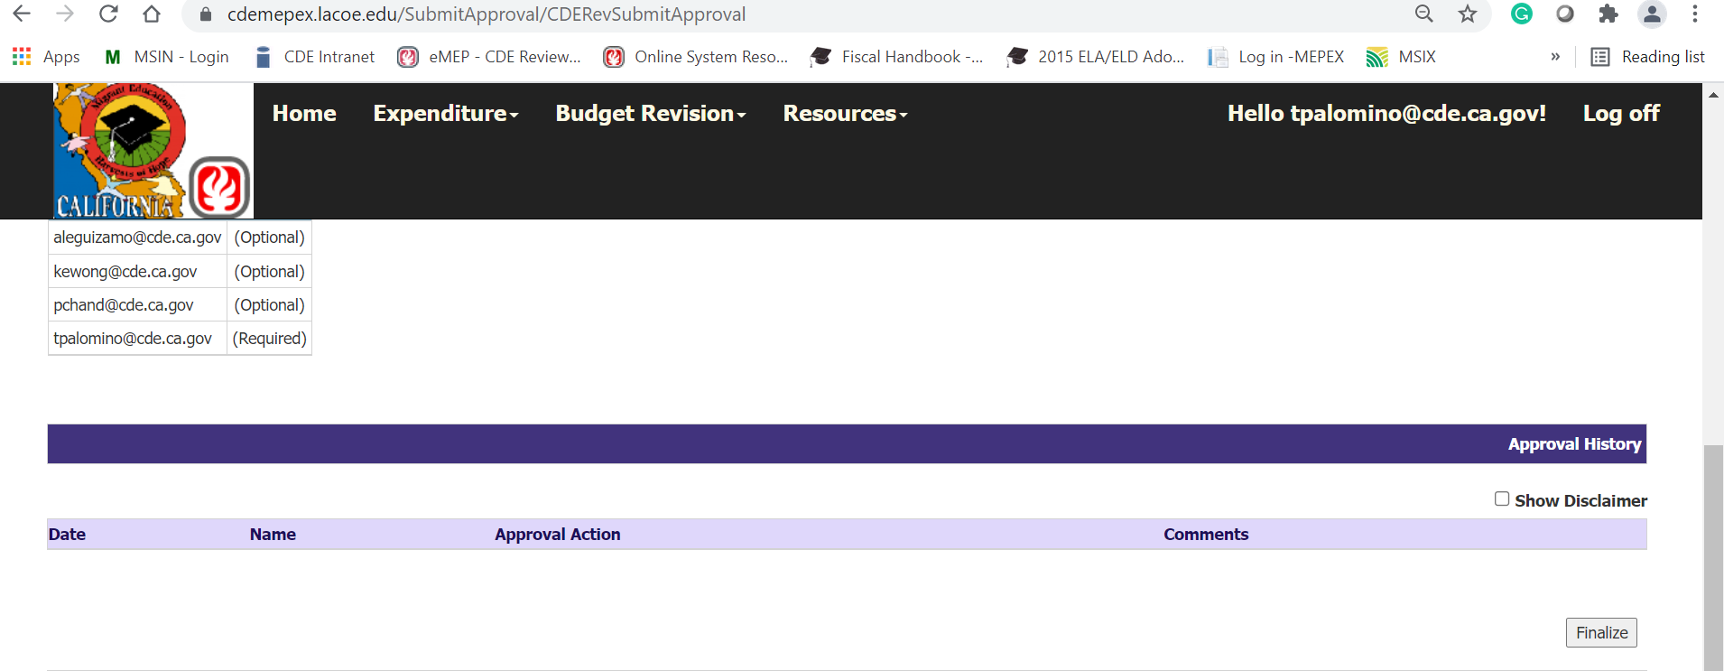
MEPEX Budget Revision Finalize Screen
VI. MEPEX (7)
Notes:
Facilitator: Alex
Say the following:
If a reimbursable district does not submit a BR. The region must go to MEPEX and select the Budget Revision dropdown tab, then select the Submit/Review/Approve option. Once the Submit/Review/Approve option is selected, the region will be directed to the screen shown on this slide. The Region will select the finalize button, located at the bottom right corner of the page.
If a direct funded district or region does not submit a BR, the CDE must follow the same process.
Please note, when a BR is not submitted, there are no further actions needed besides the steps listed in this slide. However, reimbursable districts should notify their regions, as soon as possible, if they are not planning to submit a BR.
Direct funded districts and regions should also notify CDE if they are not planning to submit a BR.
This will ensure the business rules that are in place clear when the CDE approves the BRs.

Slide 89
MEPEX Expenditure Screens Updated
VI. MEPEX (8)
The dates for the ‘Approved Budget’ rollover into the expenditure side, are as follows:
Submission 1 – Sep. 15 | Revised Budget will first appear in the July Expenditure Screens
Submission 2 – Dec. 15 | Revised Budget will first appear in the October Expenditure Screens
Submission 3 – Mar. 15 | Revised Budget will first appear in the January Expenditure Screens
Submission 4 – May 31 | Revised Budget will first appear in the April Expenditure Screens
Notes:
Facilitator: Alex
Say the following:
The MEPEX Expenditure Screens are updated upon the second approval being complete.
The dates for when the Expenditure Approved Budget columns are updated, based on the budget revisions, are found in this table.
Please note, budgeted expenditures must be approved in the grant application, budget revisions, or through pre-approvals before the funds can be used.

Slide 90
ME-1 REGION LEVEL
VI. MEPEX (9)
Notes:
Facilitator: Alex
Say the following:
The ME-1 Cover Page will show an overview of the net changes for both Region and District Budgets.

Slide 91
Check for Understanding (11)
Almost done…
Notes:
Facilitator: Alex
Say the following: It is time to check for understanding.

Slide 92
Check for Understanding (12)
Using the Zoom annotate button, place a stamp in either TRUE or FALSE.
Question 1: true or false, you must manually enter the budget revisions into the MEPEX system after you enter them in eMEP?
TRUE
FALSE
Notes:
Facilitator: Alex
Say the following: Using the Zoom annotate button, place a stamp in either TRUE or FALSE
Question 1: True or False: You must manually enter budget revisions into the MEPEX system after you enter them in the eMEP?
Answer 1: False, the BR entries will automatically populate in the MEPEX-Revision Screens.
To do: Teresa
Add the following to the chat: Zoom annotate: (1) click on “View Options”, (2) click on “Annotate” in the dropdown menu, (3) in the annotate toolbar that appears, click on “Stamp”

Slide 93
Check for Understanding (13)
Using the Zoom annotate button, place a stamp in either TRUE or FALSE.
Question 2: true or false, to complete the approval of a BR, you must select the finalize button in the MEPEX system?
TRUE
FALSE
Notes:
Facilitator: Alex
Question 2: True or False: To complete the approval of a BR, you must select the finalize button in the MEPEX system?
Answer 2: False, you must select the approval button in the MEPEX system. The finalize button should only be selected if the reimbursable districts, region, and direct funded districts do not submit a BR.
Thank you for participating. I will now pass it back to Emily to finish the presentation.

Slide 94
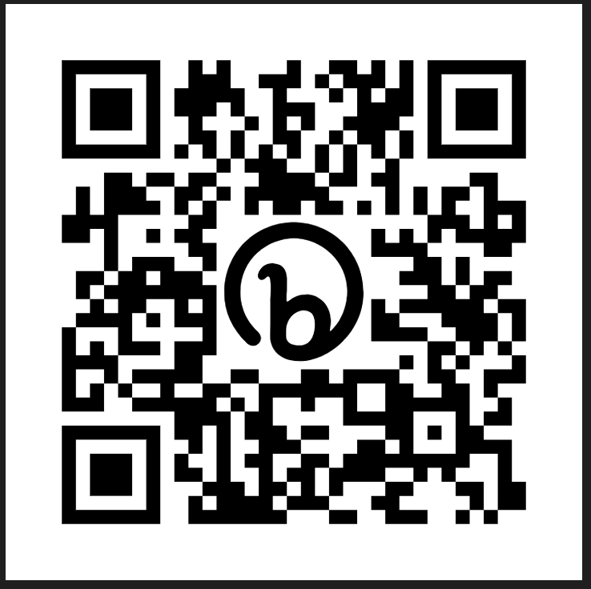
Budget Section of a Canceled Service/Activity
Notes:
Facilitator: Emily
Say the following:
Here is an example of what a budget section looks like for a canceled service or activity. You will see that every line item that was originally added during the application approval was added again during BR1 as a negative amount to cancel out the budget. So, the new total is now zero.
Please make sure you reduce the exact amounts for each object code. For example, in this scenario we had a budget of $1,500 in object code 4700. You must ensure you reduce this exact object code by the same amount to ensure your budget stays in alignment. If instead you reduce the $1,500 from object code 5800, you will end up creating a negative balance for object code 5800, and this can possibly create an issue, when it comes to submitting your expenditure reports.
To see a step-by-step instruction video on how to cancel a service/activity, please watch the YouTube video (QR code is providing on this slide).

Slide 95
When are pre-approvals needed?
Notes:
Facilitator: Emily
Say the following:
When are pre-approvals needed?
Ideally subgrantees should plan their services/activities in advance and their budgets need to be created during the application approval process, or during budget revisions. However, there are situations when a subgrantee cannot wait until a BR. For example, you increase student participation for one of your summer services and you need additional funds for transportation. In this scenario, you can reach out to your consultant and request for a pre-approval.
We try to avoid pre-approvals because it causes more work for you and your consultant. Also, for record and auditing purposes, we prefer all communication to happen within the system.

Slide 96
Most Common Mistakes:
Regions forgetting to either approve or finalize their reimbursable districts’ budget revisions in MEPEX.
Users not being able to create a new budget revision because previous Budget Revisions were kept in 'draft‘ mode.
Regions requesting districts to edit while the plan is still in 'review mode'.
Object codes are being reduced more than their original budget amount causing negative balances.
Notes:
Facilitator: Emily
Say the following:
Some of the most common mistakes we encounter when creating, reviewing, or approving a BR are:
Regions forgetting to either approve or finalize their reimbursable districts’ plans in MEPEX. Please remember that if your district submitted a BR, you must approve in eMEP and MEPEX. If your district did not submit a BR, you must finalize only in MEPEX.
Users not being able to create a new budget revision because previous Budget Revisions were kept in 'draft‘ mode. These drafts are typically never utilized or submitted for approval. Reminder: the system only allows 1 active plan at a time. Please delete any unused plans.
Regions requesting districts to edit while the plan is in 'review mode'. The Region must reject and mark the correct budget areas as 'Not Approved' in order for the district to have edit access. Technology Services cannot open any specific areas - this must be done through the Review Process.
As discussed earlier, it is crucial to be mindful while adjusting your budgets within a specific service. Make sure to only decrease object codes that have an assigned budget and avoid surpassing their original budgeted amounts. For more detailed instructions, please refer to slide 37.

Slide 97
Budget Revision 1
All DFDs and Regions must submit BR 1 and make the necessary changes to properly reflect your 2023–24 services/activities.
Account for your entire 2023–24 grant allocation.
Do not begin the BR until instructed to do so by the CDE.
Submit your BR to the CDE by October 1.
Notes:
Facilitator: Emily
Say the following:
During budget revision one, all DFDs and Regions must submit a BR to CDE. The BR must reflect all the necessary changes to indicate what services or activities you will be providing in fiscal year 2023–24. Please ensure you account for your entire final 2023–24 grant allocation. Please do not begin working on your BR until you are instructed to do so by the CDE. The eMEP system is currently undergoing updates is not ready for you to begin the BR at this time. We will let you know when you can access the system and begin the BR. Please also note that the due date for the BR will be extended to October 1, 2023. For regions with reimbursable districts, your districts’ BR must be approved before the region submits their BR to CDE.

Slide 98
Key Takeaways and Tips
Do not hit the save button unless you have an actual change to the service/activity.
Provide a date next to the change to make the change easier to identify. For example: 8/26/2023 - Program will now be in person instead of a hybrid program. We will need to hire instructional aids.
Use a different color font when making a change. This makes it easier for the reviewer to identify the changes.
Notes:
Facilitator: Emily
To do: Read slide

Slide 99
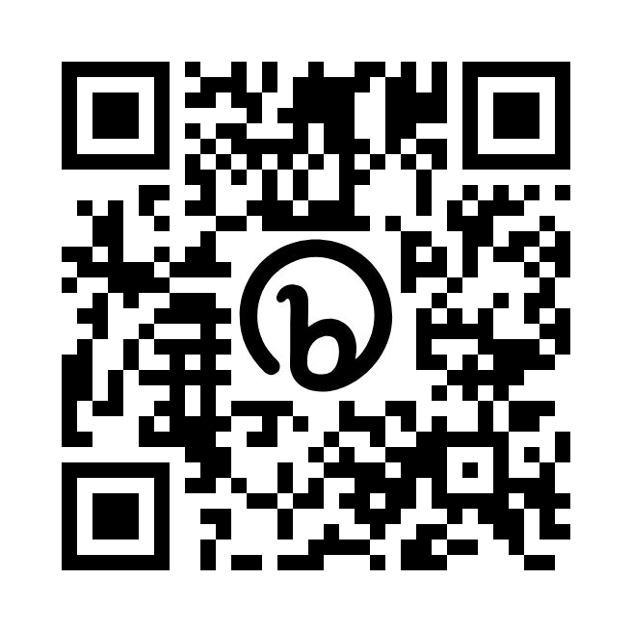
Presentation Materials:
Migrant Ed Program Online Support (lacoe.edu)
Notes:
Facilitator: Emily
Say the following:
This presentation as well as the recording will be posted at the LACOE’s website and will be posted within the next week. The QR code to the website is provided on this slide.

Slide 100
Questions? (3)
100
Notes:
Facilitator: Teresa
To do:
Do you have any more questions? If so, please add your question in the chat box or feel free to unmute.

Slide 101
Contact Information
Emily Smith
Education Programs Assistant
California Department of Education
emsmith@cde.ca.gov
916-319-0227
_____________________________
LACOE Help Desk
HelpDesk@lacoe.edu
562-922-6646
Notes:
Facilitator: Emily
Say the following: If you need to contact the LACOE helpdesk or myself, you can contact us via email or phone, our contact information is listed on this slide.
Please keep in mind that when reaching out to the LACOE helpdesk, it would be helpful to provide as much information as possible regarding the issue you are facing. Additionally, please be aware that the LACOE TSD team cannot reopen BRs once they have been approved, unless authorized by the CDE. If, for any specific reason, you require a BR to be reopened after approval, kindly ensure that the Regional or DFD Director contacts their CDE consultant for further assistance.

Slide 102
Thank you for attending!
102
Notes:
Facilitator: Emily
This webinar has come to an end. We will be back at 10:45 to discuss the expenditure report system. Thank you.

