Slide 1
Migrant Education Program 2025–26 Online Application Training February 26, 2025
Welcome! Please complete the brief Google Form to confirm your attendance (link provided in the chat).

Slide 2
Presenter
Emily Smith, Education Programs Consultant Migrant Education Office

Slide 3
Housekeeping
Microphones have been muted to minimize background noise.
Please use the Q&A Zoom feature for questions. You can upvote questions in the Q&A; we will address questions with the most votes first.
The slides and recording will be posted to the Los Angeles County Office of Education MEP Online Systems website.
3

Slide 4
Learning Objectives
Participants will:
Understand how to navigate the online eMEP system to complete their 2025–26 Migrant Education Program (MEP) application (and review district applications as necessary).
Identify evidence of state Service Delivery Plan (SSDP) strategy implementation in an example service.
Draft a criteria list of high-quality elements in an example service.
Learn how to complete the 2025 Summer Waiver Request Form.
4

Slide 5
Agenda
Application Overview
Getting Started
Adding Users to a Plan
Navigating a Plan
Sections 1-4: Overview Information & Allocations
Sections 5-9: Services & Allowable Activities
Break
Sections 10-14: Identification and Recruitment (I&R), Parent Advisory Councils (PAC), Administration, and Other Information
Summer Waivers
Submitting a Plan
Resources and Support
5

Slide 6
Target
Audience
Regional, Direct-Funded Districts and Reimbursable District Staff
Directors, Fiscal Staff, Program Coordinators, Program/Area Managers

Slide 7
Application Overview

Slide 8
Terminology
RA:
Regional Application
DFD:
Direct Funded District
DSA:
District Service Agreement
MOU:
Memorandum of Understanding (District)
8

Slide 9
Levels of Review
California Department of Education (CDE)
Migrant Education Office
RA
DSAs
MOUs
DFD
9

Slide 10
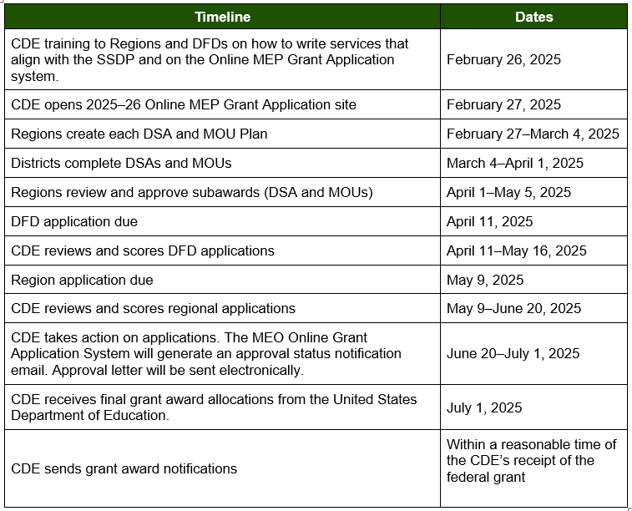
Application Timeline for Regions & DFDs
DSAs/MOUs will be provided an application due date by their Region.

Slide 11
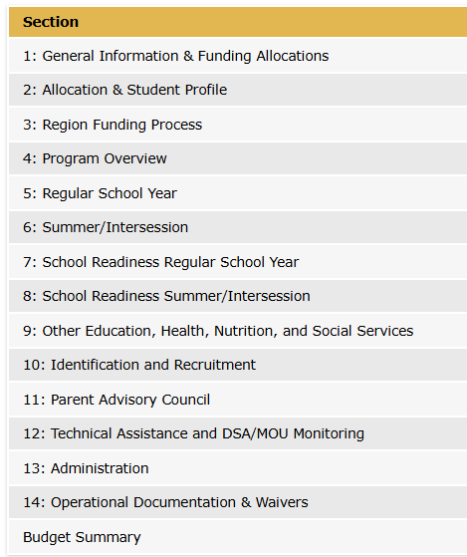
Application Sections

Slide 12
Application Sections for RAs, DFDs, DSAs & MOUs

Slide 13
User Roles
Approver
Region Director (or designee) will approve DSA/MOU plans.
CDE Consultant (for regions) will approve region and DFD plans.
Submitter
DSA/MOU Director (or designee) will submit the application to their region.
Editor
Directors
Program Specialist
Program Coordinators
Assistant Administrator
Fiscal Staff
I&R Coordinators
Data Entry Specialist
Read Only
Commenters
Region staff
Assign this role to anyone that needs access to view the plan without having to make edits or comments
Assign this role to anyone you think will provide helpful comments
Region or DFD Director (or designee) will submit their application to CDE.

Slide 14
Getting Started

Slide 15
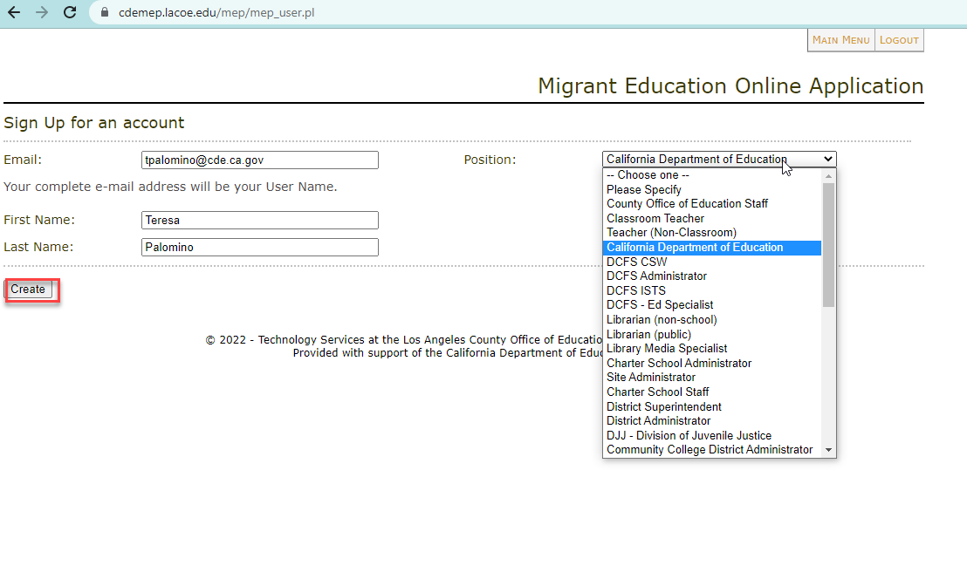
Create Your Account
http://cdemep.lacoe.edu/mep

Slide 16
Logging In
2025–26.
http://cdemep.lacoe.edu/mep

Slide 17
Three Ways to Get Started
Rollover a Plan (for Regions & DFDs)
DFDs and Regions will rollover their own plans.
Regions will rollover their DSA/MOU plans.
Locate a Plan (for DSAs & MOUs)
DSAs and MOUs will locate their plan after the Region has created it or rolled it over (see slide 30).
Create a Plan (for Regions)
Regions may create a plan for new DSAs or MOUs.
17

Slide 18
First Steps for RAs, DFDs and DSA/MOUs
Region
Create or rollover DSA & MOU plans
Input DSA/MOU information in Sections 1 and 2
DFD
Rollover their own DFD plan
*Do not update Section 1: Funding Allocation for DFD Plan
DSA & MOU
Region will notify DSAs/MOUs when their plan has been created
*Do not update Sections
1 & 2 for DSA/MOU Plan (Region will complete)
Rollover their own
RA plan
*Do not update
Section 1: Funding Allocation for RA Plan
Begin editing their
RA plan
Begin editing their
DFD plan
Locate their DSA/MOU plan and begin editing
18

Slide 19
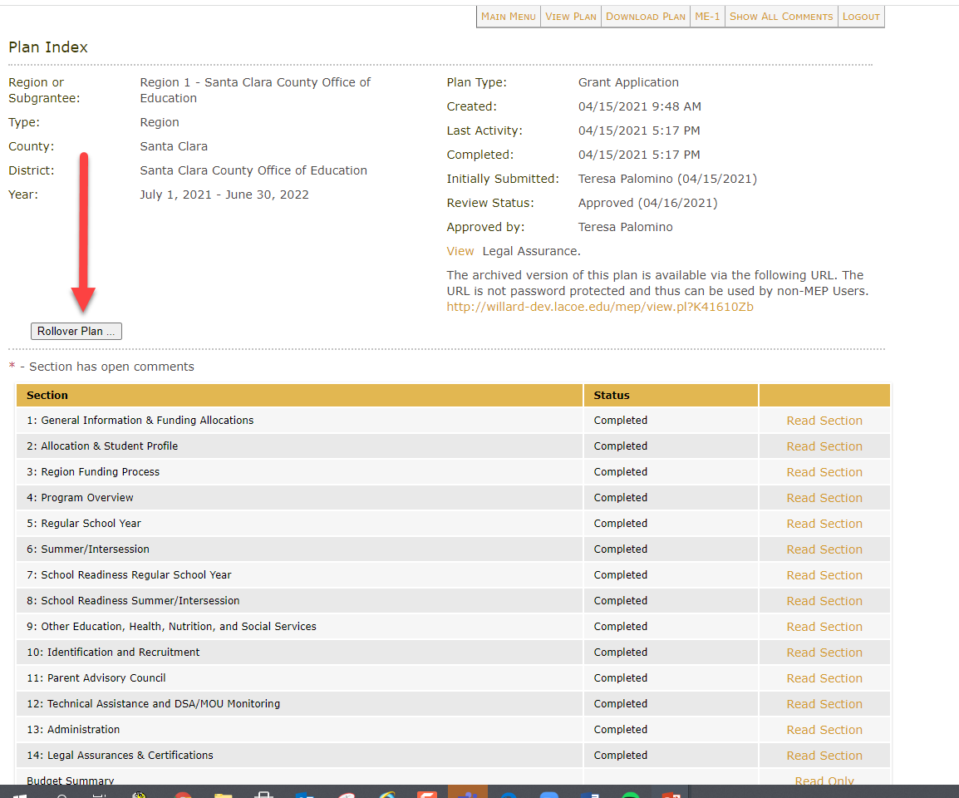
Rollover a Plan
Regions are responsible for rolling over plans for their districts.
Regions and DFDs will rollover their own plans.

Slide 20
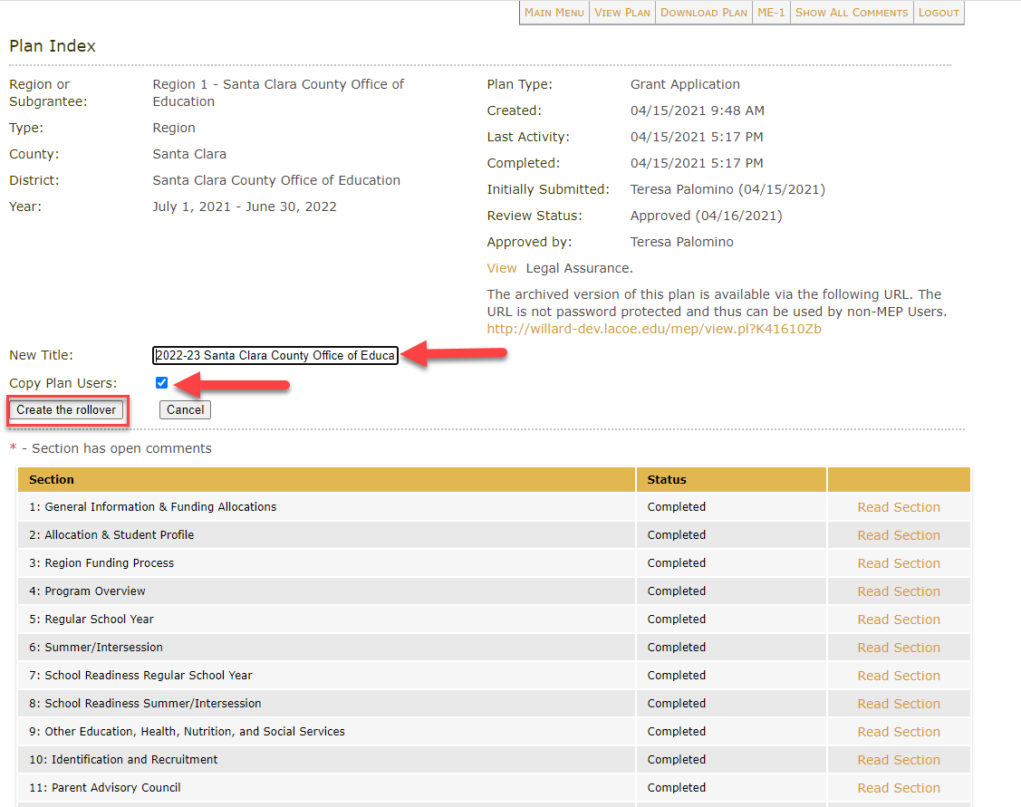
Title a Rollover Plan
Make sure to update the title of the new plan. Use the following naming convention:
“2025–26 District/Region Name”
For example:
“2025–26 Sacramento Unified School District”
2025-26
*Don’t forget to remove the word “copy” from your new plan’s title!

Slide 21
Create a New Plan
Regions will create DSA/MOU plans for new reimbursable districts or districts that did not submit applications during the prior fiscal year.
All other subgrantees will rollover their plan from the prior year.

Slide 22
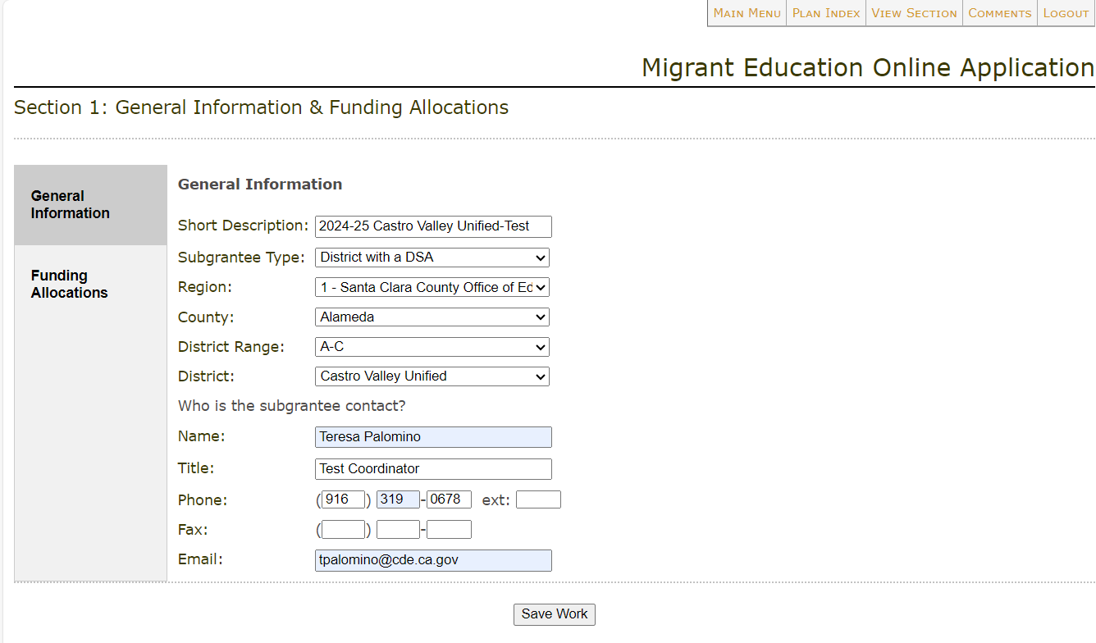
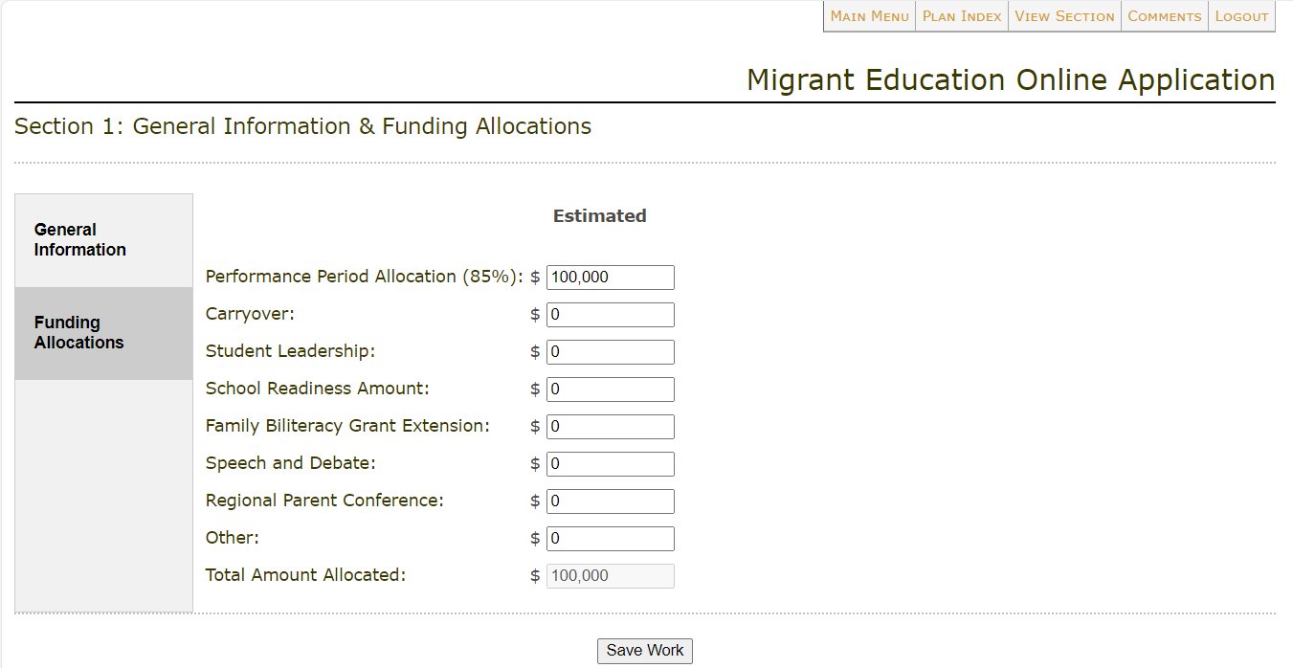
Section 1: General Information & Allocations
After Regions rollover their DSA/MOU plans, they must fill out the information in Section 1 (including the DSA/MOU’s allocation).
Reminder: Regions/DFDs will not be able to edit Section 1: Funding Allocation of their own plans; this information will be pre-populated.
Please see slide 38 for more information on completing Section 1.

Slide 23
Regions Input DSA/MOU Allocation in Section 2
Regions enter DSA/MOU allocation amounts in Section 2.
Student counts are pre-populated based on Migrant Student Information Network (MSIN) reports and cannot be changed.
Please see slide 43 for more information on completing Section 2 for Regions and DFDs.

Slide 24
Locate 2025–26 Plan
After the plan has been created or rolled over and users have been added, select “Read or Edit an Existing Grant Application” to locate the plan for the current fiscal year.

Slide 25
Check for Understanding – Zoom Poll
Learning Objective #1: Participants will understand how to navigate the online eMEP system to complete their 2025–26 MEP application (and review district applications as necessary).
25

Slide 26
Break

Slide 27
Adding Users to a Plan

Slide 28
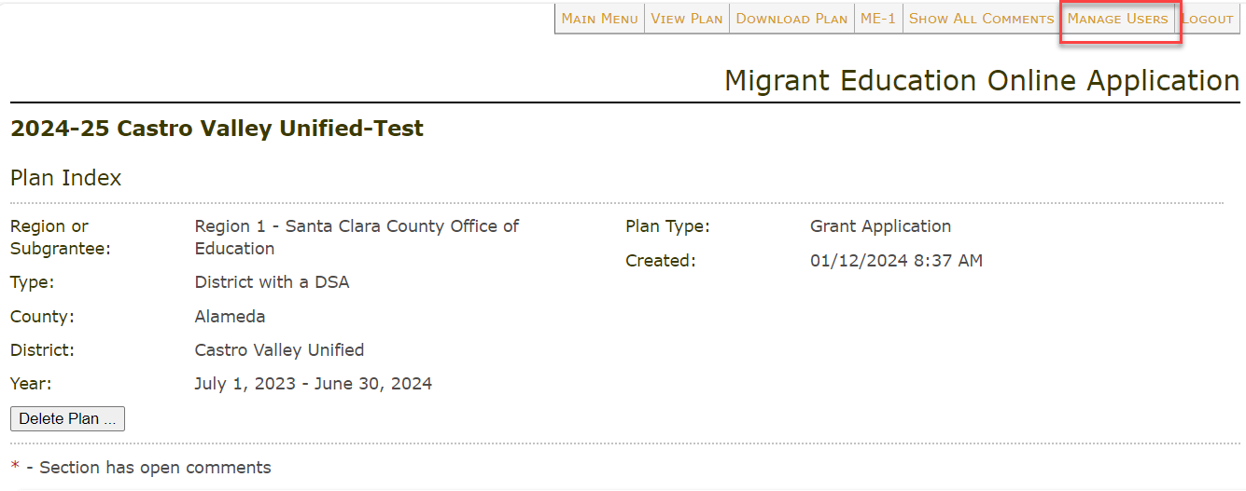
Manage Users Tab
Only users with submitter status will see the “Manage Users” tab.

Slide 29
New Plan User

Slide 30
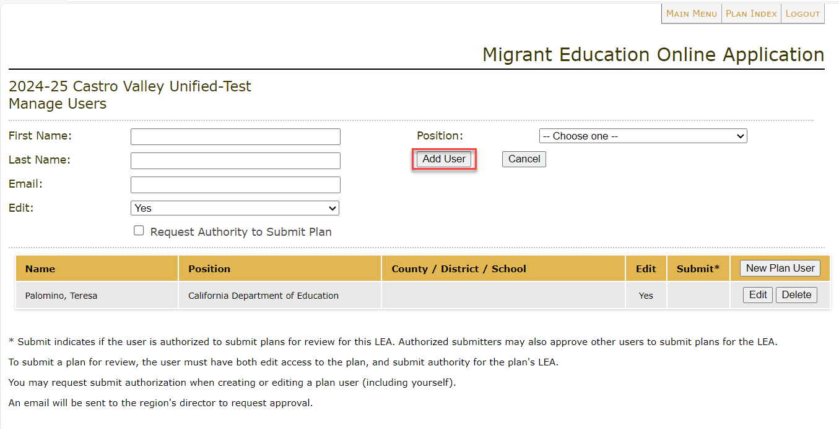
Assigning a User Role
Select the user role: editor, comments only, or read-only.

Slide 31
Assigning a Plan Submitter
Directors can add Submitters to a plan.
Submitters can add other users to a plan.
Submitters can request other users be granted the Submitter role. The Director will receive an automated email for all Submitter requests and must approve all Submitters.

Slide 32
Navigating a Plan

Slide 33
eMEP System Toolbar

Slide 34
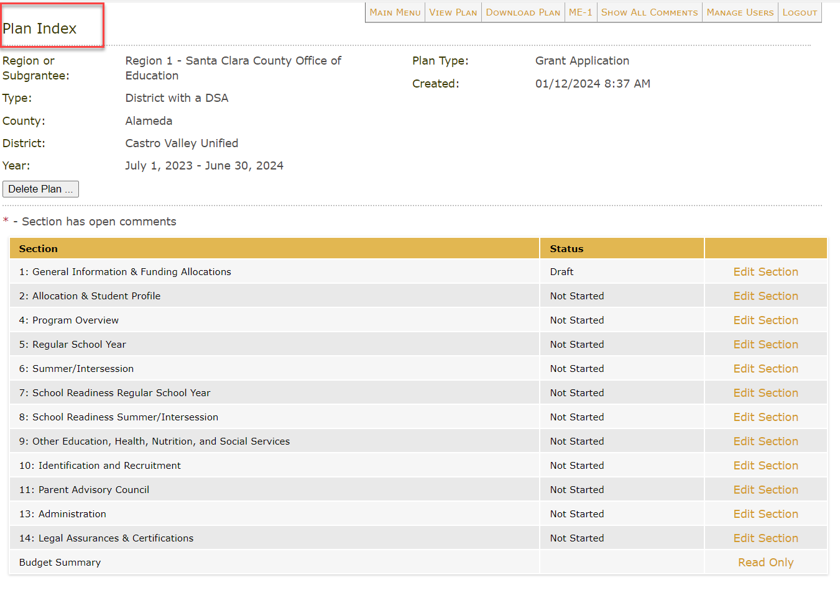
Plan Index Page

Slide 35
Update Status & Save Buttons
Make sure that after entering any information into your plan you click one of the “Save” buttons at the bottom of the page.
After you have finished editing all tabs, change the status from “Draft” to “Completed.”

Slide 36
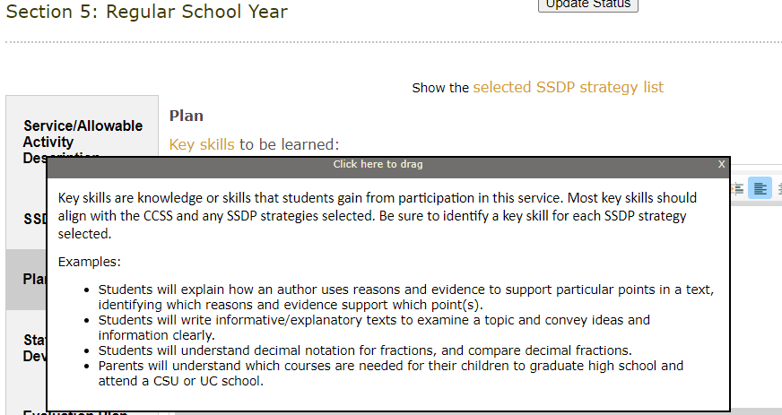
Helpful Tip: Sample Links

Slide 37
Sections 1-4: Overview Information & Allocations

Slide 38
Section 1: General Information
Reminder: Regions complete Section 1 for their DSAs and MOUs.

Slide 39
Subgranting Report
Which districts should be offered migrant funds for a DSA?

Slide 40
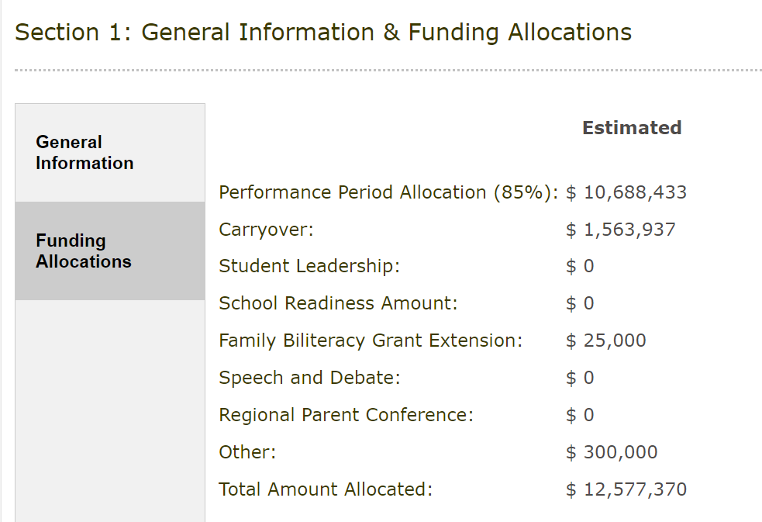
Section 1: Funding Allocations
Reminder: Regions complete Section 1 for their DSAs and MOUs.

Slide 41
Section 1: 2025–26 Allocations
To expedite the opening of the system, we will be using 2024–25 allocation amounts as the estimated allocations populated in Section 1 of the DFD and Region applications.
The final allocation in Section 1 will be updated to the actual allocation during Budget Revision 1.
The total budget in the application must match the estimated allocation amount listed in Section 1 of the application.

Slide 42
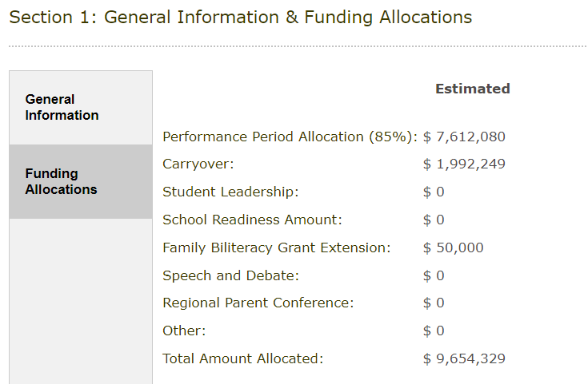
Funding Allocations
The total budget in the application must match the Estimated “Total Amount Allocated” in Section 1. Regions can view their total overall budget (including DSA and MOU budgets) in the ME-1 download.

Slide 43
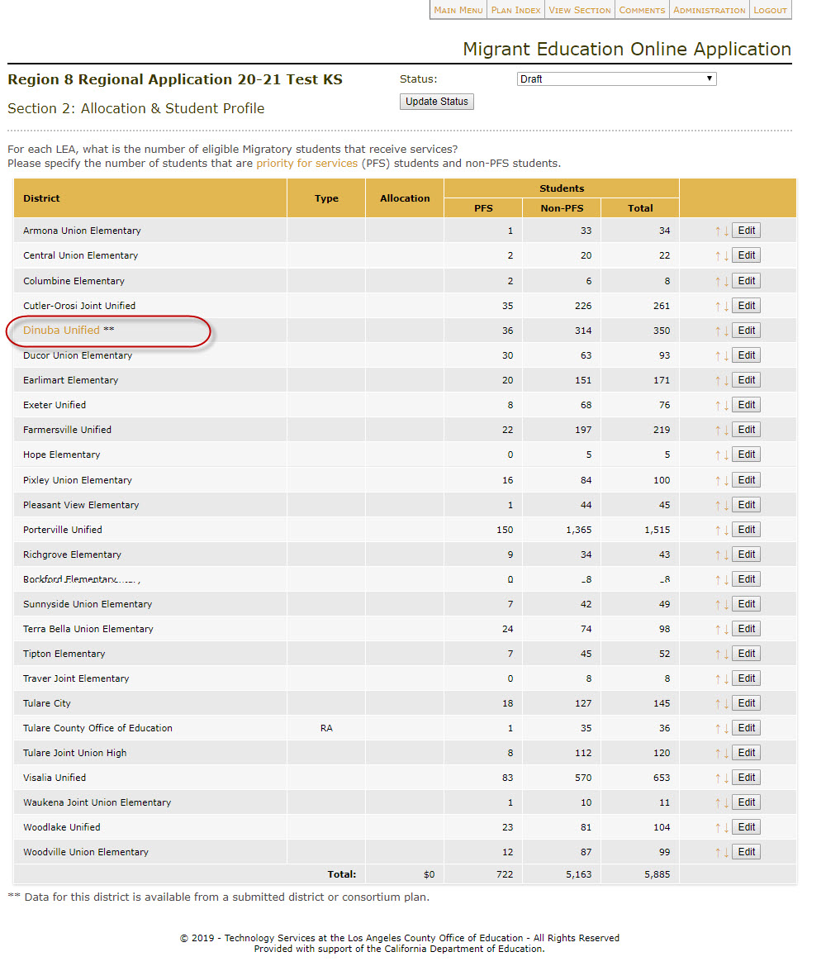
Section 2: Allocation and Student Profile
Updating DSA/MOU allocations for Regions.

Slide 44
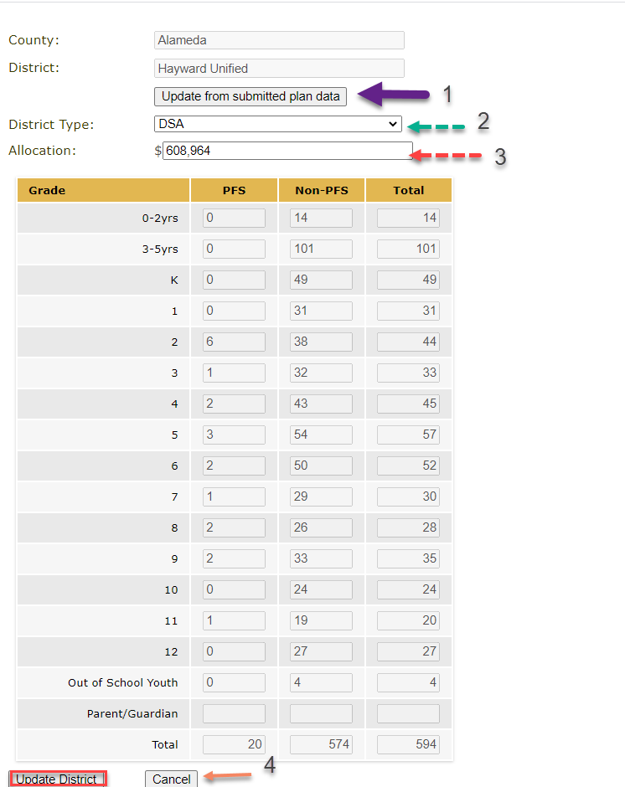
Section 2: Allocation and Student Profile
Updating DSA/MOU allocations for Regions.

Slide 45
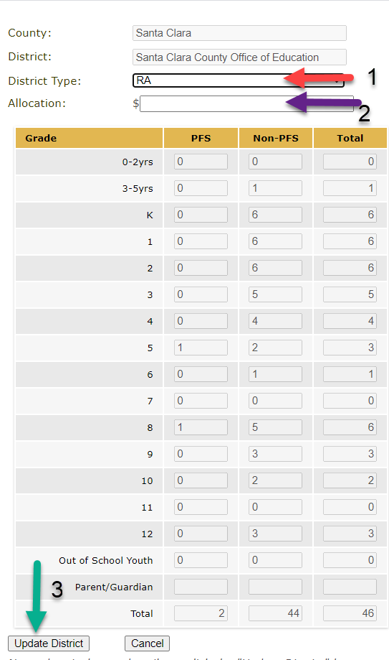
Section 2: Allocation and Student Profile
Updating the County Office of Education (COE) (Region) allocation.

Slide 46
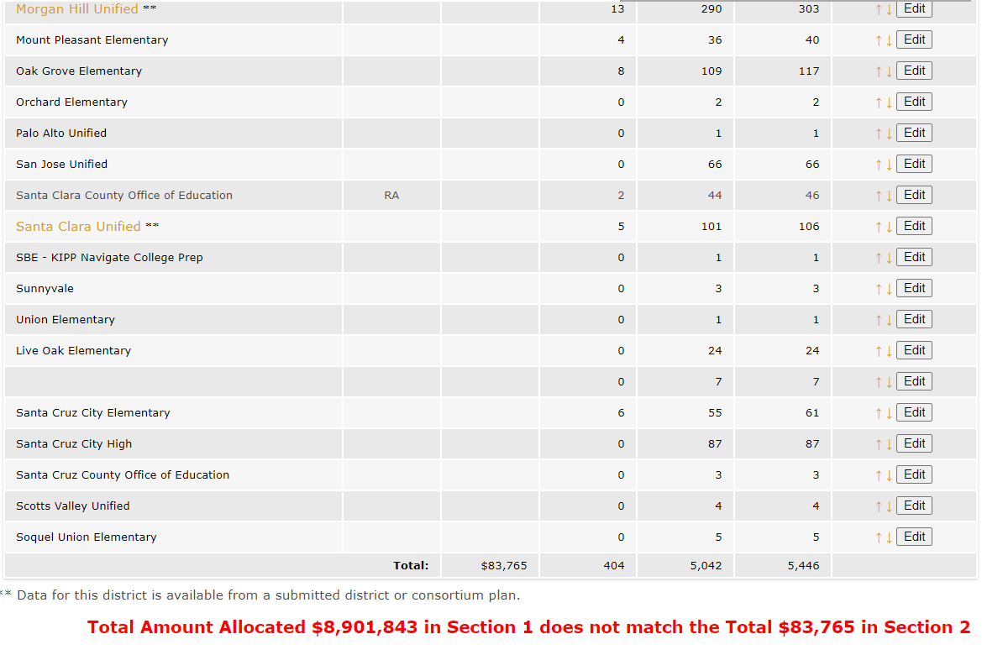
Section 2: Checking for Allocation Errors
Regions should ensure that the total allocations for all reimbursable districts + COE equals the allocation from Section 1.

Slide 47
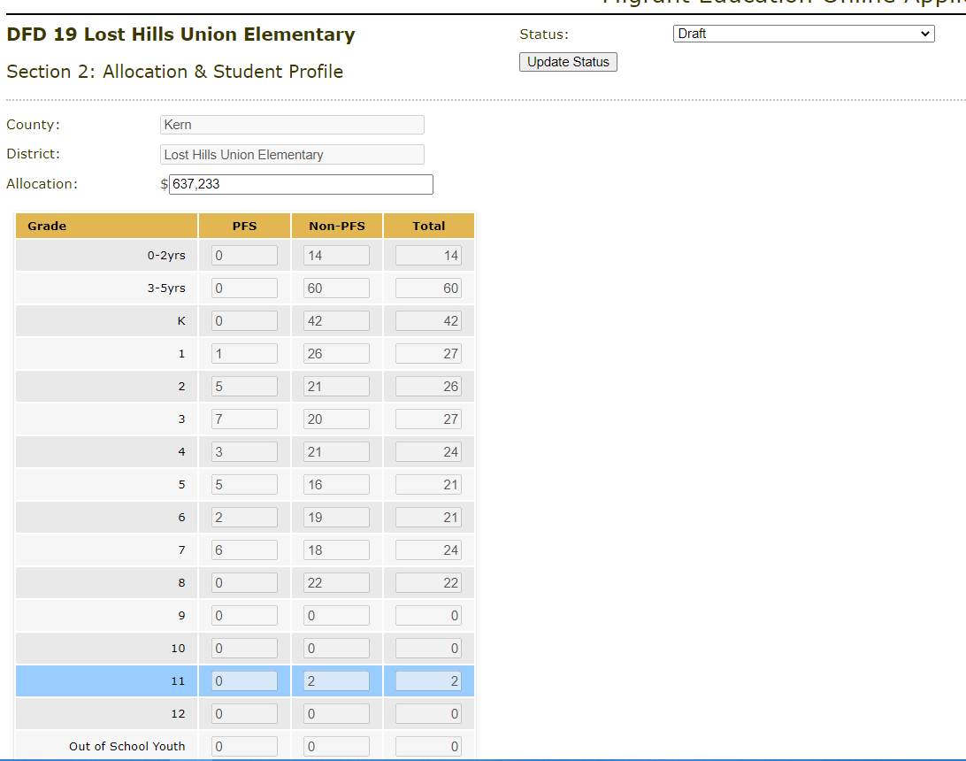
Section 2: Allocation and Student Profile for DFDs

Slide 48
Section 3: Region Funding Process
Reminder: only Regions complete Section 3.

Slide 49
Section 3: Tips for Drafting a High-Quality Funding Process
Describe or list the centralized services and activities that the Region provides with their COE funding amount.
Write out the funding formula utilized to allocate to districts.
Include any additional information necessary to explain how you produced the amounts allocated to each reimbursable district, including any variations from the formula.
A reviewer should be able to follow your processes and produce the allocation amounts for each district that are inputted into Section 2.

Slide 50
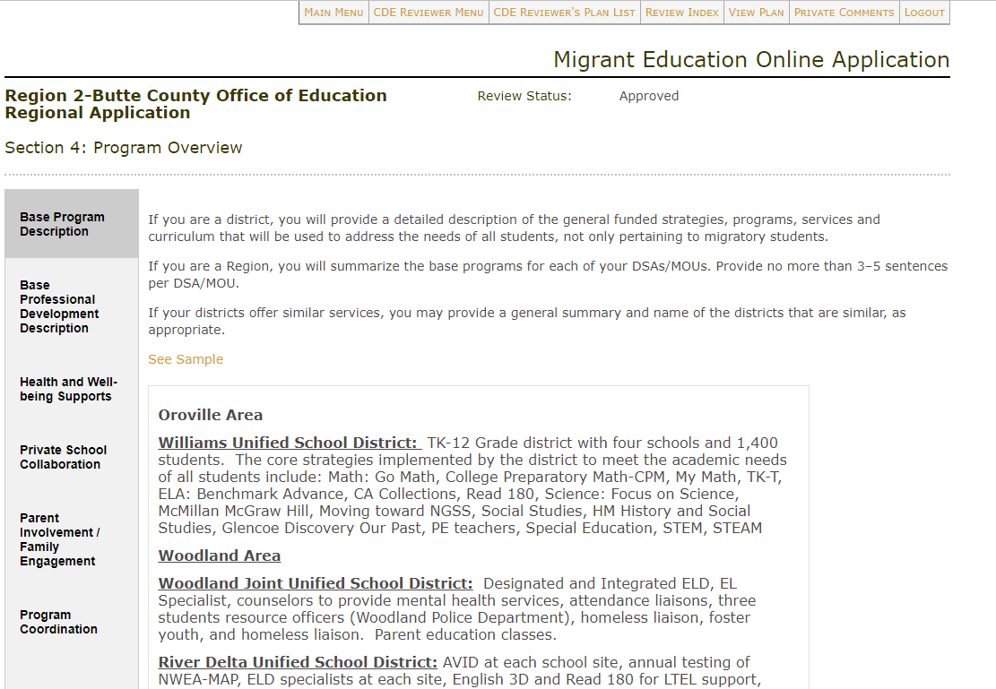
Section 4: Program Overview
Reminder: MOUs do not need to complete Section 4.

Slide 51
Check for Understanding – Zoom Poll (2)
Learning Objective #1: Participants will understand how to navigate the online eMEP system to complete their 2025–26 MEP application (and review district applications as necessary).
51

Slide 52
Questions & Answers

Slide 53
Break

Slide 54
Sections 5-9: Services & Allowable Activities

Slide 55
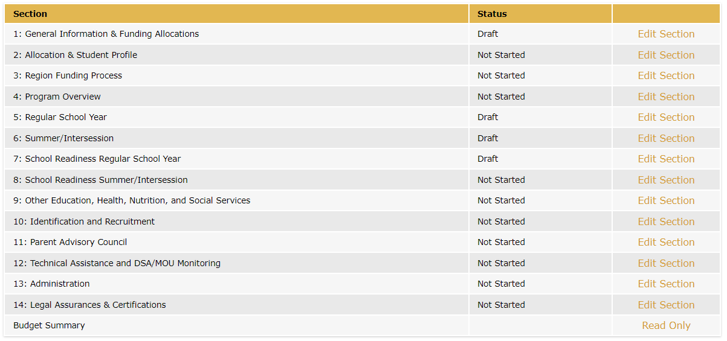
Sections 5-9: Overview
Services and allowable activities are entered into Sections 5-9.

Slide 56
Adding or Editing Services/Activities

Slide 57
MSIN Alignment
Service names in eMEP and MSIN should match or be similar.
eMEP Application:
MSIN:

Slide 58
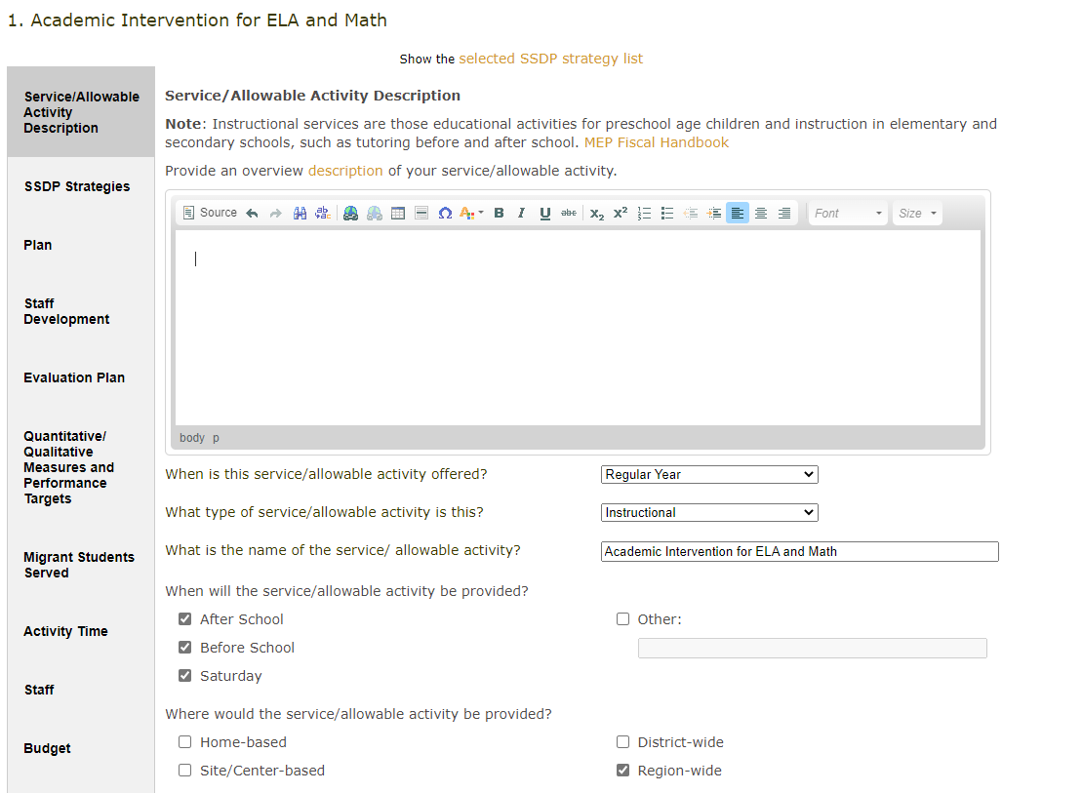
What information is required for each service/activity?
Input information into 10 different tabs for each service or allowable activity.

Slide 59
Before You Begin
All subgrantees should carefully read the SSDP strategies and their measurable performance objectives (MPOs). Be sure to read both the strategy and the MPO, as the MPOs tell you specifically what needs to be implemented at the local level.
Regions and DFDs should also ensure that they have done pre-planning to make sure that their application as a whole will meet all MPOs.
Reimbursable districts are not expected to address all SSDP strategies in their applications and should consult with their Regions regarding the planning for which strategies should be addressed so that the Region meets the SSDP MPOs as a whole. In general, districts should plan to offer services that meet MPOs 1.0 and 2.0.

Slide 60
MPOs
All MPOs should be considered and reviewed as the grant application is being developed.
The MPOs provide additional information on SSDP Strategy implementation as well as identify implementation targets or goals for the local MEPs.
For example, some MPOs identify a percentage of children who need to be served, service duration, staffing, and grade levels to be served. Other MPOs identify the number of workshops that need to be offered by the local MEP.
Link to the SSDP Continuous Improvement folder

Slide 61
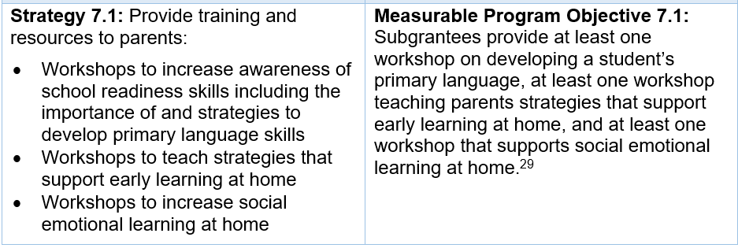
Strategies and MPOs
It is important to review both the strategy and the MPO, as the MPO provides information on how to meet the strategy. For example, MPO 7.1 provides specific information about the number of workshops required beyond what is stated in the strategy:

Slide 62
Tools for Application Planning
MSIN MPO Reports: tell the number of students with a specific need for a certain school year. Or, for some MPOs, will tell the number of workshops offered. For example:
How many K-10 students were below standard in English language arts (ELA) in 2024–25?(MPO Report 1.0)
How many students in grades 11 or 12 have an Individual Needs Assessment/Individual Learning Plan that indicates credit deficiency in 2024–25 (MPO Report 5.1/6.1)?
How many health education workshops focused on mental health were offered in 2024–25 (MPO Report 11.0)?
Subgranting Report: tells where regional services should be focused based on population if districts do not have a DSA.
MPO Tracking Tool: identifies the SSDP strategies implemented by various districts to ensure the region (as a whole) is planning on meeting all strategies and to ensure services reach as many students as possible.

Slide 63
Updates to MPOs 1.0 and 2.0
Although the SSDP has not been amended, the percent target for MPOs 1.0 and 2.0 has changed from 60 percent to an annual increase of 3 percent. Regions and DFDs should use the 2023–24 MPO reports to calculate a 3 percent increase from their current percent of students served to track their progress towards meeting this 3 percent growth goal.
This is the objective that will be measured in next year’s annual report.
+3%
+3%

Slide 64
MPOs 1.0 and 2.0 – Application Planning
To identify the number of students Regions and DFDs should plan to serve in their 2025–26 application, they should review their 2023–24 Annual Report and plan to serve at minimum the total number of students who were served in 2023–24. In this example, the Region would need to serve:
Regular School Year (RSY) MPO 1.0 = 750 students
RSY MPO 2.0 = 505 students

Slide 65
Common Missteps
Not ensuring that selected strategy/MPO requirements are easy to identify in the service/activity write-up.
Not calculating the percentage of SSDP components (e.g., MPO 3.0 at 100 percent or 13.0 at 50 percent) included in instructional services.
Common errors specific to regional subgrantees:
Not reviewing district applications to ensure that the region, as a whole, plans to meet the MPOs.
Not tracking what strategies are being implemented at reimbursable districts.

Slide 66
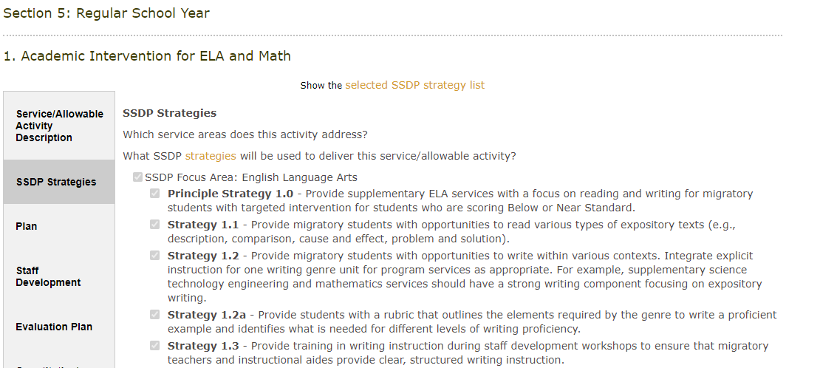
SSDP Strategies Tab
The strategies are the “backbone” of your service. Make sure the other tabs explicitly demonstrate how each strategy will be met.

Slide 67
Breakout Room Activity
Learning Objective #2: Participants will Identify evidence of SSDP strategy implementation in an example service.
Independently skim the example service .
In your small group, find evidence for how you know that each of the SSDP strategies selected will be met. Jot down the evidence that you find for each strategy on the notecatcher.
Whole group debrief.

Slide 68
A Clear Application is ACE
Aligned
Do calculations add up?
Are all tabs within a service aligned with the same information?
Does narrative text specifically address selected SSDP strategies?
Current
Has all information from a rollover (prior year) plan been updated?
Has outdated information been removed?
Is the application titled correctly (no “copy” in title)?
Are org charts and duty statements up-to-date?
Easy to Understand
Would this application paint a clear picture (to a new reader) of what is being offered in your program?
Are there many spelling or grammatical errors?

Slide 69
Description Tab
Overview description: a high-level overview of what is happening and how the service is structured. Key skills shouldn’t be included here. Hint: the Description Tab should tell what students are doing; the Plan Tab should tell what students are learning.
Type of service: instructional, support, or allowable activity (see next slide).
Where service/activity will be provided: The selection should make sense (home-based, site-based, district-wide, region-wide).
Districts that will be served: Regions should ensure that districts without a DSA/MOU will receive services, especially the most populus districts.
Need for the service/activity based on data: Achievement data should be current. Can include California Assessment of Student Performance and Progress (CAASPP), English Learner Proficiency Assessment for California (ELPAC), MPO reports, or local assessment data.
Curriculum: Curriculum should align to Common Core State Standards.

Slide 70
Service or Allowable Activity?
Instructional Services: instruction in elementary/secondary schools or educational activities for preschool age children, such as tutoring before and after school. Other examples could include Speech & Debate, Cyber High, or a leadership service.
Support Services: educationally related activities, such as transportation, advocacy for migrant children, case management, or health, nutrition, and social services.
Allowable Activities: activities related to identification and recruitment, parental involvement, program evaluation, or professional development are examples of allowable activities that are not considered services.

Slide 71
Plan Tab
Key Skills to be learned: What specific knowledge or skills will students learn during the service? Think of Key Skills as overarching content objectives. Make sure there is at least 1 key skill listed for each SSDP strategy selected (unless it is a professional development strategy).
Student/teacher ratio: The ratio should be appropriate for the grade level.
Instructional strategies: Please list the instructional strategies employed for this service, such as teacher modeling/direct instruction, total body response, visual aids, real-world problem solving, sentence/language frames, guided practice, scaffolding, or project-based learning. If 3.0 is selected in the SSDP Tab, there should be English language development strategies included here.
Student grouping method: The grouping method should align with your goals for the service.
Differentiation strategies: Describe how the content, process, product and/or learning environment will be differentiated.
Other Strategies: Optional field. May include the arts, technology, etc. If you selected “Other” in the SSDP Strategies tab, you may include that information here.

Slide 72
Staff Development Tab
Name of Training | Dates | Minutes | Description | Strategy Being Met
Visual Math and Math Talks | 09/2024 | 90 | Teachers learn about new brain research tells us that visual mathematics even helps students learn numerical mathematics. Teachers will learn about Visual Mathematics and Math Talks and learn how to use these techniques for various mathematical concepts. | 2.2

Slide 73
Evaluation Tab
An outcome is a change in knowledge, skills, abilities or behaviors. This is a broad statement indicating improvement in some area, such as:
Increase migratory students’ reading and writing proficiency.
Increase students' mathematical proficiency.
Increase parents’ ability to support math achievement at home.

Slide 74
Measures & Performance Targets Tab
Measure = the tool you will use to determine if growth occurred Performance Target = what you hope the measure will show (your goal!)
The measures and performance targets should only be focused on what will be taught in that specific service or activity. Ask yourself: would this assessment help you know if your service/activity “worked” (achieved the intended outcome)?

Slide 75
Measures & Performance Targets Tab (2)
Measure/Tool
Target/Goal

Slide 76
Measures & Performance Targets Tab (3)
Quantitative measures: | Qualitative measures:
Quantitative measures involve numerical data or statistics. A quantity can be definitively measured or quantified. Always include pre/posttests for student achievement areas (e.g., ELA, math, STEM). For services like cyber high, health, and Out-of-School Youth (OSY), subgrantees should track the number of services given. | Qualitative measures can include interviews, open-ended survey questions, and observations. Qualitative measures will be typically used for areas in which there is limited student data (e.g., parent involvement, student engagement, health).
Subgrantees do not need to include both a quantitative and qualitative measure. You should choose what will best measure the SSDP strategy and the intended outcome.

Slide 77
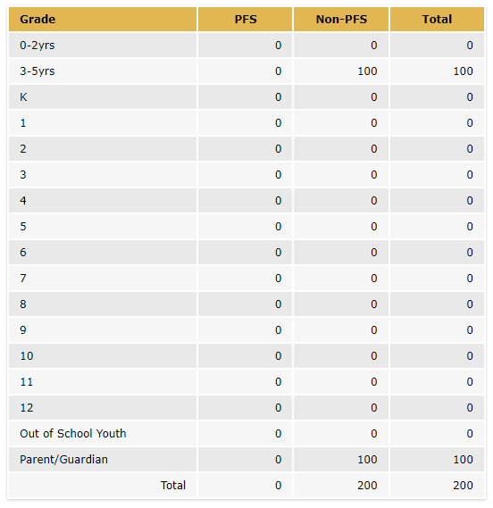
Migrant Students Served Tab
Ensure that Priority for Service (PFS) students are being served, if applicable.
The numbers of PFS and non-PFS students, OSY and parents listed in the Migrant Students Served tab should align with the other tabs, especially the Activity Time and Budget tabs.

Slide 78
Activity Time Tab
Ensure that the number of students entered matches the Migrant Students Served tab.
Note that if multiple MPOs are selected for the service (e.g., 1.0 and 2.0) then the reviewer may need to divide the total minutes in half to determine if each MPO will be met.

Slide 79
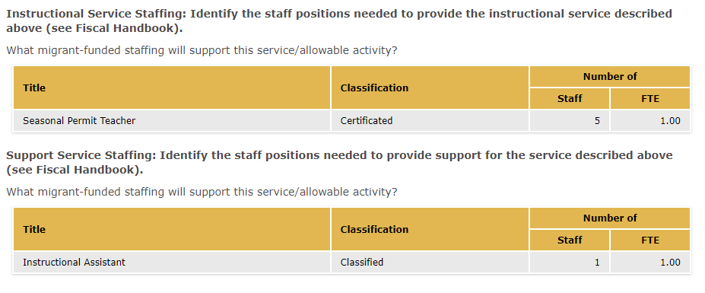
Staff Tab
Staff funded with MEP funds should be listed in either the Instructional or Support staffing tables. The number of staff and full-time equivalent (FTE) should match what is listed in the budget.

Slide 80
Budget Tab
See the Allowable Expenses and Unallowable Expenses sections in the MEP Fiscal Handbook for additional guidance.

Slide 81
Breakout Room Activity
Learning Objective #3: Participants will draft a criteria list of high-quality elements in an example service.
In the notecatcher, find the slide number that matches your breakout room number.
Review two tabs in the example service and write down any high-quality elements that you notice in your assigned tabs, or any suggestions to make it better.
Whole group: review notecatchers.
Whole group: debrief.

Slide 82
Break

Slide 83
Sections 10-14: I&R, PAC, Administration, and Other Information

Slide 84
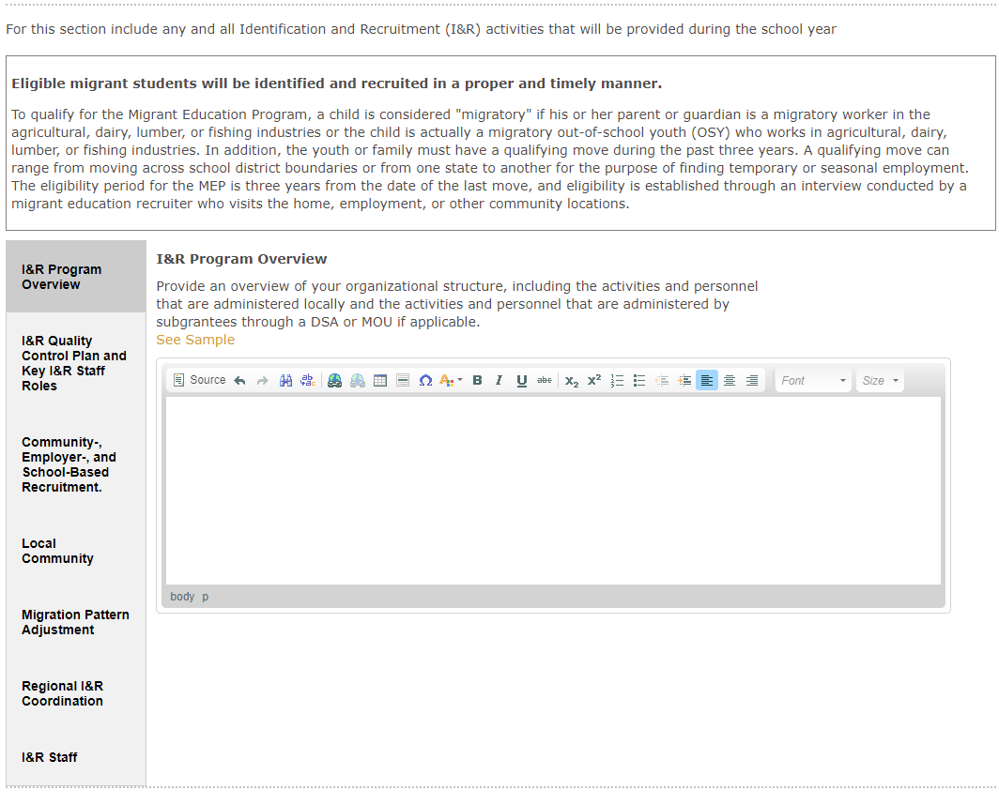
Section 10: I&R

Slide 85
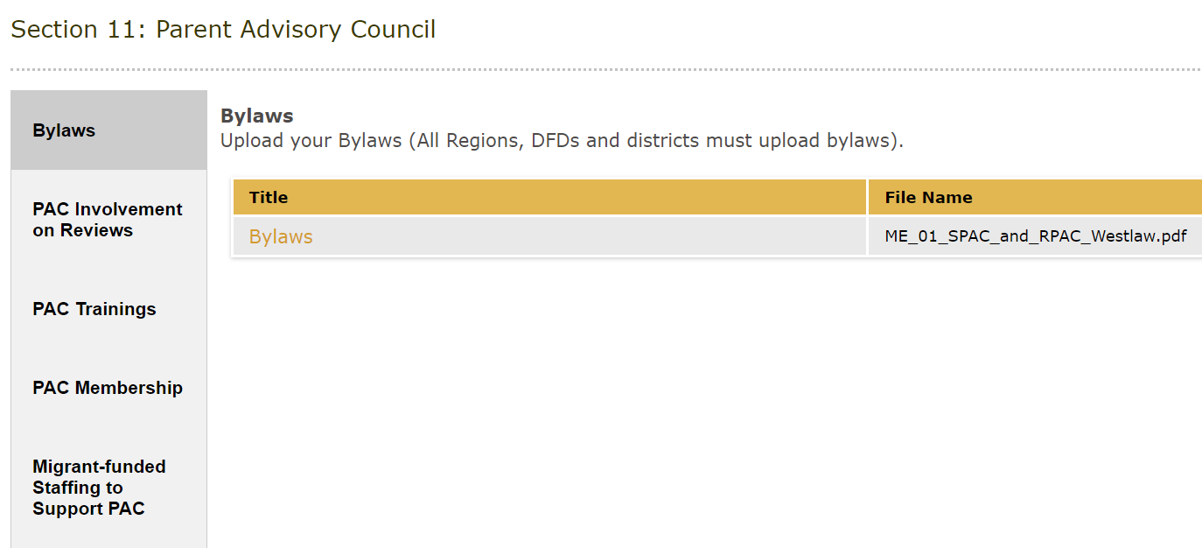
Section 11: PAC

Slide 86
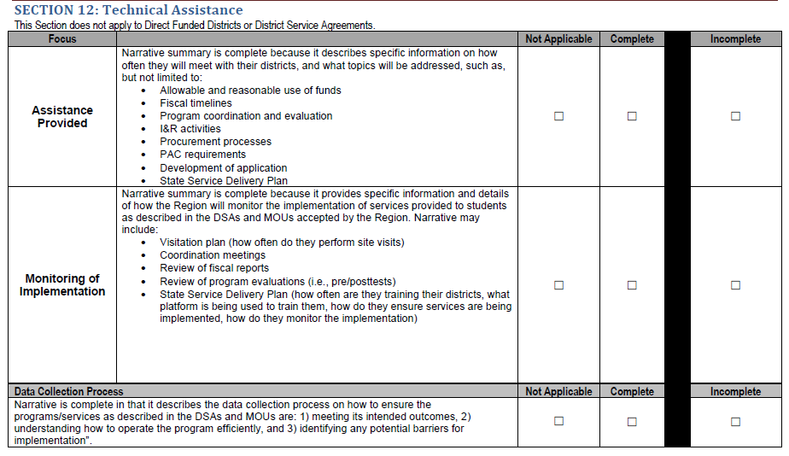
Section 12: Technical Assistance & DSA/MOU Monitoring for Regions
Reminder: only Regions complete Section 12.

Slide 87
Section 13: Administration
Indirect Cost tab: enter the indirect cost rate and check off all costs rendered by indirect cost charges.
Administrative Staff tab: ensure admin staff align with the admin budget and match the staff listed in the Organizational Chart (Section 14).
Administrative Budget tab: input all costs related to administration of the MEP. Ensure the administrative rate is under the Region or DFD’s administrative cap . You can check the Admin Rate in the ME-1 workbook.

Slide 88
Section 14: Operational Documentation & Waivers
The Legal Assurances, Budget Certification and Cover Page are no longer required uploads in this section.

Slide 89
Section 14: Uploaded Documents
Inventory List: This list should include all inventory with an acquisition purchase of over $500 (per item) or less, if the subgrantee has a lower threshold. The list should include data devices and vehicle inventory.
Job Duty Statements: The statements should be from your local Human Resources Department.
Organizational Charts: Must include name and job title of all staff funded with MEP funds (partially or fully). Exception would be teachers (temporary) or staff hired for extra hours. Subgrantees should maintain records of their extra hours staff and temporary staff as they are also subject to the time and effort federal regulations.
Summer Waivers: Region, DFD and DSA subgrantees must provide summer waiver if they do not meet the requirements listed in California Education Code (EC) Section 54444.3 for the summer 2025.

Slide 90
Other Requirements for Regions and DFDs
Please visit the 2025–26 General Guidelines and Timeline webpage for more program requirements, for example:
The MEP grant application must include at least one Summer Leadership Institute program that takes place on the campus of an institution of higher education.
The MEP grant application must include a Speech and Debate program including a regional tournament. Regions/DFDs can host their own tournament or partner with a neighboring Region/DFD.
And other requirements.

Slide 91
Check for Understanding – Zoom Poll (3)
Learning Objective #1: Participants will understand how to navigate the online eMEP system to complete their 2025–26 MEP application (and review district applications as necessary).
91

Slide 92
Summer Waivers

Slide 93
EC Section 54444.3(a)(1)(A)
Each operating agency receiving Title I Migrant Education funding shall conduct summer school programs for eligible migratory children in kindergarten and grades 1 to 12, inclusive. The summer school programs shall respond to the individual needs of participating pupils and shall build on and be consistent with the instructional programs offered to these pupils during the regular school year. Each summer school program shall be funded, to the extent that funds are available, by federal funds earmarked for migrant education programs, and shall meet the following criteria:
(A) That summer school programs meet the following time requirements:
(i) For kindergarten classes, not less than 180 minutes per day, based upon the full apportionment day of 240 minutes, including recesses, for not less than 20 teaching days.
(ii) For grades 1 to 8, not less than 200 minutes per day, based upon the full apportionment day of 240 minutes, including recesses and passing time but excluding noon intermissions, for not less than 20 teaching days.
(iii) For grades 7 to 12, not less than 240 minutes per day, including passing time but excluding noon intermissions, for not less than 30 teaching days.

Slide 94
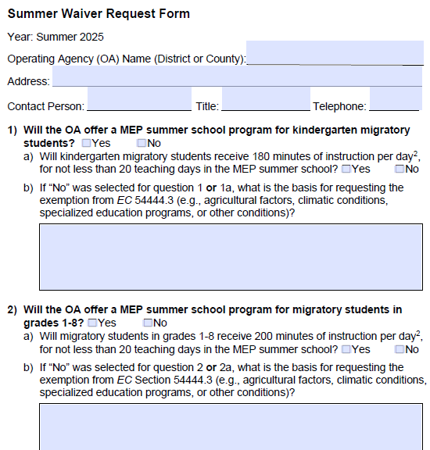
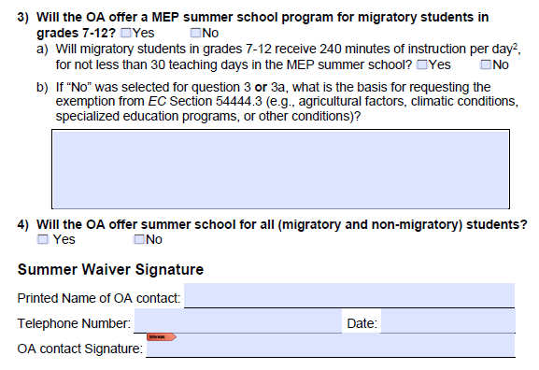
2025 Summer Waiver Request Form
Questions 1, 2 and 3 are referring to MEP-funded summer programs.
Question 4 is referring to a non-MEP funded summer program.

Slide 95
Summer Waiver Important Notes
Only districts with a DSAs need to submit summer waivers; MOUs do not need to submit a waiver.
It is the responsibility of the Region to review and verify their DSA waivers. This includes:
Monitoring DSA instructional programs and ensuring that those who should submit a waiver have done so.
Regions must submit their waiver and all necessary DSA waivers to the CDE. By submitting the DSA waiver to the CDE, the Region indicates that they have reviewed the DSA waiver and that they approve of the waiver request.

Slide 96
Due Dates
Summer Waivers should be uploaded to Section 14 of the application by the following due dates:
April 11 for DFDs
May 9 for Regions (Region & DSA waivers)
CDE consultants will be reviewing summer waivers early in the application review process and therefore it is essential that summer waivers be submitted on time.

Slide 97
Summer Waivers FAQ
Q: Can my summer waiver be denied?
A: Yes, summer waivers can be denied if they are incomplete or if they do not provide a valid exemption as listed in EC Section 54444.3.
Q: What are the consequences if my waiver is denied, my application does not demonstrate that I have met the summer time requirement, or I do not submit my waiver in a timely manner?
A: A condition will be included in your approval letter.

Slide 98
Summer Waivers FAQ (2)
Q: What if a holiday, such as the Fourth of July, falls during the period of summer instruction?
A: Holidays designated in EC Section 37220 other than Saturday and Sunday may be deducted from the required number of teaching days. For example, if the Fourth of July holiday falls on a Tuesday during the operating agency’s kindergarten MEP summer program, the total requirement for kindergarten would be adjusted to 19 days instead of 20 days.
Q: Where do I submit the waivers?
A: Waivers should be uploaded to Section 14 of the application. Regions must upload their approved DSA waivers (if applicable).

Slide 99
Check for Understanding – Zoom Poll (4)
Learning Objective #4: Participants will learn how to complete the 2025 Summer Waiver Request Form.
99

Slide 100
Questions & Answers

Slide 101
Submitting a Plan

Slide 102
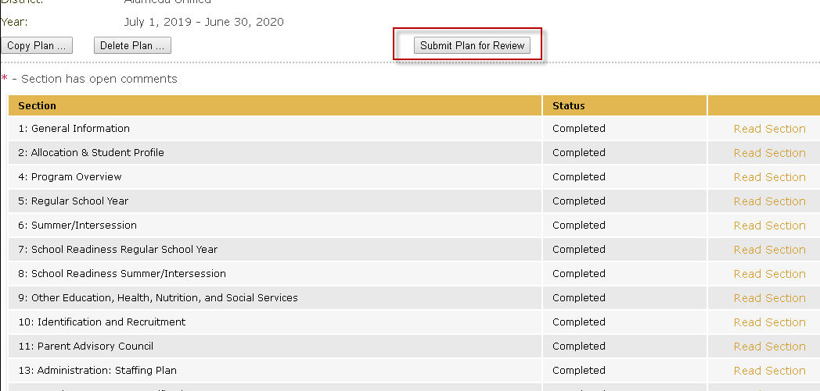
Submit Your Plan
Reminder: only the submitter user role will have access to the “Submit Plan for Review” button.

Slide 103
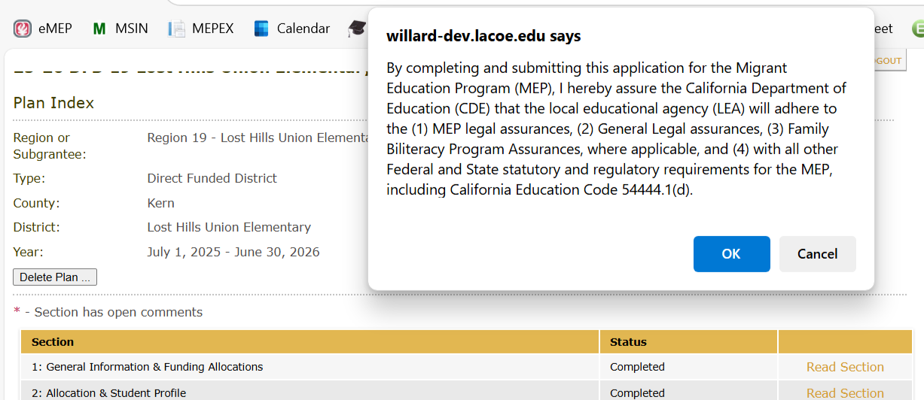
Legal Assurances and Certifications
Before submission, the approved submitter will be prompted to accept the legal assurances, certifications and requirements.
The General Legal Assurances and MEP Legal Assurances (including Family Biliteracy Program assurances) can be found on the 2025–26 Request for Application webpage.

Slide 104
California Education Code (EC) 54444.1(d)
Applicants should ensure they maintain documentation of compliance with EC 54444.1(d). This documentation will be reviewed during Federal Program Monitoring (FPM).
“The parties, whether regional or directly funded, shall take the necessary steps to ensure the effective involvement of the migrant parent advisory committee for that district or agency. Representatives of the migrant parent advisory committee shall have the right to be present and participate in all deliberations between the parties regarding the service agreement or any subsequent changes thereto. The service agreement shall include a signed statement from the officers of the migrant parent advisory committee signifying that the participation has occurred” (EC 54444.1[d]).

Slide 105
Review Process & Scoring
Reminder: Regional Directors review DSA/MOU applications. CDE staff review Region/DFD applications.

Slide 106
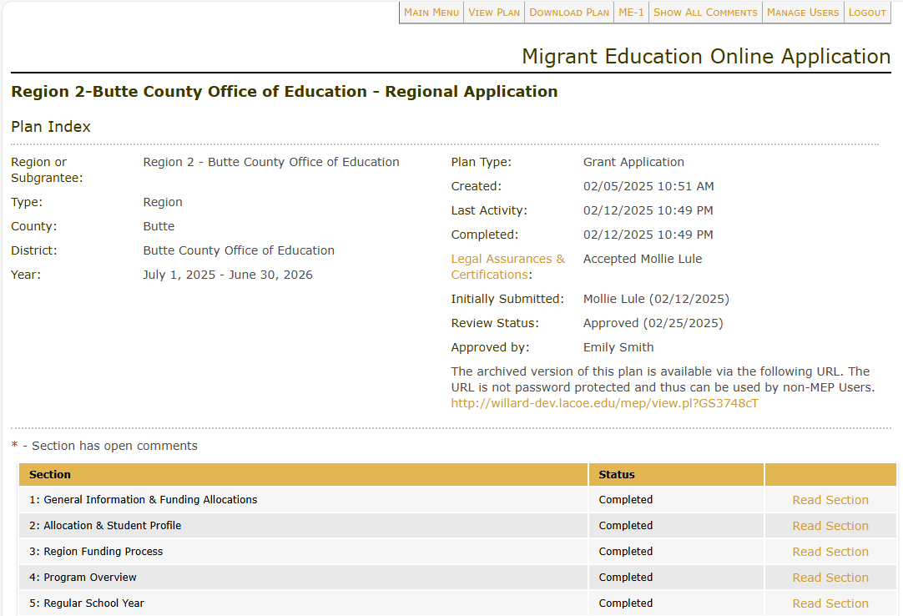
Plan Approval

Slide 107
Questions & Answers

Slide 108
Resources & Support

Slide 109
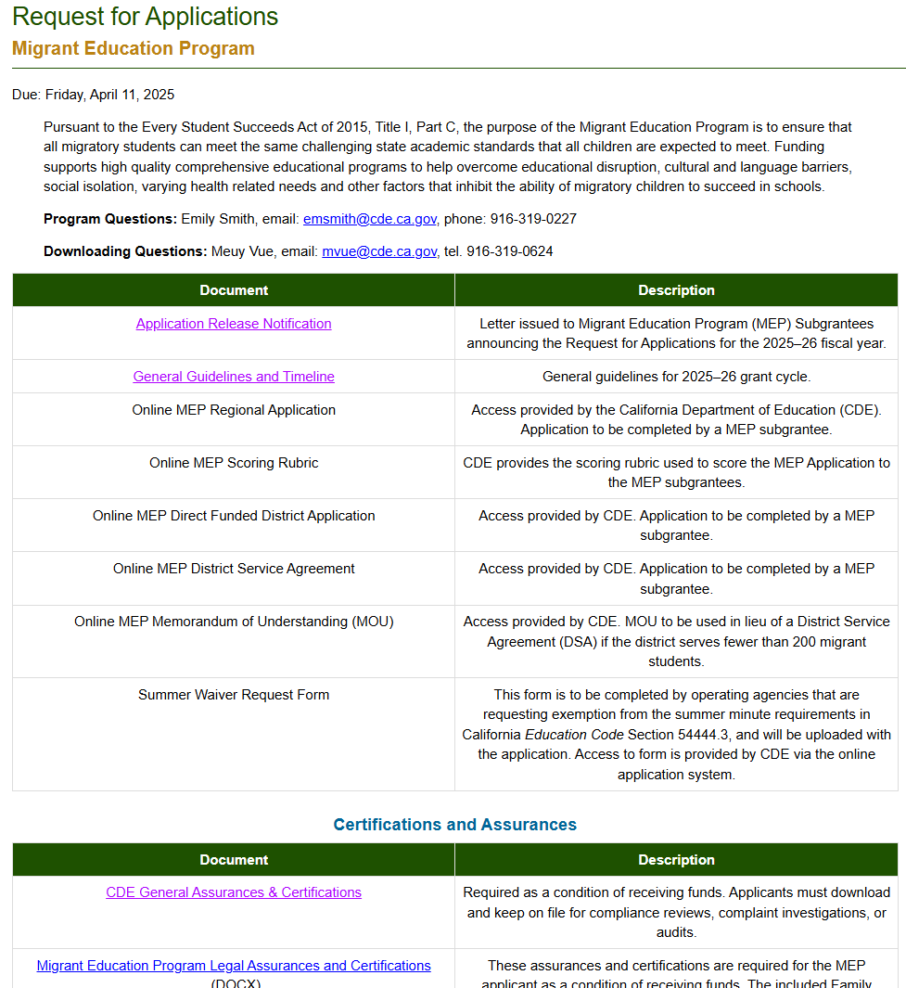
MEP Request for Applications Website
https://www.cde.ca.gov/fg/fo/r28/migrant25rfa.asp

Slide 110
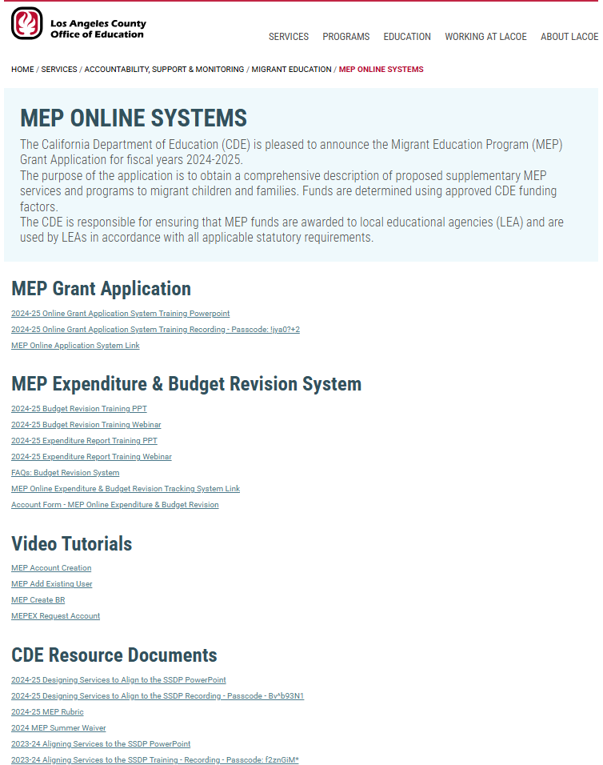
eMEP System Resources
www.lacoe.edu/services/accountability/migrant-education/online-systems

Slide 111
eMEP System Support
DSA/MOU staff can contact their Region for support.
Contact LACOE Technology Services staff via the “Contact Us” button on the eMEP Main Menu.
Contact LACOE Technology Services staff via the support email. This option is best so that you can send screenshots of the issue.
mepsupport@lacoe.edu

Slide 112
Migrant Education Office Staff Contact Information
Alex Leguizamo Education Programs Consultant (EPC), CDE ALeguizamo@cde.ca.gov 916-327-4408 | Lizette Rocha EPC, CDE LRocha@cde.ca.gov 916-323-2241
Jamie Contreras EPC, CDE JContrer@cde.ca.gov 916-319-0391 | Melissa Mallory EPC, CDE MMallory@cde.ca.gov 916-319-0730
Monica Nepomuceno EPC, CDE MNepomuceno@cde.ca.gov 916-323-2212 | Teresa Palomino EPC, CDE TPalomino@cde.ca.gov 916-319-0678
Emily Smith EPC, CDE EmSmith@cde.ca.gov 916-319-0227 | Loan Tran EREC, CDE LTran@cde.ca.gov 916-319-0239

Slide 113
Learning Objectives: Self-Assessment
Participants will:
Understand how to navigate the online eMEP system to complete their 2025–26 MEP application (and review district applications as necessary).
Identify evidence of SSDP strategy implementation in an example service.
Draft a criteria list of high-quality elements in an example service.
Learn how to complete the 2025 Summer Waiver Request Form.
113

Slide 114
Thank you for attending!
Please fill out this feedback form to inform future trainings: https://tinyurl.com/MEPtrainingFeedback2025
on this training:
If you have additional questions, contact Emily Smith at EmSmith@cde.ca.gov | 916-319-0227

