Slide 1
As you join us, please type into the Chat a movie or show you’re currenly watching or recently watched that you’d recommend.
Notes:
Link to sign-in sheet
https://forms.gle/LaNoabKLwap4yG3A8

Slide 2
Designing Services and Activities to Align with the Migrant Education Program State Service Delivery Plan
February 28, 2024
Welcome! Please complete the brief Google Form to confirm your attendance (link provided in the chat).
Notes:
Before the webinar starts (5 min. and 1 min. before)
Good afternoon! Thank you for joining us. We are going to get started in just a few minutes. While you wait, please complete the attendance sign-in sheet at:
Emily
Good afternoon! Welcome to the “Designing Services and Activities to Align with the State Service Delivery” webinar.

Slide 3
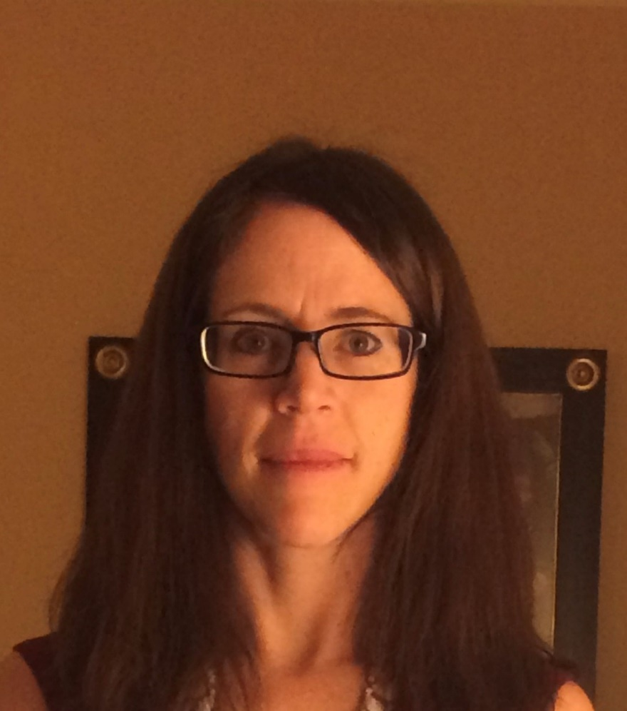
Presenters
Melissa Mallory, Education Programs Consultant
Emily Smith, Education Programs Assistant
Notes:
Emily
My name is Emily Smith, an Education Programs Assistant, for the Migrant Education Office and I am the lead for the Migrant Education Program grant application. Joining me today is Melissa Mallory, the lead for the State Service Delivery Plan.

Slide 4
Housekeeping
Microphones have been muted to minimize background noise.
Please use the Q&A Zoom feature for questions. You can upvote questions in the Q&A; we will address questions with the most votes first. There will be designated times for questions throughout the webinar.
The slides and recording will be posted to the Los Angeles County Office of Education MEP Online Systems website.
4
Notes:
Emily
Read slide

Slide 5
Webinar Objectives
Participants will review how to develop services in the grant application that align to the State Service Delivery Plan (SSDP).
Participants will be able to identify what needs to be included in services that map to specific measurable program objectives (MPOs).
Notes:
Emily
For our webinar today:
Participants will review how to develop services in the grant application that align to the State Service Delivery Plan (SSDP).
Participants will identify what needs to be included in services that map to specific measurable program objectives (MPOs).
During the webinar today we will review resources necessary to complete the grant application, review a sample service and discuss the SSDP requirements based on the selected SSDP Strategies as well as practice reviewing a service and identifying common missteps and best practices.
Now I will turn it over to my colleague, Melissa Mallory, who will continue with the presentation.

Slide 6
Agenda
Review webinar objectives
Resources to complete the grant application
Walk through a sample service
Break
Practice reviewing different components of a service
Identify common missteps
Review best practices
Conclusion
Notes:
Emily
During the webinar today we will review webinar objectives, resources necessary to complete the grant application, review a sample service and discuss the SSDP requirements based on the selected SSDP Strategies as well as practice reviewing a service and identifying common missteps and best practices.

Slide 7
Audience
SSDP Leads
Directors
Coordinators and Program Managers
Other Migrant Education Program (MEP) staff who develop services in the grant application
Notes:
Emily
The audience for this presentation includes Directors, Coordinators/Program Managers, and Other Migrant Education Program, or MEP, staff who develop services in the grant application.

Slide 8
Resources for Designing Instructional Services
Amended SSDP (Section III General Framework)
MPO Tracking Tool: identifies the SSDP strategies implemented by various districts to ensure the region (as a whole) is planning on implementing all strategies and to ensure services reach many students
Subgranting Report: identifies the districts that should complete a district service agreement (DSA); it also tells you where regional services should be focused based on population if districts do not have a DSA
MPO Reports: identify the size of the population with that specific need (MPOs 1.0, 2.0, 7.0, 9.1), the number of workshops (MPO 11.0), and in many cases who needs to served for that specific MPO (e.g., MPOs 1.0, 2.0, 5.0, 5.1, etc.)
Notes:
Melissa continues
To develop your grant application, you’ll need a few resources. Section III of the Amended SSDP identifies the SSDP Strategies and the MPOs that will guide service development. The MPO Tracking Tool provides a way to track where SSDP Strategies are being implemented to ensure that all strategies are implemented and all individual MPO requirements are met. This includes aggregating the number of students who are below proficiency planned to be served by the region and reimbursable districts. Additionally, the Subgranting Report identifies the number of migratory students in each district. If a district has 200+ students, they should have a district service agreement (DSA).
Because the Academic Risk Report also includes the English Learner indicator, you should use MPO Reports 1.0 and 2.0 to identify the number of students who are not proficient in ELA and math and then figure out your 60% target. For your case management service, the MPO 5.0 Report may provide some insight into how many 9th grade students will be served in the upcoming year. For credit accrual services, MPO 5.1/6.1 Report may give you a good idea of the number of proposed students to be served in 2024-25. Using the reports to plan service delivery in addition to regular use of the MPO reports throughout the year to match students with specific needs to services offered has a huge impact on the MEP’s ability to meet the needs of students. We’ll discuss use of the tracking tool, subgranting report, and MPO Reports during the next few slides.
I would also like to note that the past years’ presentations on aligning the grant application to the SSDP are included on LACOE’s MEP Training web page. Past presentations have focused specifically on ELA, math, and pre-K services aligned to MP) 7.0. I highly encourage any folks who are somewhat new to this process to review those recordings as well.

Slide 9
MPO Tracking Tool
Notes:
Melissa
As noted in previous trainings, Region 10 created an MPO Tracking Tool that has been shared with the field and it’s still in the SSDP Google Drive Folder. For districts, this is pretty easy as the district can easily track the strategies within their own districts. A little more organization is needed when regions have multiple DSA and MOU districts. This year I’d like to share a modified program tracking tool that my colleague, Teresa Palomino, developed. Subgrantees should use a tool that serves the same purpose, to track implementation of strategies and to strategically plan to meet all MPOs for each focus area as you review your regional and reimbursable districts’ applications. For regional subgrantees, you’ll want to identify the strategies being implemented at each of your reimbursable districts as well as at the regional level. Please be sure to check that your districts and the region as a whole are meeting the requirements in the MPOs.
I’m going to stop sharing so I spend a few minutes walking participants through the different functions of this tool.

Slide 10
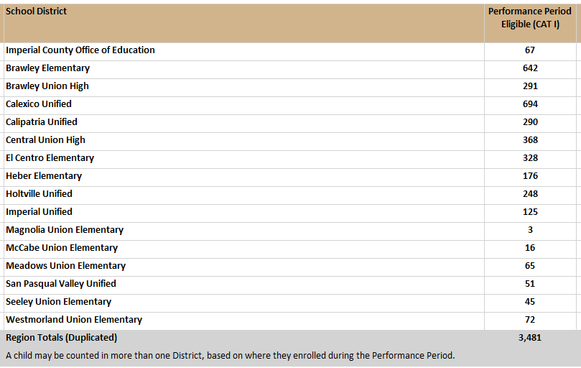
Checking for Understanding: Subgranting Report
Notes:
Melissa
Let’s take a quick break to check for understanding on the Subgranting Report. Remember that the Subgranting Report is provided to you every January and it identifies the number of students you are receiving funding for in the next funding cycle. This report identifies the number of students who were eligible in the performance period, number of PFS students, number of out of school youth and other factors included in the state funding formula that all of the regions use to fund districts in their program areas. So, the Subgranting Report is also used to identify which districts within a region should be identified as a DSA or MOU district.
Districts need to have a certain number of students to enter into a district service agreement. Using the Chat, please identify the districts who should be offered migrant funds for a DSA.
Answer: Brawley Elem, Brawley HS,Calexico, Calpatria, Central Union, El Centrol Elem, Holtville. If any district declines funds, the MEP Director must provide the CDE consultant with a letter from the District Super (on letterhead) stating that funds have been declined for the upcoming school year and that they’d prefer the region serve their students.

Slide 11
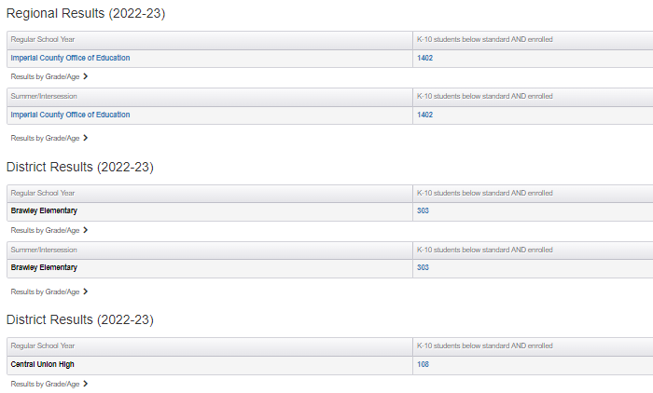
Using the MPO Reports
District | # of eligible students (Subgranting Report) | # of students below proficiency (MPO Report)
Brawley Elementary | 642 | 303
Brawley Union High | 291 | 118
Calexico Unified | 694 | 284
Calipatria Unified | 290 | 100
Central Union High | 368 | 108
El Centro Elementary | 328 | 175
Holtville | 248 | 96
Notes:
Melissa
Districts using the MPO Reports for planning services is straight forward; you’ll run the report from the previous year to get a good idea of the number of students with a specific need. In this case, we are looking at the number of students with a need to develop their ELA proficiency. Districts will run the report and multiply the total number of students below proficiency by .6 to identify the number of proposed students to be served by their services aligning to MPO 1.0.
This slide shows the total number of students who were identified as below proficient in ELA for Region 6.0. Regions need to do a bit more work to ensure their services are targeting the right students. When regions plan for services with the most student need (i.e., MPOs 1.0 and 2.0), it’s important to identify where these students are. The Subgranting Report gives you a good idea of total number of students, but regional staff shouldn’t rely on these numbers to identify the proposed number of students they’ll serve for MPO 1.0. Regional staff need to also run the previous year’s MPO 1.0 Report for their districts to get a sense of the proposed number of students they will serve and where to serve them. In this case, let’s use Region 6 as an example, and I should note, I just made this up, so it’s not a reflection on what Region 6 is doing. To calculate the 60% that the region is planning for, we take 1402 and multiply that by .6=841.2, which we’ll round up to 842 because you can’t serve part of a child. If the region proposes to serve 600 students and this service is mapped to MPO 1.0, you’ll need to identify the total number of below proficient students available in those districts. Let’s say that Region 6 decides to provide a service for 600 students in Calipatria, Central Union High, and Holtville…knowing that we are targeting students who are below proficient, the region would only really have access to 304 students who are below proficient, so it’s the 304 that should count towards that 60% of students served, not 600. Therefore, I would need to aggregate numbers from other ELA services and possibly from reimbursement districts within Region 6 to get to the 842 students that the region, as a whole, needs to plan to serve.

Slide 12
Measurable Program Objectives
All MPOs should be considered and reviewed as the grant application is being developed.
The MPOs provide additional information on SSDP Strategy implementation as well as identify implementation targets or goals for the local MEPs.
For example, some MPOs identify a percentage of children who need to be served, service duration, staffing, and grades. Other MPOs identify the number of workshops that need to be offered by the local MEP.
Link to the SSDP: https://www.cde.ca.gov/sp/me/mt/statesrvcdelivrypln.asp
Link to other SSDP trainings/resources: https://drive.google.com/drive/folders/1XbK2v4eNbv4Wg2O4tLZe5AjZkiGacrKx?usp=sharing
Notes:
Melissa
Before developing and writing services in the grant application, it’s important to know what is required for each subgrantee as a whole. All MPOs should be considered and reviewed as the grant application is being developed.
The MPOs provide additional information on SSDP Strategy implementation as well as identify implementation targets or goals for the local MEPs. For example, some MPOs identify a percentage of children who need to be served, service duration, staffing, and grades. Other MPOs identify the number of workshops that need to be offered by the local MEP.

Slide 13
Time for Questions
Notes:
Melissa
I’ll take a minute to pause to see if there are any questions in the Q&A feature.

Slide 14
Example Service: SSDP Strategies
The example service selected the following SSDP Strategies:
Strategy 2.1: Offer Math Literacy Family Nights, targeting priority for services and migratory students scoring Below Standard, focused on math Common Core State Standards and learning strategies to use at home.
Strategy 2.2: Provide professional development opportunities for MEP staff to understand student math achievement data, increase their knowledge and skill set for teaching concepts and procedures and problem solving and data modeling in mathematics. Professional development should also include strategies for communicating and reasoning in mathematics as this piece should be integrated in learning for both mathematical claims identified in this strategy.
Notes:
Melissa
Now we are going to move on to reviewing a sample service.
When reviewing services, the first section I look at is the SSDP Strategies tab. This way I know exactly what to look for in all the other fields in the application. The strategies selected will inform the narrative written in the application. This service selected the Math Family Night and Math PD strategies as well as the workshops identified in MPOs 7.1, 11.0, and 12.1. The Key Skills field will identify student and parent outcomes for the workshops. From the strategies selected, I automatically know that I should expect to see the Math PD in the Staff Development tab.

Slide 15
Example Service: SSDP Strategies (2)
The example service selected the following SSDP Strategies:
Strategy 7.1: Provide training and resources to parents:
Workshops to increase awareness of school readiness skills including the importance of and strategies to develop primary language skills
Workshops to teach strategies that support early learning at home
Workshops to increase social emotional learning at home
Strategy 11.0: Each year, MEPs will offer two health education workshops that focuses on mental health (e.g., self-esteem, depression, anxiety, etc.)
Notes:
Melissa

Slide 16
Example Service: SSDP Strategies (3)
The example service selected the following SSDP Strategies:
Strategy 12.1: Provide a variety of workshop series for parents including:
How the U.S. school systems works and parent and family opportunities for participation within this system
Parent engagement evidence-based strategies
Understanding student achievement data
Supporting your child in obtaining a high school diploma
Understanding career technical education
Learning educational vocabulary (acronyms, A-G, parent homework dictionary, educational glossary)
Notes:
Melissa

Slide 17
Example Service: Service Description
Migrant Family Conference: Service Description
The local MEP will hold an all-day Migrant Family Conference. The day will start with a keynote speaker to set the tone of the conference’s theme, Increasing Proficiency: Expanding Future College and Career Opportunities. After the keynote speaker, there will be three sessions of workshops with five workshops per session to choose from. Workshops include, but are not limited to:
Mindfulness Meditation: Dealing with Feelings of Anxiety and Depression
Math Family Session (for parents and children)
Parent Engagement Evidence-based Strategies
Career Technical Education: What educational options are available other than college?
Notes:
Melissa
Here we have the example service description [read description]. As you read/listen to the description, please indicate in the Chat which strategies are represented in the service description.

Slide 18
Example Service: Service Description (2)
Migrant Family Conference: Service Description (continued)
Workshops include (continued):
Getting a Diploma: How to Support your High School Student
Ready for Kinder!
Self-management and Self-awareness: Strategies to Support PreK students
Sessions one and two will offer separate workshops/activities for parents and students; however, session three will offer workshops in which parents and students can participation together. Childcare will also be provided for younger children. Because the conference will begin at 9 a.m. and last until 3 p.m. a light lunch and snacks will be provided. The conference will conclude with a children’s folklorico dance performance.
Notes:
Melissa
Here we have the example service description [read description]. As you read/listen to the description, please indicate in the Chat which strategies are represented in the service description.

Slide 19
Is the Service Description Sufficient?
To participate, please unmute yourself to discuss the service description or use the Chat feature to share your thoughts.
Some questions to consider…
Does the service description paint a picture of the service? Do I know what’s happening more or less?
Which strategies are identified in the description? If it doesn’t address all the strategies, does it need to, or can we find information on a missing strategy elsewhere?
Notes:
Melissa
To participate, please unmute yourself to discuss the service description or use the Chat feature to share your thoughts.
Answer: The math PD (MPO 2.2) and the primary and secondary language workshop from 7.1 was not included in the Service Description. As far as PD is concerned, I don’t expect to see PD in the service description field because there is a separate tab for PD. As far as the workshop is concerned, I think it would be clearer to add the primary and secondary language workshop because all of the other workshops are identified. But if I see the key skills learned during this specific workshop, and the others from 7.1, I can then add it to my program tracker as being met through this service. It’s also not clear if there are one or two workshops for 11.0, so I would want to clarify that before marking the strategy/MPO as being met.

Slide 20
Example Service: Key Skills
During the Migrant Family Conference, participants will learn many key skills depending on the workshops they attend.
Students and parents will learn techniques on how to deal with stress and anxiety.
Parents will learn how to support several key mathematical standards after learning how to play specific math games with their children.
Parents will learn how to support their children’s early learning at home.
Parents and preK students will learn strategies for managing their emotions and actions in different environments. Parents will learn how to support their children during difficult emotions.
Parents and students learn what is required to graduate high school, attend a California State University or University of California, and what opportunities are available through Career Technical Education.
Parents learn ways to engage with school and how to support their child’s education through high school.
Notes:
Melissa
Here we see the skills to be learned by the students most of which are written as content objectives. Is this sufficient? Are we missing any key skills that we need to add?
Answer: A key skill for the primary and secondary language workshop needs to be included.

Slide 21
Example Service: Instructional Strategies
Teachers will use a variety of strategies including teacher modeling, use of visuals/manipulatives, various opportunities to discuss content, scaffolding when needed, and primary language support.
What do we think about this narrative? Is it sufficient? Are there any SSDP components that needed to be included?
Notes:
Melissa
What do we think about this narrative? Is it sufficient? Are there any SSDP components that needed to be included?
Please unmute your microphone or add your comments into the Chat.

Slide 22
Example Service: Staff Development
Name of Training | Dates | Minutes | Description | Strategy Being Met
Visual Math and Math Talks | 09/2024 | 90 | Teachers learn about new brain research tells us that visual mathematics even helps students learn numerical mathematics. Teachers will learn about Visual Mathematics and Math Talks and learn how to use these techniques for various mathematical concepts. | 2.2
Notes:
Melissa
[Review slide and Staff Development requirements]

Slide 23
Example Service: Expected Outcome and Local Measures
Expected Outcome: Parents who will participate in the Migrant Family Conference will be better prepared to support their children in the following areas:
a) academics, b) college and careers, c) health needs and d) school readiness,
e) as well as access the local community agencies when need of social services.
Local Qualitative Measure
Local Performance Measure | Local Performance Target
Survey | Eighty percent of the 400 parents who will participate will feel that the conference prepared them well to better support their children’s education, as well as providing them information on how to access local health and social services.
Notes:
Melissa
For the Expected Outcome, we should see a change in knowledge, skills, abilities, and/or behaviors. The outcome is a simple broad statement and is the foundation for your local measures and performance target. The outcome identified here, is perfect. We see a change, or increase, in knowledge and skills for the skills identified in the Key Skills tab for both students and parents.
The CDE expects to see pre and posttest assessments for most instructional services addressing core content areas. Since the Migrant Conference really isn’t geared towards expected outcomes in proficiency, we see a survey focused on how parents feel the conference prepared them to better support their education and if they feel like they can access local services.
Just a reminder that if you have a quantitative measure, you do not also need a qualitative measure and vice versa.

Slide 24
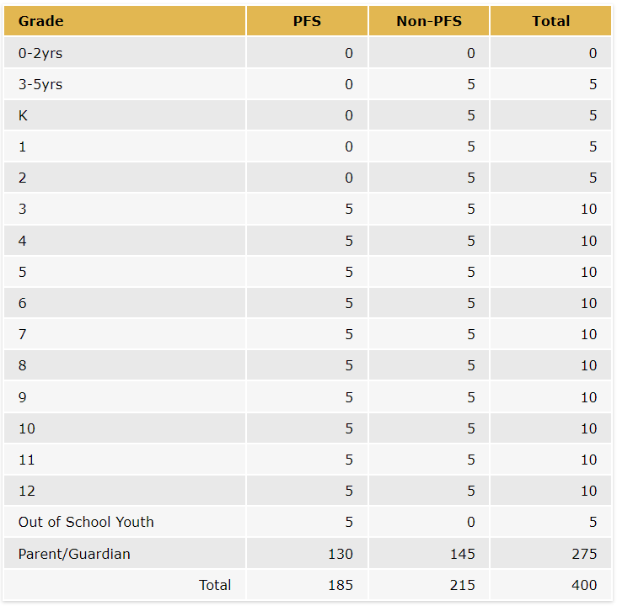
Example Service: Migrant Students Served and Activity Time
Grade Levels | Students Served | Activity Dates | Total # of Days | Minutes/ Days | Total Minutes
PreK - OSY | 125 | 3/9/2025 | 1 | 420 | 420
Parents | 275 | 3/9/2025 | 1 | 420 | 420
Notes:
Melissa
[Review slide]

Slide 25
Any Questions?
Notes:
Melissa
I’ll pause here to answer any questions identified in the Q&A.

Slide 26
Check for Understanding
Let’s take a quick poll to assess our knowledge of the content covered so far during this presentation. Please choose the BEST answer.
Notes:
Melissa
1. Do all the SSDP Strategies need to be addressed in the Service Description?
a. Yes.
b. No. Some strategies may be addressed in other fields like Key Skills, Instructional Strategies, Staff Development, etc. (correct answer)
2. If a service includes SSDP Strategies 2.1, 2.2, 3.0, and 12.1 which skills would you include in the Key Skills field?
a. Parents will learn evidence-based strategies to participate in school and support their children academically.
b. Objectives for the Math Family Nights.
c. Parents will learn how to read student achievement data for mathematics.
d. Students will exchange information and ideas as well as offer opinions when working with classmates to solve word problems involving multiplication (of whole numbers, fractions, etc. depending on grade level).
e. Students will write for two genres and use student-friendly rubrics.
f. a, b, c (correct answer)
3. True or False? Each SSDP Strategy selected for Staff Development should include a moderately detailed description of the PD to be offered. Details may include title of PD, description of PD, and key objectives for the PD.
True (correct answer)
False

Slide 27
Let’s Take a Break
Please be back in 10 minutes!

Slide 28
Practice
Directions:
Select a facilitator, note taker, and volunteer to report out.
Open the Google doc link via the Chat or Outlook.
Your Breakout Room group number will be the group number for your slides.
In your Breakout Room, you will have three prompts to practice what was covered today.
Take notes to address the prompts on your group’s slides in Google Docs.
After 20 minutes, we will reconvene the whole group and share what was discussed in the Breakout Rooms.
Notes:
Melissa
The past three years we reviewed sample services and worked in small groups to identify what is missing from each service. This year I’ve changed it up a bit in which we are going to specifically look at three prompts which correspond to different SSDP Strategies and fields within the application itself. Participants will review the prompts in small groups in a breakout room and identify specifics for each prompt.
Directions:
Select a facilitator, note taker, and volunteer to report out.
Open the Google doc link via the Chat or Outlook.
Your Breakout Room group number will be the group number for your slides.
In your Breakout Room, you will have three prompts to practice what was covered today.
Take notes to address the prompts on your group’s slides in Google Docs.
After the 20 minutes, we will reconvene the whole group and share what was discussed in the Breakout Rooms.
Once we reunite as a whole group, I will share each groups slides when they share their insights on the review of the grant application service.
Link to group slides: https://docs.google.com/presentation/d/13TC-h6MQV3y3cfHT73KpFdgjWQhNqIBnAHCFb3EpHRk/edit?usp=sharing

Slide 29
Breakout Rooms
Please note your group number. Your group number corresponds to the group slides that you will use.
Notes:
Melissa
Link to group slides: https://docs.google.com/presentation/d/13TC-h6MQV3y3cfHT73KpFdgjWQhNqIBnAHCFb3EpHRk/edit?usp=sharing
Framework: chrome-extension://efaidnbmnnnibpcajpcglclefindmkaj/https://www.cde.ca.gov/ci/rl/cf/documents/elaeldfwchapter7.pdf
ELD Standards: chrome-extension://efaidnbmnnnibpcajpcglclefindmkaj/https://www.cde.ca.gov/sp/el/er/documents/eldstndspublication14.pdf

Slide 30
Whole Group: Share Findings
Notes:
Melissa
Welcome back, everyone. What about prompt #1? What needed to be added to mark this tab as adequate or comprehensive?
Answers:
Prompt 1
Service starts in Sept., but the PD is in November. PD should happen prior to the service starting.
Description should have key objectives for staff
Staff learn how to embed ELD standards into lessons with accompanying CCSS standards.
Staff learn how to provide opportunities in class for students to gain and exchange information and ideas in three communicative modes (collaborative, interpretive, and productive), and to apply knowledge of language to academic tasks via three cross-mode language processes (structuring cohesive texts, expanding and enriching ideas, and connecting and condensing ideas) using various linguistic resources.
Standard being addressed is 3.1
Prompt 2:
Yes, it meets the intent of 13.0 because cultural pride is being explicitly taught. Key skills could include: 1) Students build an appreciation of culturally relevant non-fiction. 2) Students identify the valuable contributions of migratory farm workers and discuss what traits make them most proud to be part of this community.
Prompt 3:
Students exchange information and ideas with others through oral collaborative discussions on their shared experiences.
Students offer and justify opinions, negotiating with and persuading others in communicative exchanges

Slide 31
Common Missteps
Ensuring selected strategy/MPO requirements are included within the application narrative and tables (e.g., Key Skills, Staff Development, Migrant Students Served, Activity Time, etc.).
Not calculating the percentage of SSDP Components (MPOs 3.0, 8.0, 13.0, and 13.1) included in instructional services.
Common errors specific to regional subgrantees:
Not reviewing district service agreements to ensure that the region, as a whole, plans to meet the MPOs.
Not tracking what strategies are being implemented at reimbursable districts.
Notes:
Melissa
Common missteps in application development when it comes to the SSDP include:
Ensuring selected strategy/MPO requirements are included within the application narrative and tables (e.g., Key Skills, Staff Development, Migrant Students Served, Activity Time, etc.).
Not calculating the percentage of SSDP Components (MPOs 3.0, 8.0, 13.0, and 13.1) included in instructional services.
Common errors specific to regional subgrantees include:
Not reviewing district service agreements to ensure that the local MEP, as a whole, plans to meet the MPOs.
Not tracking what strategies are being implemented at reimbursable districts.

Slide 32
Best Practices
Ensure selected strategy/MPO requirements are met by identifying where the strategies are addressed in the application narrative for each service including a percentage of students served.
Use the MPO Reports to calculate the number of students who need to be served by the region/direct-funded district and reimbursable districts (each district has its own number of students that should be reviewed).
Notes:
Melissa
Now I’d like to review some best practices for ensuring that services are properly aligned to the SSDP and that all necessary information is included.
Ensure selected strategy/MPO requirements are met by identifying where the strategies are addressed in the application narrative for each service including a percentage of students served.
Use the Academic Risk Report to calculate the number of students who need to be served by the region/direct funded district and reimbursable districts (each district has its own number of students that should be reviewed).

Slide 33
Best Practices (2)
Track SSDP Components for instructional services and identify if the subgrantee as a whole has met the targets for MPOs 3.0, 8.0, 13.0, and 13.1.
Use a monitoring/tracking tool to ensure that the local MEP as a whole plans to meet the MPOs when reviewing the regional and reimbursable district applications.
Notes:
Melissa
As Emily noted earlier in this morning’s presentation…
Track SSDP Components for instructional services and identify if the subgrantee as a whole has met the targets for MPOs 3.0, 8.0, 13.0, and 13.1.
Use a monitoring/tracking tool to ensure that the local MEP as a whole plans to meet the MPOs when reviewing the regional and reimbursable district applications.

Slide 34
Any Remaining Questions?
Notes:
Melissa
If there are any remaining questions, please feel free to enter them into the Q&A feature. We’ll take a few minutes to respond to any questions.

Slide 35
Thank you!
Emily Smith, Education Programs Assistant
Migrant Education Office
Phone:916-319-0227
Email: emsmith@cde.ca.gov
Melissa Mallory, Education Programs Consultant
Migrant Education Office
Phone: 916–319-0730
Email: mmallory@cde.ca.gov

