Slide 1
Migrant Education Program
Speech and Debate System Training
Thursday, January 30, 2025

Slide 2
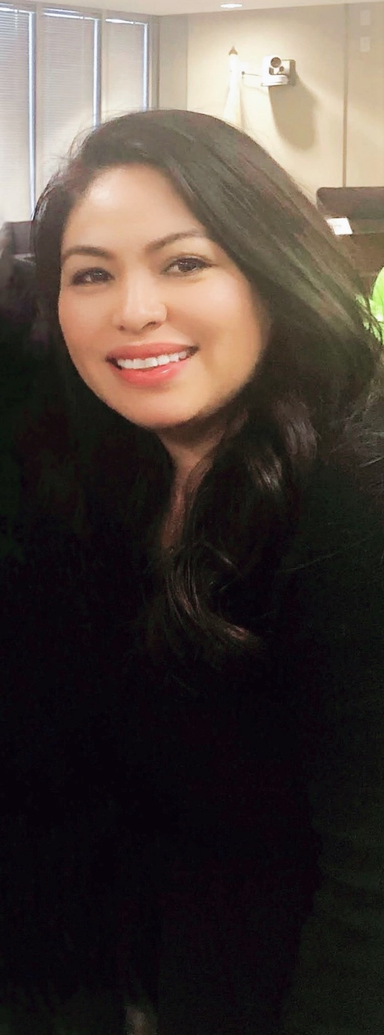
Meeting Facilitators
Teresa Palomino, Education Programs Consultant, California Department of Education (CDE)
Brian Yamamoto, Web Applications Manager, Los Angeles County Office of Education (LACOE)
Amalenalee Lule, Technology Services, LACOE

Slide 3
Meeting Agreements
Please use the chat function to enter your questions
Presentation materials will be posted to Migrant Education Program Online Systems website
MEP Online Systems

Slide 4

Outline and Objectives
  Navigating the System
  Creating a Regional Tournament
  “Student” Registration
  “Debate Team” Registration
  “Others” Registration
  Completing the Registration Process
Notes:
This webinar training provides a general overview of the Migrant Education Speech & Debate System, focusing on the following components:
Navigating the System
Creating a Regional Tournament
Student Registration
Debate Team Registration
Others Registration
Completing the Registration Process

Slide 5
Outline and Objectives (2)
  Judges Account
  Understand how to score Regional Tournaments
  Regional Tournament Reports
  Regional Tournament Check-in Functionality
  How to Register for the State Tournament
  **The term Region throughout this webinar references both Regional Subgrantees and Direct-Funded Districts
Notes:
Judges Account
Understand how to score Regional Tournaments
Regional Tournament Reports
Regional Tournament Check in functionality
And how to register for the state tournament
💡 A Quick Note
When we say "Region," we mean both Regional Subgrantees and Direct-Funded Districts—so you’re all included in this conversation!

Slide 6
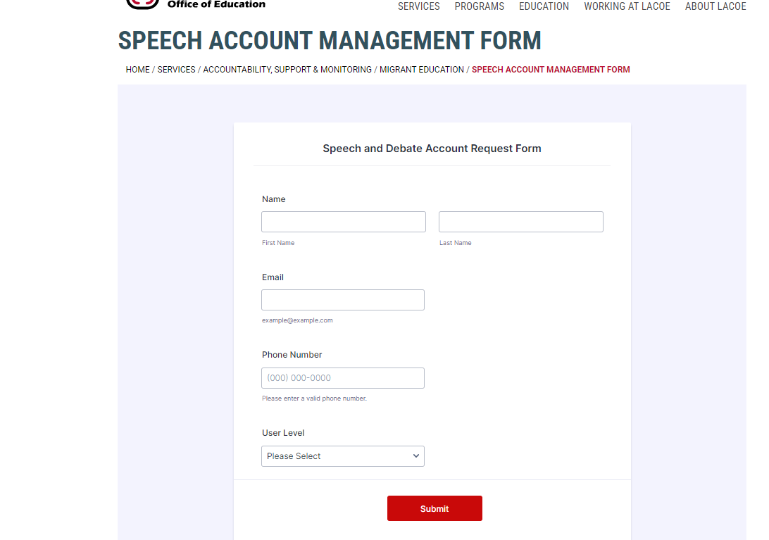
Requesting an Account
Speech Account Management Form
Notes:
Before we dive in, here’s the first step: requesting a system account. This part is just for Region Users or Tournament Administrators—the VIPs of account creation!
🛑 Who doesn’t need to fill out this form?
Judges
Students
Facilitators
Pretty much anyone else!
Don’t worry—they’ll get their accounts set up by the Region Users.
📌 How to Get Started
To access the Speech Account Management form, simply click the link on this slide.

Slide 7
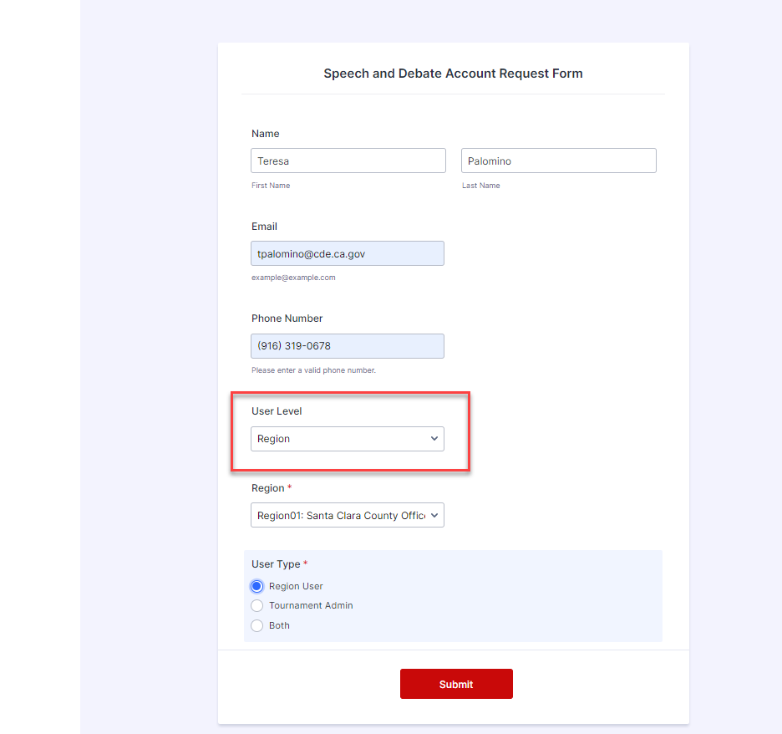
Requesting an Account (2)
Notes:
Once you’ve accessed the form, it’s time to fill in the details! Here’s what to do:
1️⃣ Enter Your Basic Info
First Name
Last Name
Email Address
Phone Number
2️⃣ Select Your User Level
Options: Region or CDE
For most of you, it’ll be Region.
When you select Region, a dropdown menu will appear—pick your Region or Direct-Funded District from the list.
3️⃣ Choose Your User Type
You’ve got three options:
Region User
Tournament Administrator
Both
What’s the Difference?
💼 Region User
Can add and manage users (district users, Region Users, Tournament Admins, and check-in users).
Handles student, judge, and “other” registrations for both Regional and State Tournaments.
Manages accounts for their Region, including creating, editing, and resetting passwords.
⚠️ Note: Region Users can only manage accounts within their own Region or County.
🎯 Tournament Administrator
Manages everything related to tournaments: creating Regions, Multi-Regions, or State Tournaments.
Can access every tab within a tournament: Check-In, Scheduling, Scoring, Reports—you name it!
Limitations: Tournament Admins cannot add users.
✨ Why Choose Both?
If you want your Tournament Admin to also handle user accounts, select “Both”—but proceed with caution.
Our recommendation? Let Tournament Admins focus on tournament creation and management, while Region Users handle account management. It’s a division of labor that keeps things running smoothly!

Slide 8
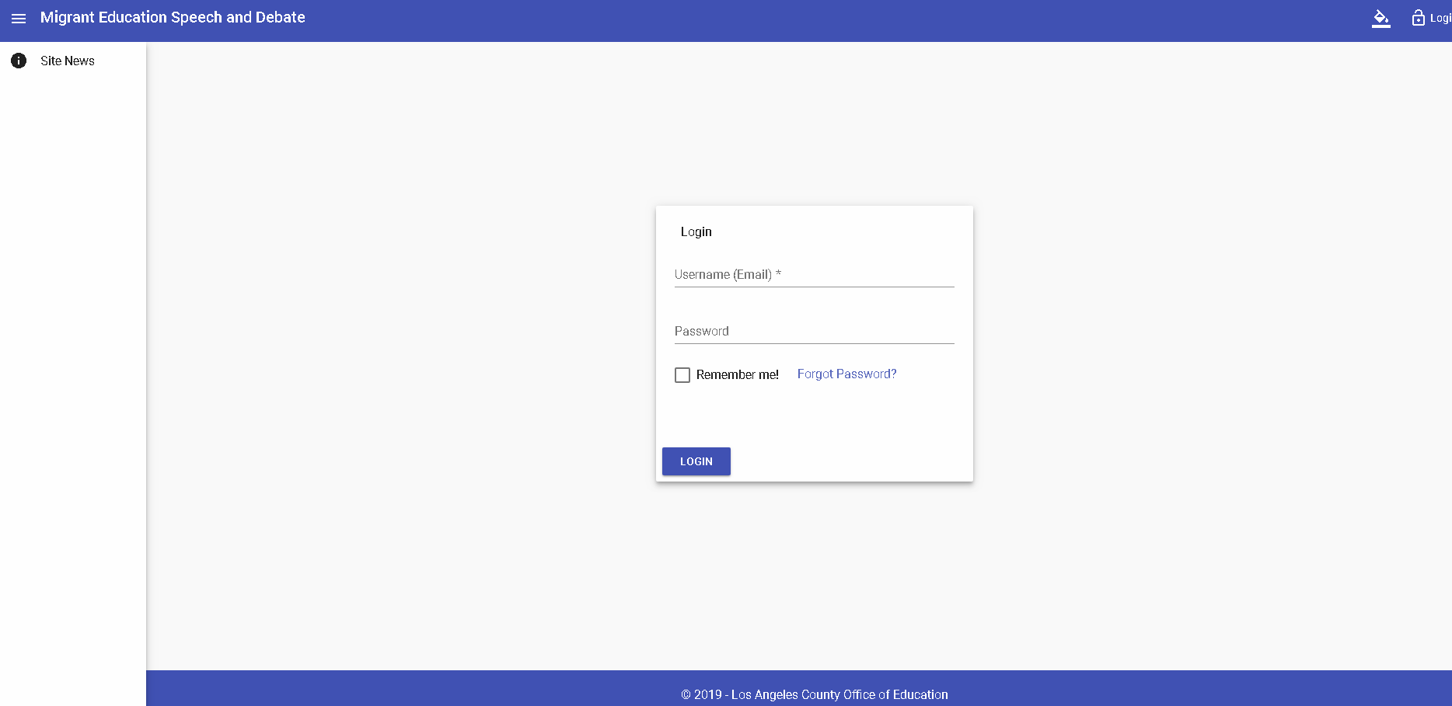
Login System Page
Login - Migrant Education Speech and Debate
Notes:
Once your account request is processed, you’ll receive an email with your login details. Here’s how to get started:
1️⃣ Use the Login Link
Click the link provided on this slide to access the system:
Login - Migrant Education Speech and Debate
🖥️ Pro Tip: Use Google Chrome for the best experience.
2️⃣ Enter Your Login Details
Username: Your email address
Temporary Password: Provided in the email
3️⃣ Create Your Unique Password
The first time you log in, the system will prompt you to change your password. Make it something unique and secure!
Need a Password Reset?
Follow the prompts to reset your password.
Temporary reset password: Test@123 (capital T).
Once logged in, you’ll be prompted again to create a new unique password.
💡 Remember: Passwords should be unique and changed regularly for best results!

Slide 9
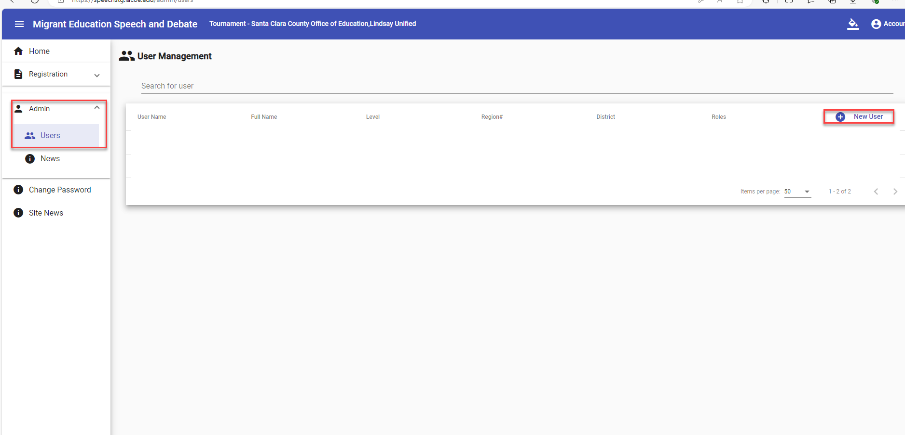
Adding Users
Notes:
Once you’re logged into the system, it’s time to set up your team. As a Region User, you have the power to add other system users. Here’s how:
1️⃣ Navigate to the Admin Tab
Look at the left-side menu and click on the Admin Tab.
2️⃣ Select ‘USERS’
Under the Admin Tab, click on ‘USERS’ to open the User Management grid.
3️⃣ What Happens Next?
The User Management grid will appear, giving you full control to add, manage, and update users for your Region.
💡 Pro Tip: Keep the system organized by ensuring only the right people have access to the right roles.

Slide 10
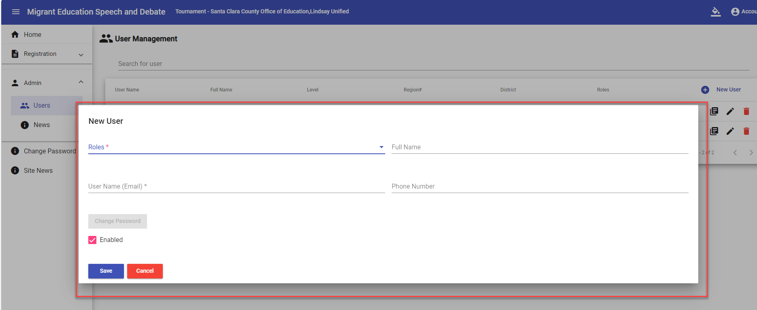
Adding Users (2)
Notes:
1️⃣ Hit ‘+ NEW USER’
In the User Management grid, look to the top-right corner and click ‘+ NEW USER’.
2️⃣ Enter the Details
A pop-up window will appear
Fill in the required information for the new user, ensuring everything is accurate.
💡 Pro Tip: Double-check the user’s details before hitting save—it’ll save you from extra clicks later!

Slide 11
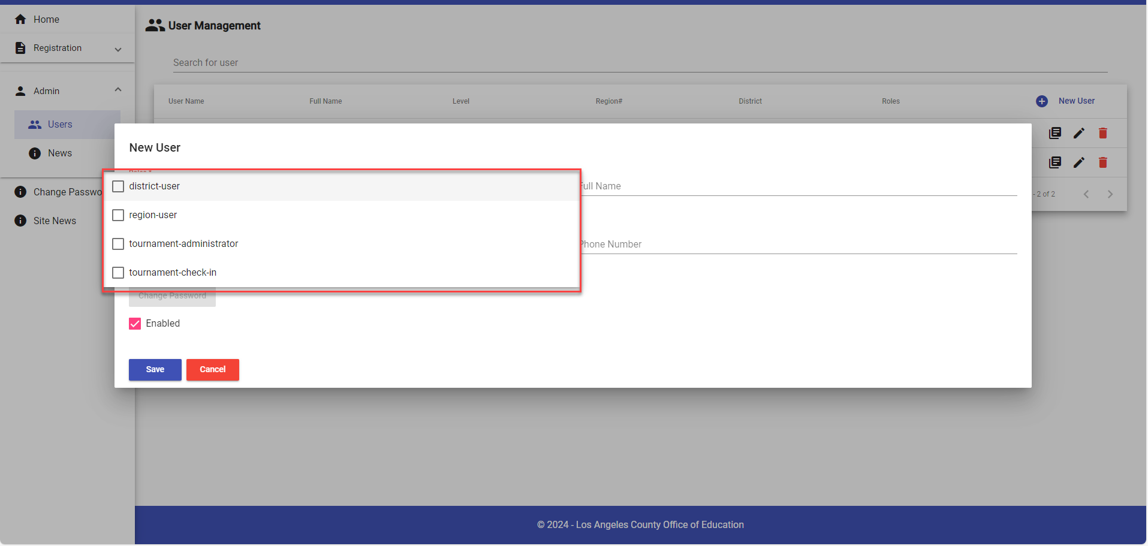
Adding Users (3)
Notes:
When adding a new user, you’ll need to assign them a role (or roles). Here’s a breakdown of your options:
Available Roles
1️⃣ District User
Registers students, “other staff,” and judges for their assigned district only.
Can register for Region/Multi-Region Tournaments but not State-level tournaments.
2️⃣ Region User
Registers students, others, and judges for Region/Multi-Region and State Tournaments.
Manages user accounts within their Region (create, edit, reset passwords).
3️⃣ Tournament Administrator
Oversees the entire tournament process for their Region.
Can create Region, Multi-Region, and State Tournaments and access all tournament tabs: Check-In, Scheduling, Scoring, Reports.
This training focuses on registration only, but they can handle the full tournament setup.
4️⃣ Tournament Check-In
Handles attendee check-ins on the day of the Regional Tournament.
Important Guidelines
⚠️ Don’t assign all roles to one user!
The only allowed combination: Region User + Tournament Administrator.
Do not mix District User with any other role.
Pro Tip:
Double-check the user’s email before saving—it becomes their Username and is essential for logging in.

Slide 12
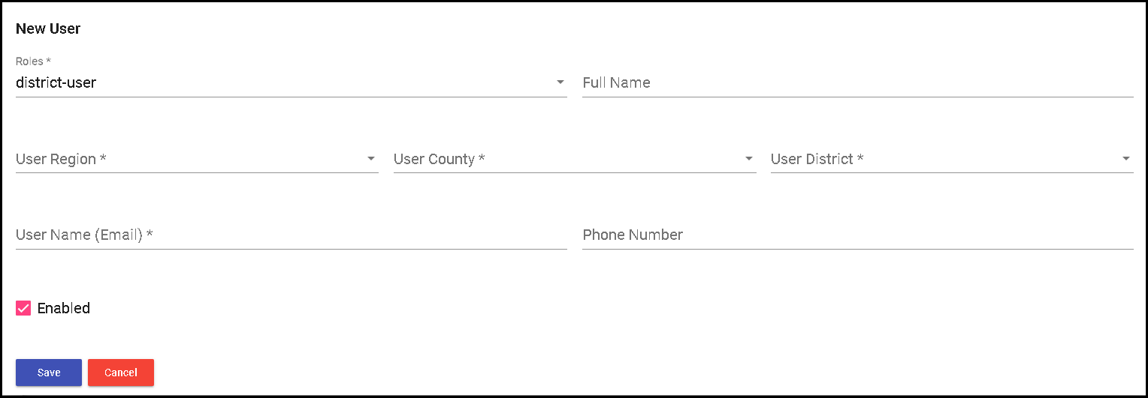
Adding Users (4)
Notes:
When selecting the District User role, you'll need to fill out these required fields:
Required Fields
User’s Region
County
District
Email Address
⚠️ Important Note:
A District User can only register students, others, and judges for their assigned district and Region’s Tournament—no state-level registration allowed.
Optional Fields
Full Name
Phone Number
The ENABLED Checkbox
The enabled checkbox is automatically selected, ensuring the user has active access to the Speech & Debate System.
💡 Pro Tip:
Double-check the email address—it becomes the user’s Username and is essential for logging in!

Slide 13
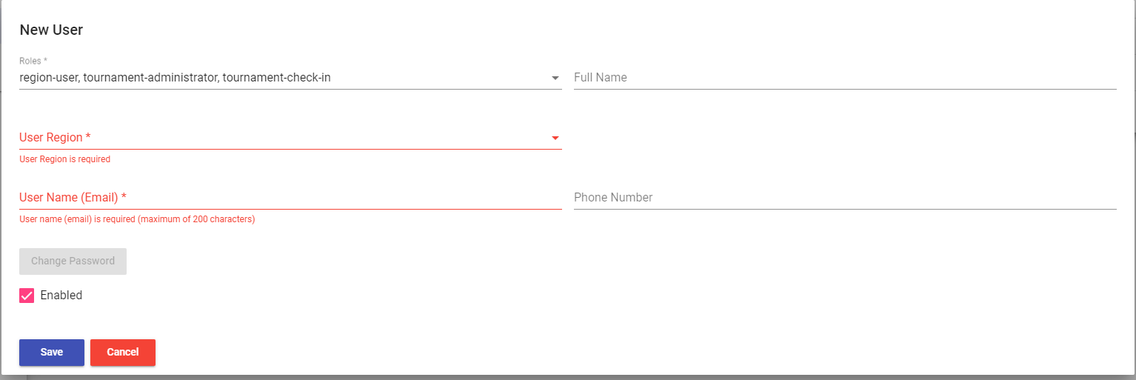
Adding Users (5)
Notes:
For Region Users, Tournament Administrators, and Tournament Check-In roles, you’ll need to enter the following required information:
Required Fields
User’s Region
User’s Email Address
Optional Fields
Full Name
Phone Number
The ENABLED Checkbox
The enabled checkbox is automatically selected, giving the user active access to the Speech & Debate System.
💡 Pro Tip:
Be sure to enter the correct email—it’s not just for communication, it’s also the user’s Username and needed for login!
What Happens Next?
Once the user is added, they’ll receive an email with detailed login instructions to get started.

Slide 14
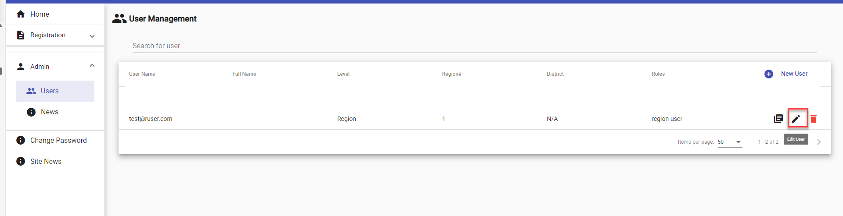
Editing Users
Notes:
If you need to make changes to a user’s account, follow these steps:
1️⃣ Select the Pencil Icon
Find the pencil icon next to the user account you want to update.
Click it to unlock the ability to edit roles and district assignments.
2️⃣ Updating Email?
If you need to change a user’s email address, you’ll have to delete the old account and create a new user account with the correct email.
The system treats each email address as a separate user, so make sure everything is accurate!
💡 Pro Tip:
Double-check the email address—you want to ensure the Username is correct for logging in.

Slide 15

Check for Understanding
True or False: All system users must use the speech account management form to create an account?
Notes:
It is time to check for understanding. Using the chat feature, please respond to the following question: True or False: All system users must use the speech account management form to create an account?
The correct answer is False. Only Region Users, Tournament Administrators, and select CDE staff should use the account management form to create an account. For all other users, accounts will be created by the Region User.

Slide 16
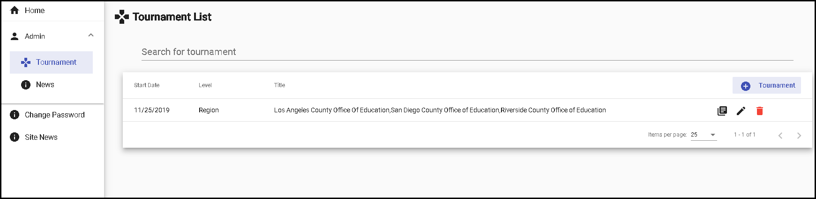
Creating a Region/Multi-Region
Tournament
Notes:
Now that you’ve added a Tournament Administrator, it’s time for them to create a tournament! Here’s how they can get started:
1️⃣ Log in and Head to Admin
The Tournament Administrator will log in to the system.
On the left column, click the Admin option.
2️⃣ Select the Tournament Option
In the Admin menu, click on Tournaments.
3️⃣ View the Tournament List
The system will display a list of tournaments the Tournament Administrator is allowed to manage.
This is where they can see all active tournaments and create a new one!
4️⃣ Create a New Tournament
To add a new tournament, simply click the ‘+ TOURNAMENT’ button in the top-right corner.
💡 Pro Tip:
The Tournament Administrator now has full access to manage Region, Multi-Region, and State Tournaments.

Slide 17
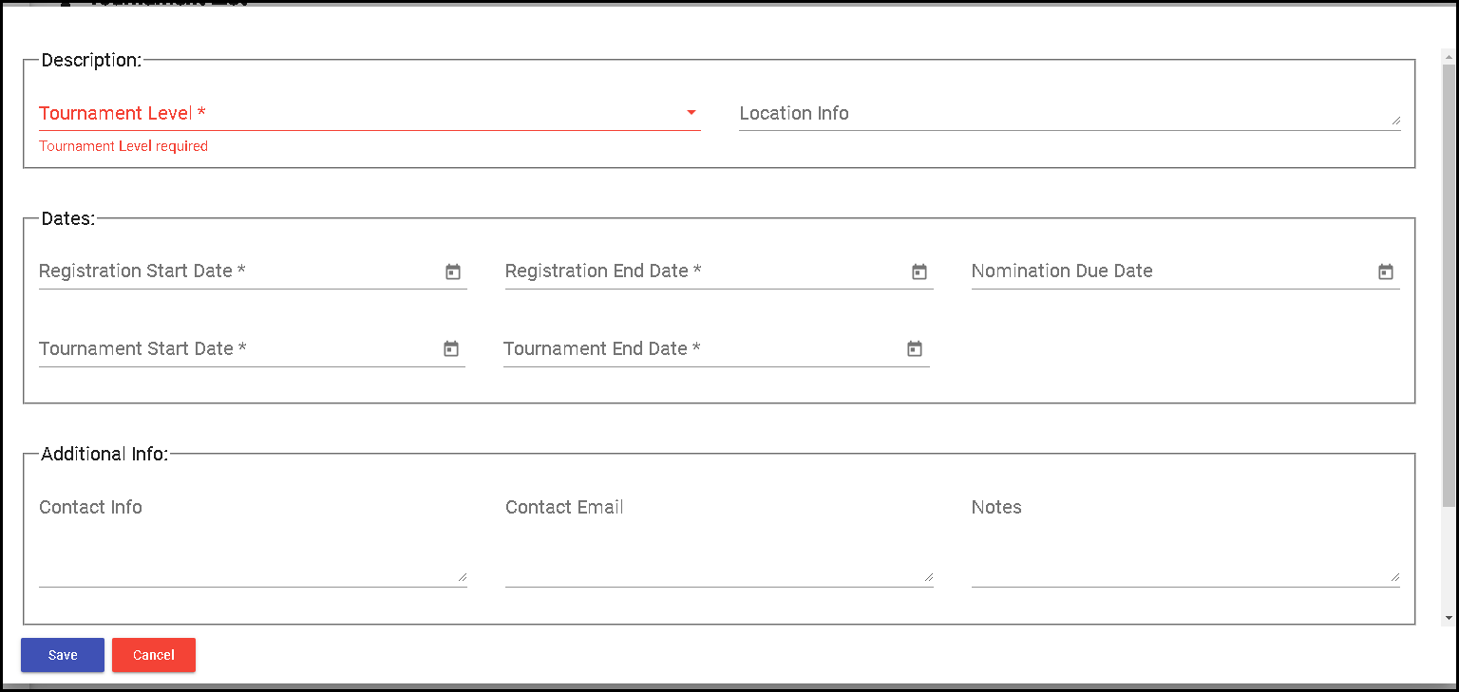
Creating a Region/Multi-Region
Tournament (2)
Notes:
Once you click the ‘+ TOURNAMENT’ button, a new screen will pop up with a few important fields to fill out.
1️⃣ Tournament Level
In the Description area, the first field you’ll see is Tournament Level.
Here’s where you decide whether the tournament is at the State Level or Region Level.
💡 Pro Tip:
Make sure to choose the correct level to ensure your tournament is classified properly!

Slide 18
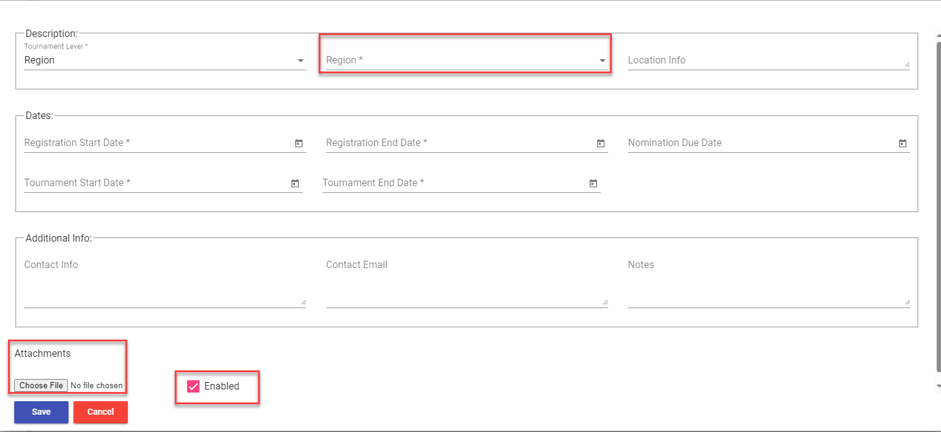
Creating a Region/Multi-Region
Tournament (3)
Notes:
1️⃣ Tournament Level & Region Selection
If you’ve selected Region Tournament:
The “Region” dropdown menu will appear.
Select one or multiple regions that will have access to registration.
This is where you differentiate between single-region and multi-region tournaments.
2️⃣ Location Information
The Location Info box allows you to enter any relevant tournament location details.
This concludes the Description section.
3️⃣ Date Fields
The Date section includes several key fields:
Registration Start Date
Registration End Date (Important! Once this date passes, registration will close for Region and District Users)
Nomination Due Date (Not required, but an optional field)
Tournament Start Date
Tournament End Date
4️⃣ Additional Information
In this section, you’ll find optional fields:
Contact Info (textbox)
Contact Email
Notes
5️⃣ Attachments Area
At the bottom of the screen, you’ll see the Attachments section.
Here, the Tournament Administrator can upload any important documents (PDF, EXCEL, WORD, JPG) that will be accessible to users within the selected Region.
6️⃣ Don’t Forget to Enable the Tournament!
To ensure the tournament shows up on users’ home pages and is available for registration, make sure to select ‘Enabled’ before finalizing.
💡 Pro Tip:
Double-check all dates and information before submitting—accuracy is key for smooth tournament management!

Slide 19
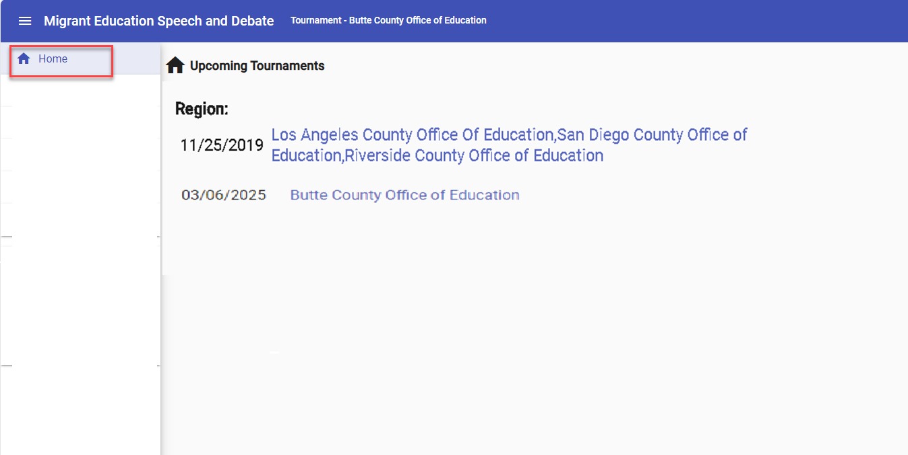
Viewing Regional Tournaments on the Home Page
Notes:
Once the Tournament Administrator has created a Region Tournament, it will automatically appear on the Home page for all users within the specified regions.
What Will You See?
Multi-Region Tournament:
The top entry represents a multi-region tournament.
Single-Region Tournament:
The bottom entry represents a single-region tournament.
(Note: These examples are for demonstration purposes only!)
Both Region Users and District Users will see the tournament listed on their own Home Pages—no extra steps needed!
💡 Pro Tip:
Keep your eye on the Home Page for easy access to all active tournaments in your region(s).

Slide 20
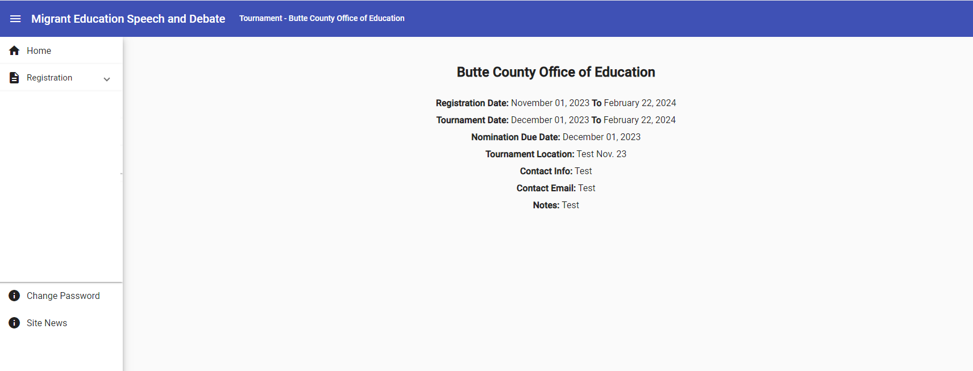
Regional Tournament Information
Notes:
Once a tournament is selected from the Home Page, the Tournament Information page will appear. (For this example, we’ve chosen Butte County Office of Education.)
What Information Will You See?
The Tournament Information page will include:
Registration Date
Tournament Date
Nomination Due Date
Location
Lodging Info (Only available for State Tournaments)
Contact Info
Contact Email
Notes
Attachments (Where you can download specific documents for this tournament—these are unique to the selected tournament)
💡 Pro Tip:
All of this information has been prepopulated by the Tournament Administrator when creating the Region/Multi-Region Tournament, so it’s ready for you to view!

Slide 21
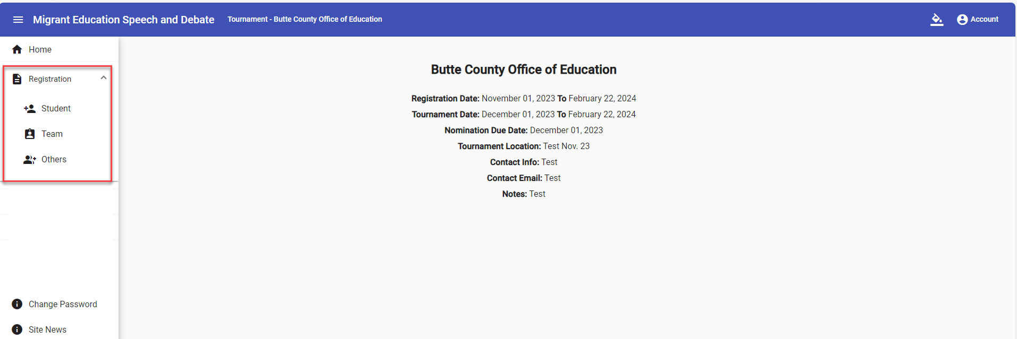
Regional Tournament Registration
Notes:
To begin, select the Registration Dropdown to kick off the registration process.
A Quick Reminder
Tournament Administrators have access to all registrations—they can manage everything!
Region Users can register participants for all districts within their assigned region.
District Users can only register participants within their own assigned district.
💡 Pro Tip:
Keep in mind your access level so you know exactly where you can register participants!

Slide 22
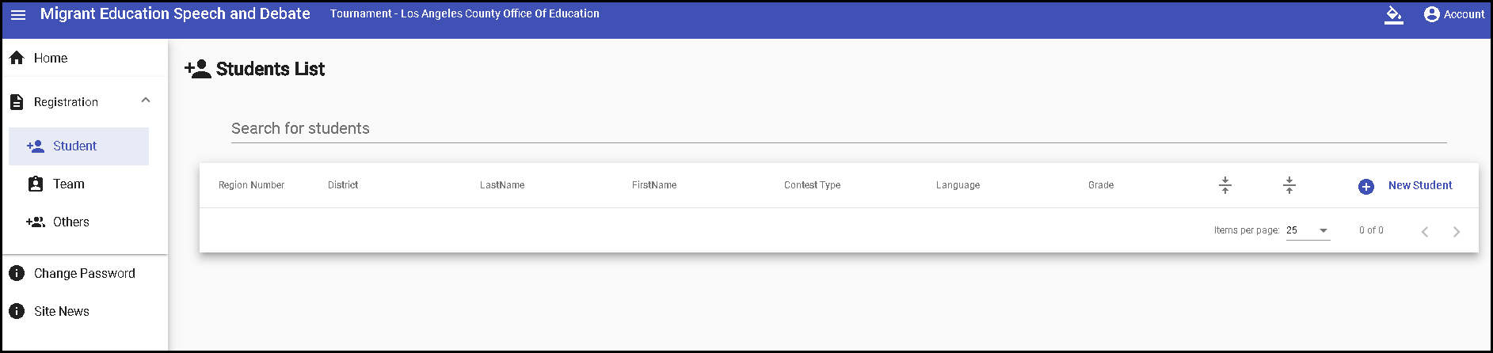
Regional Tournament Registration:
Students
Notes:
To begin Student Registration, simply:
1️⃣ Select "Student"
Click on the Registration Dropdown and choose Student.
2️⃣ Add a New Student
Hit the ‘+ New Student’ button to start adding an individual student registration.
💡 Pro Tip:
Make sure you have all the student details ready before adding them to ensure a smooth registration process!

Slide 23
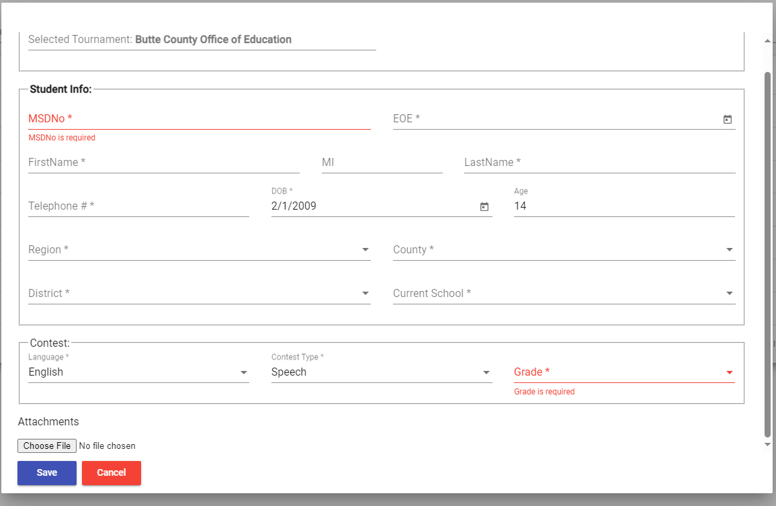
Regional Tournament Registration:
Students (2)
Notes:
Once the Student Registration Form pops up, you’ll need to fill in some essential details. Here’s what’s required:
1️⃣ Student Info Section
Make sure to complete the following required fields:
MSD Number
EOE Date
First Name
Last Name
Telephone Number
Date of Birth (the age field will auto-populate once you enter the DOB)
Region
County
District
Current School
2️⃣ Contest Area Section
Next, you’ll enter the required fields for the contest:
Contest Language (English or Spanish)
Contest Type (Debate or Speech)
Student’s Grade Level (6th–12th for Speech, Middle School or High School for Debate)
3️⃣ Scroll Down for Additional Information
Be sure to scroll all the way down to complete the additional required fields for the student registration.
💡 Pro Tip:
Make sure all fields are filled out correctly before hitting submit—double-check for accuracy!

Slide 24
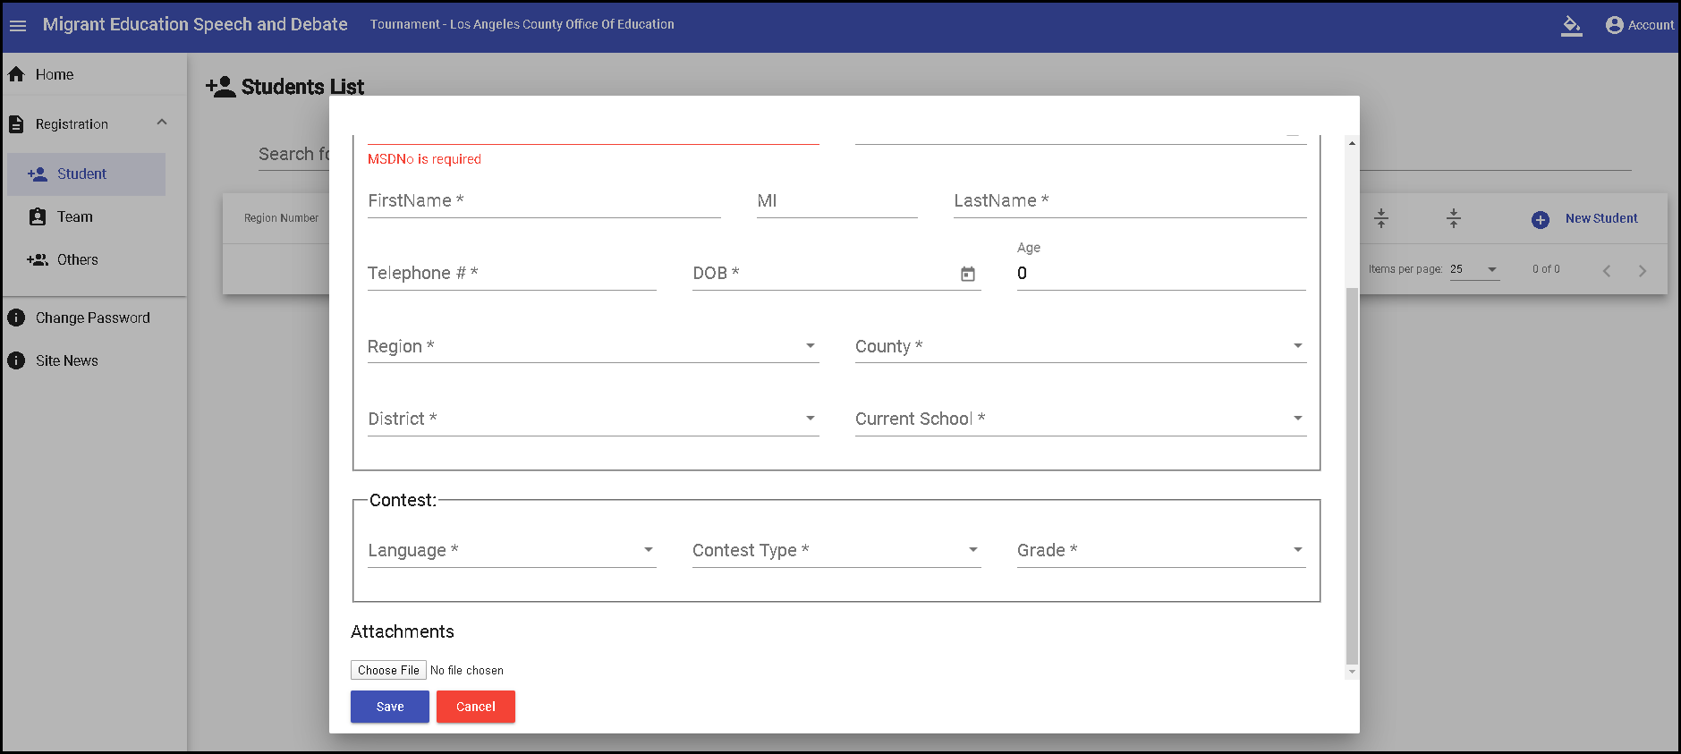
Regional Tournament Registration:
Students (3)
Notes:
At the bottom of the screen, you’ll find the Attachments section. Here, you can upload any important documents that should be accessible by other users within the selected region.
The system supports the following file types:
PDF
EXCEL
WORD
JPG
Save Your Progress
Once all the information is entered, click Save to ensure all data is properly registered in the system.
💡 Pro Tip:
Always hit Save to avoid losing any progress—your registration is now complete and ready to go!

Slide 25
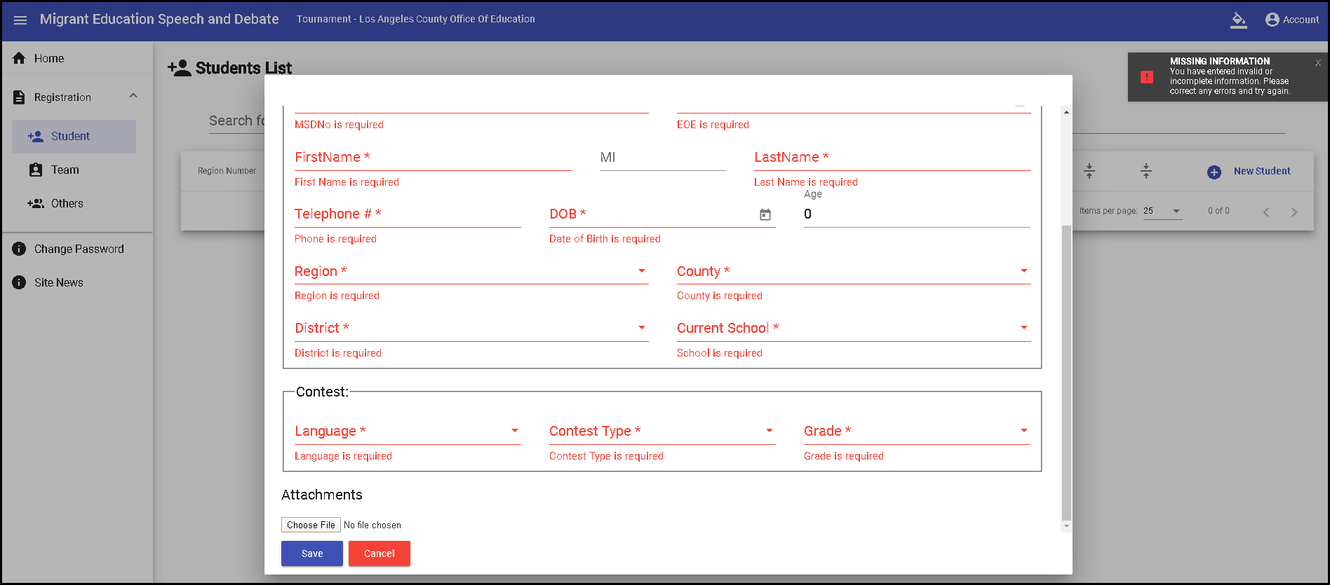
Regional Tournament Registration:
Students (4)
Notes:
Important: The system will not allow you to save a student registration if any required fields (marked with asterisks) are missing.
If any required information is incomplete, you’ll see an error warning like this:
Missing required fields will be highlighted, and the system will prompt you to fill them in before you can proceed.
💡 Pro Tip:
Double-check that all fields marked with asterisks are filled out before hitting Save to avoid error messages.

Slide 26
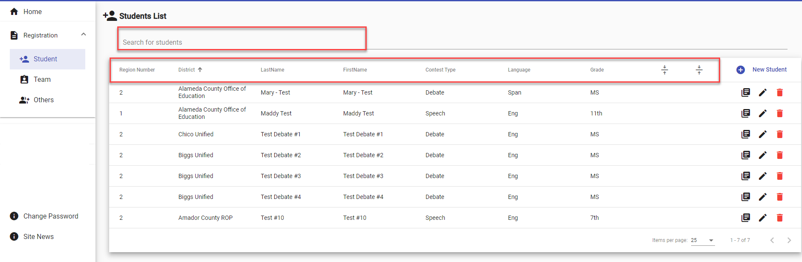
Regional Tournament Registration:
Students (5)
Notes:
Once all students have been successfully entered, they will appear in the Student List table.
What Will You See?
Region and District Users will only see students in their assigned Regional Subgrantee, Direct Funded District, or District.
The Host Region Tournament Administrator will have full access to view/edit all student registrations across all regions.
Features of the Student List
Every column in the Student List is sortable—so you can easily organize by name, district, or any other field.
Use the ‘Search for Students’ bar to quickly find specific student registrations.
💡 Pro Tip:
Sorting and searching are your best friends when managing a large number of student registrations—make the most of these features for efficiency!

Slide 27
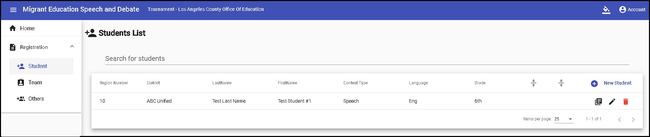
Regional Tournament Registration:
Students (6)
Notes:
To update or edit a student’s registration, simply:
Click the pencil icon next to the student’s name.
Make the necessary changes directly in the student’s form.
💡 Pro Tip:
Always double-check your edits before saving to ensure everything is up-to-date!

Slide 28
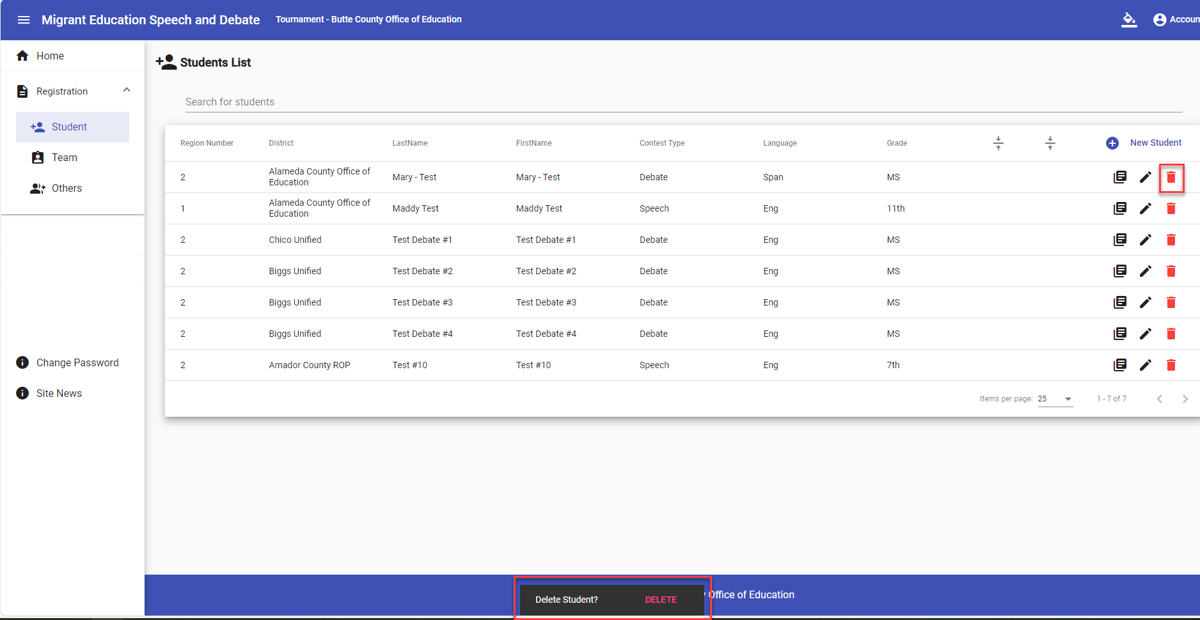
Regional Tournament Registration:
Students (7)
Notes:
To delete a student’s registration, simply:
Click the trashcan icon next to the student’s name.
A confirmation pop-up will appear to ensure you don’t accidentally delete any registrations.
Select Delete if you’re sure you want to remove the student’s registration.
💡 Pro Tip:
Always double-check before hitting Delete—once it’s gone, it can’t be undone!

Slide 29
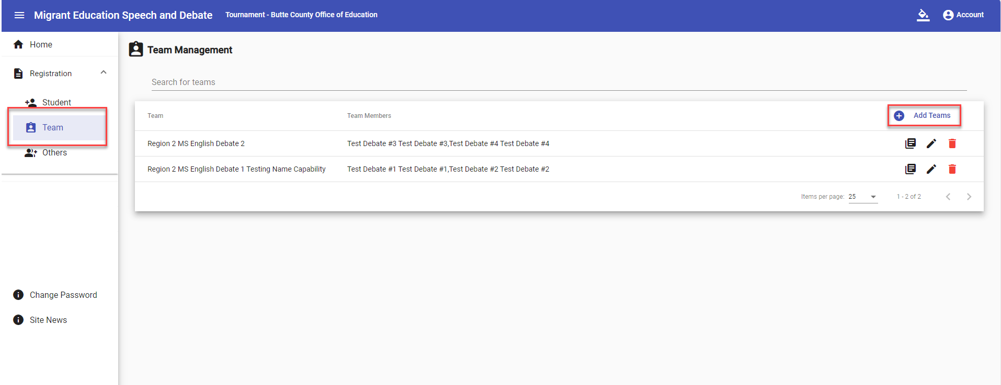
Regional Tournament Registration:
Debate Team
Notes:
Once all participating students are entered, it’s time to create the Debate Teams. Here’s how:
Select "Team" from the Registration dropdown.
Click the ‘+ Add Teams’ icon to start the Team Registration process.
Important Reminder:
Debate team registrations should only be created after all Student Registrations are complete.
The system won’t let you edit certain fields for an individual student once the team is created, such as Region Assignment, Contest Type, Language, or Grade.
💡 Pro Tip:
If a debate student drops out, don’t worry! We’ll cover how to handle this in the upcoming slide.

Slide 30
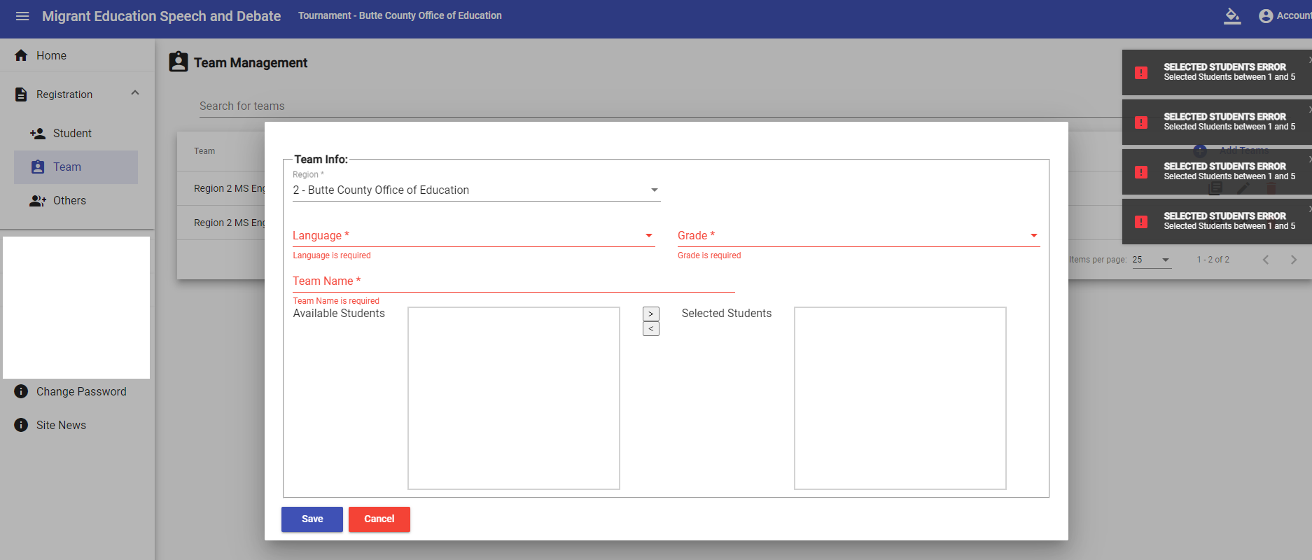
Regional Tournament Registration:
Debate Team (2)
Notes:
To create a Debate Team, you’ll need to complete these required fields:
Regional Subgrantee or Direct Funded District
Language
Grade
Team Name – The Team Name field has been updated this year, offering more flexibility and customization for regional tournaments to personalize their team names.
Important Notes:
The system will not save or populate any information if these fields are left blank.
District Users will only have access to view students in their assigned district.
Region Users have access to view all students within their assigned region.
💡 Pro Tip:
Take advantage of the Team Name update to create unique and meaningful names for your teams!

Slide 31
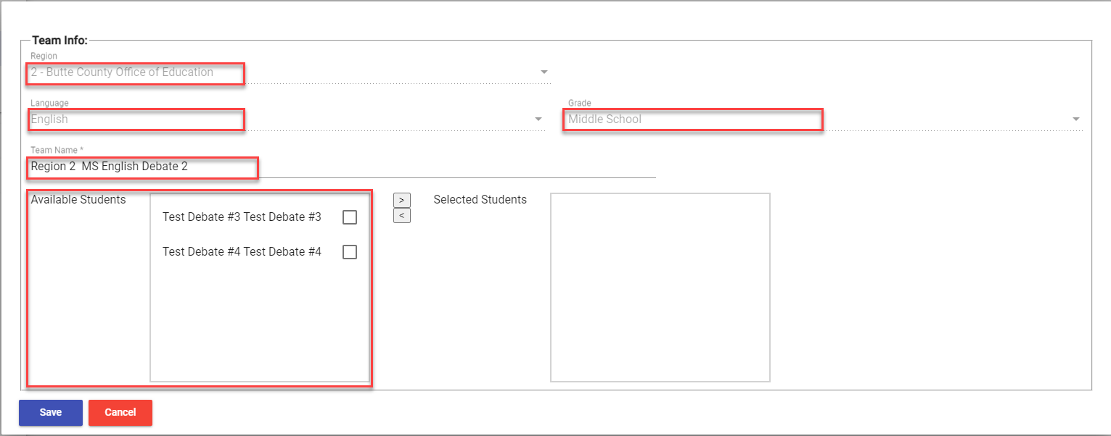
Regional Tournament Registration:
Debate Team (3)
Notes:
Once you’ve selected the Regional Subgrantee or Direct Funded District, Language, Team Name, and Grade fields, the system will automatically populate the ‘Available Students’ list with students who meet the specified criteria.
This ensures that only eligible students matching your defined parameters will be displayed, making the selection process smooth and efficient!
💡 Pro Tip:
Take a moment to double-check the Available Students list to ensure all selected students are eligible for the debate team.

Slide 32
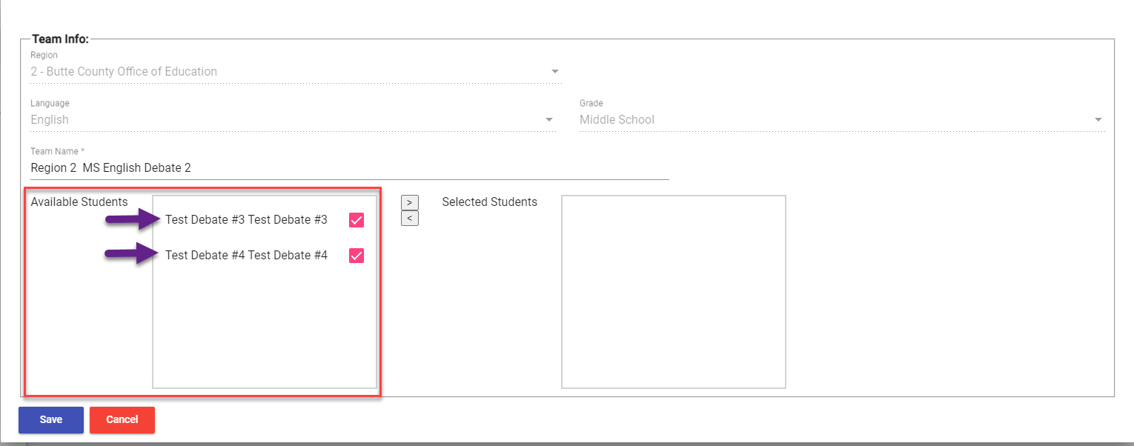
Regional Tournament Registration:
Debate Team (4)
Notes:
Individually select each student under the “available students” section, as shown in this example, this will allow you to add them to your team.

Slide 33
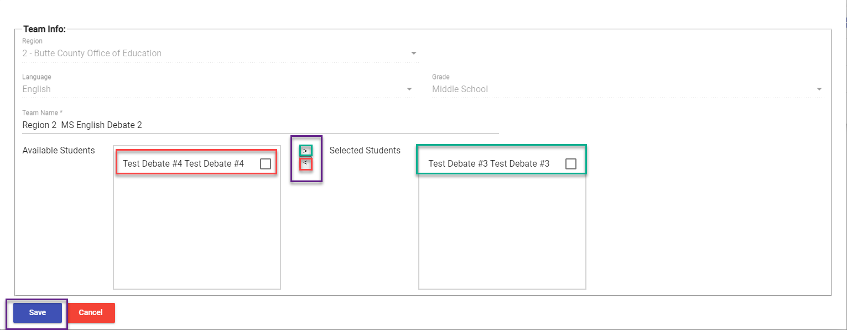
Regional Tournament Registration:
Debate Team (5)
Notes:
To manage student assignments for the Debate Team, use the following tools:
Using the Middle Arrows for Assignments
Right-Pointing Arrow (→):
Select a student in the “Available Students” box.
Click the right-pointing arrow to move them to the “Selected Students” box.
This action officially assigns the student to the Debate Team.
Left-Pointing Arrow (←):
Select a student in the “Selected Students” box.
Click the left-pointing arrow to return them to the “Available Students” list.
This action removes them from the Debate Team.
After all adjustments, click the ‘Save’ button to confirm and officially register the Debate Team. Ensure all team details are correct before saving.
Important Notes:
Handling Dropouts:
If a student drops out, use the left-pointing arrow to remove them from the Debate Team.
Once removed, navigate to the Registration – Student List and delete their registration form.

Slide 34
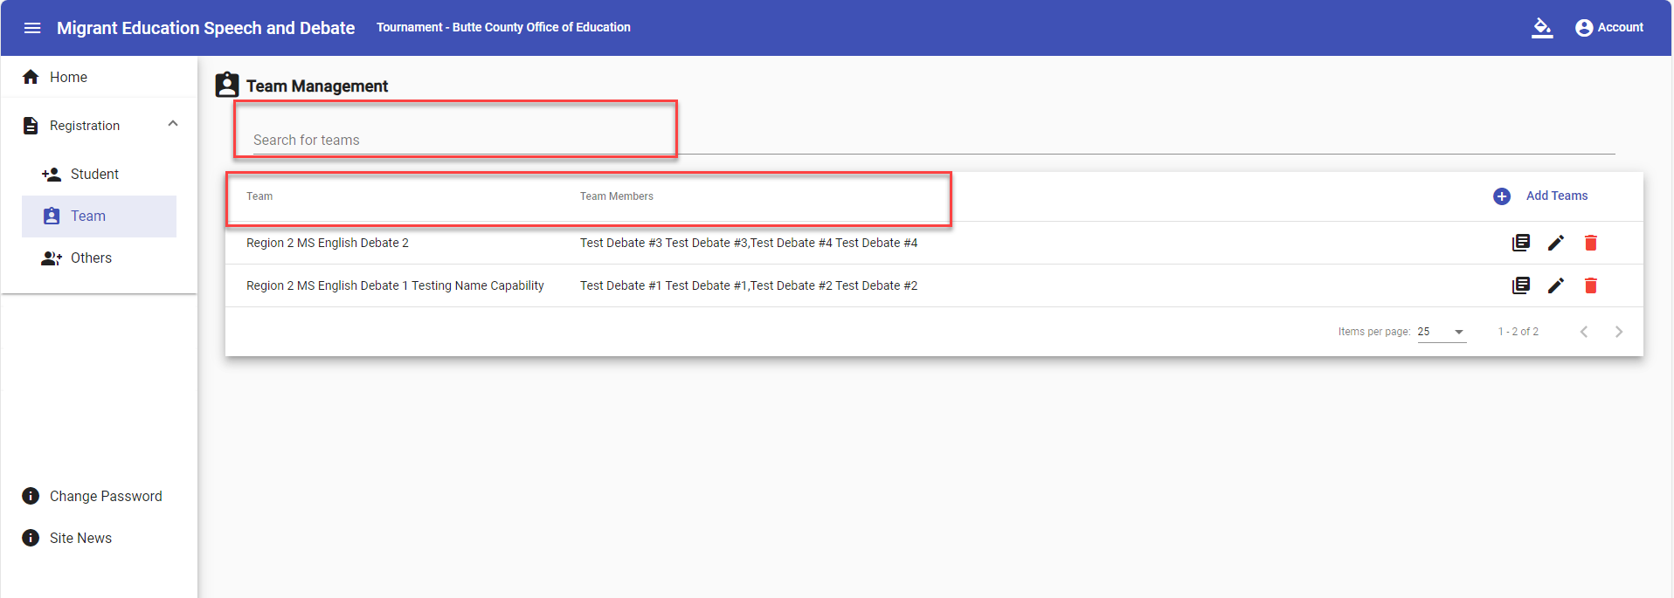
Regional Tournament Registration:
Debate Team (6)
Notes:
Once all debate teams are entered, they will appear in the Team Management table.
District Users can view teams within their assigned district.
Region Users can access all teams in their designated region.
Host Region Tournament Admins have full access to view and edit all debate teams.
To streamline navigation:
Use the sortable columns to organize the data.
The ‘Search for Teams’ bar allows quick access to specific teams.

Slide 35
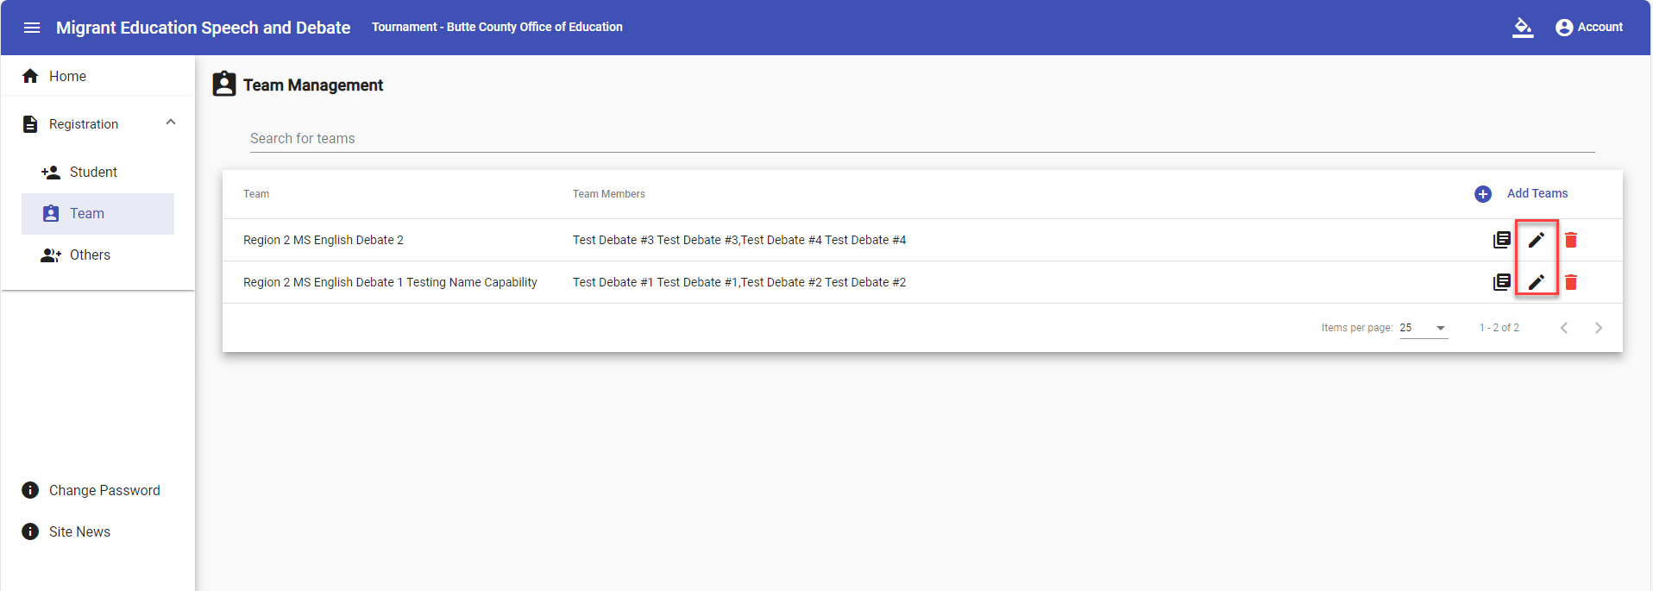
Regional Tournament Registration:
Debate Team (7)
Notes:
To edit or update a team’s registration form, simply click on the pencil icon next to the team. This will open the team’s form, where you can make any necessary updates.
Be sure to save your changes once you're done!

Slide 36
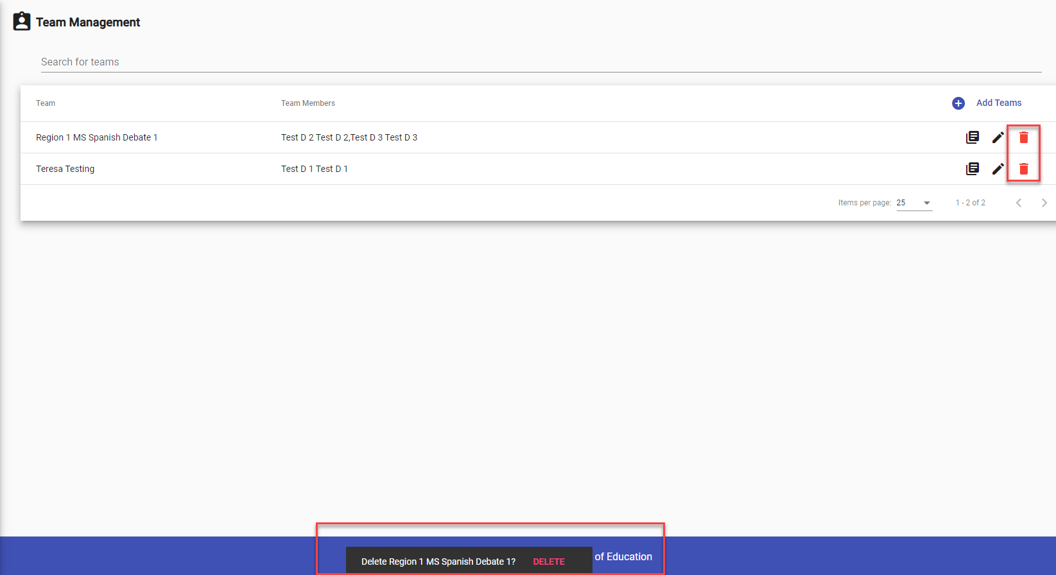
Regional Tournament Registration:
Debate Team (8)
Notes:
To remove a team’s registration form, click the trashcan icon next to the team. A confirmation pop-up will appear to prevent accidental deletions. If you’re sure about deleting the team, select Delete to proceed.

Slide 37
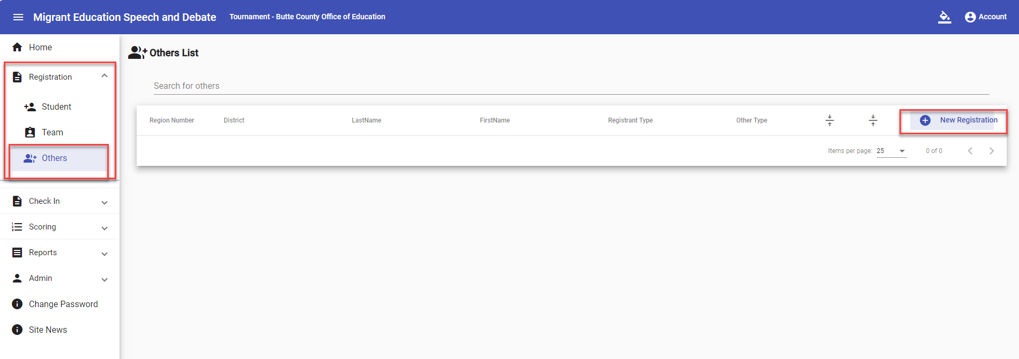
Regional Tournament Registration:
“Others”
Notes:
Registering “Others” for the Tournament
Once all debate teams are registered, it’s time to move on to individuals categorized as "Others"—judges, facilitators, additional staff, and check-in personnel.
To register "Others":
Go to the Registration dropdown menu and select ‘Others.’
Click on the ‘+ New Registration’ icon to begin adding judges, facilitators, check-in staff, or any other essential personnel.
This step ensures all tournament roles are filled and accounted for!

Slide 38
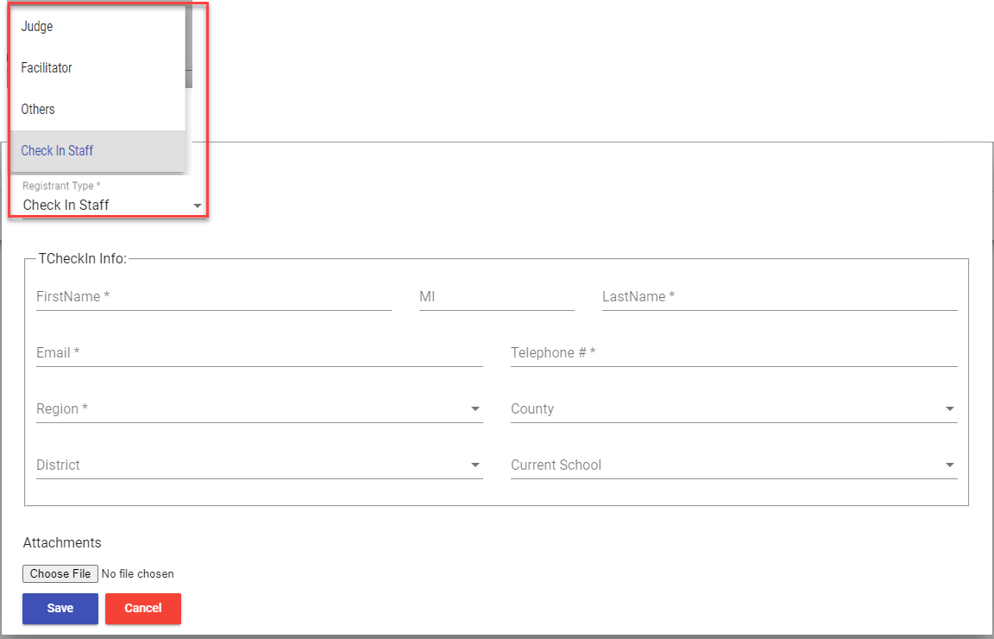
Regional Tournament Registration:
“Others” (2)
Notes:
To register judges, facilitators, check-in staff, or other key personnel:
Open the “Registrant Type” dropdown menu.
Select the appropriate category from the available options: Judge, Facilitator, Others, or Check-In Staff.
This step ensures everyone is properly categorized, streamlining assignments and tournament organization.

Slide 39
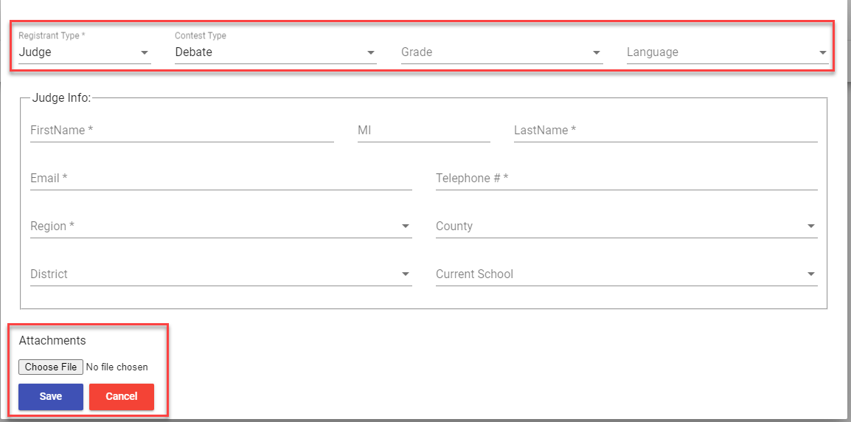
Regional Tournament Registration:
“Others” (3)
Notes:
Let’s begin by registering a Judge:
Select “Judge” under “Registrant Type.”
Once you select “Judge,” more fields will appear:
Contest Type: Choose between Speech or Debate.
Grade: Select Middle School or High School.
Language: Pick English, Spanish, or Both if you're bilingual.
Why these selections matter:
These choices are essential for the Tournament Administrator to assign Judges and Facilitators to the right rooms.
Why registering a Judge is important:
Once a Judge’s details are saved, their account is automatically created in the system. The email entered will serve as their User Name for future access.
Judges will use this account to view their scoresheets for assigned events
Double-check that all Judge information is accurate and complete during registration.
Uploading attachments:
At the bottom of the form, you’ll see an ‘Attachments’ section.
Click ‘Choose File’ to upload documents for the Judge. The system supports formats like .doc, .pdf, .xls, and more.
Final step:
Click ‘Save’ to complete the registration process and ensure all data is securely stored in the system.

Slide 40
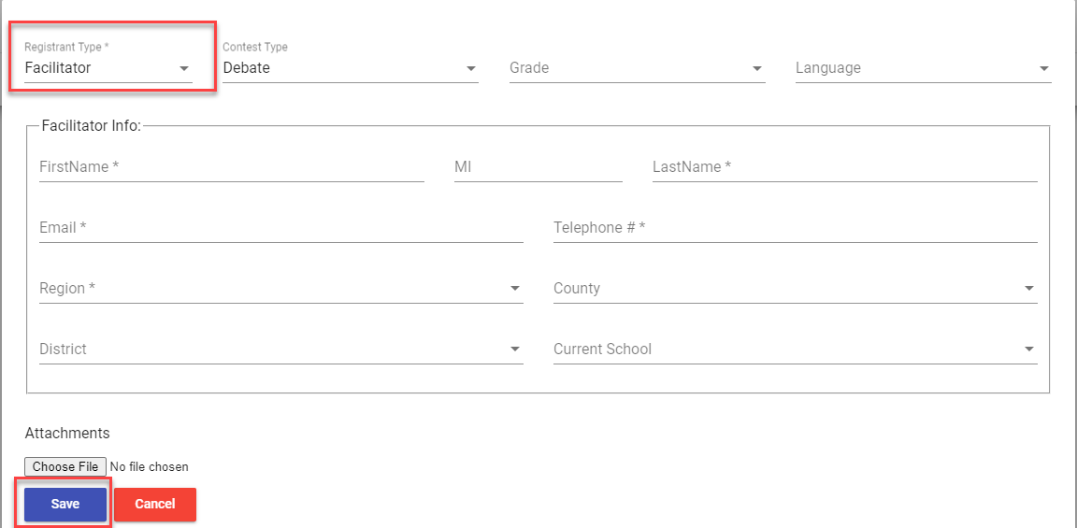
Regional Tournament Registration:
“Others” (4)
Notes:
To register a Facilitator,
Start by selecting “Facilitator” from the “Registrant Type” dropdown menu.
Enter all required information, making sure that any fields marked with an asterisk (*) are completed.
Double-check the details to ensure everything is accurate.
Click ‘Save’ to successfully record the Facilitator’s registration in the system.

Slide 41
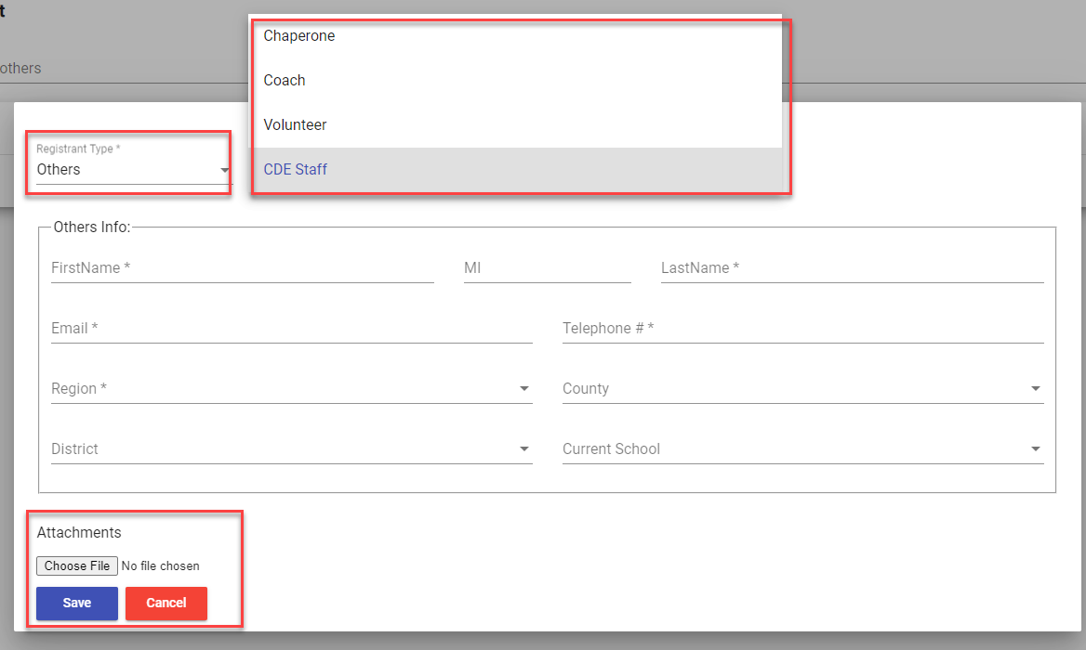
Regional Tournament Registration:
“Others” (5)
Notes:
If you select “Others” under the “Registrant Type” dropdown menu
You’ll then see the options for Chaperone, Coach, Volunteer, and CDE Staff.
Fill in all required fields, making sure to complete those marked with an asterisk (*), just like for Judges or Facilitators.
Upload any supporting documents by using the ‘Attachments’ section at the bottom of the form.
Click ‘Choose File’ to upload documents in formats like .doc, .pdf, .xls.
Click ‘Save’ to successfully register the individual in the system.

Slide 42
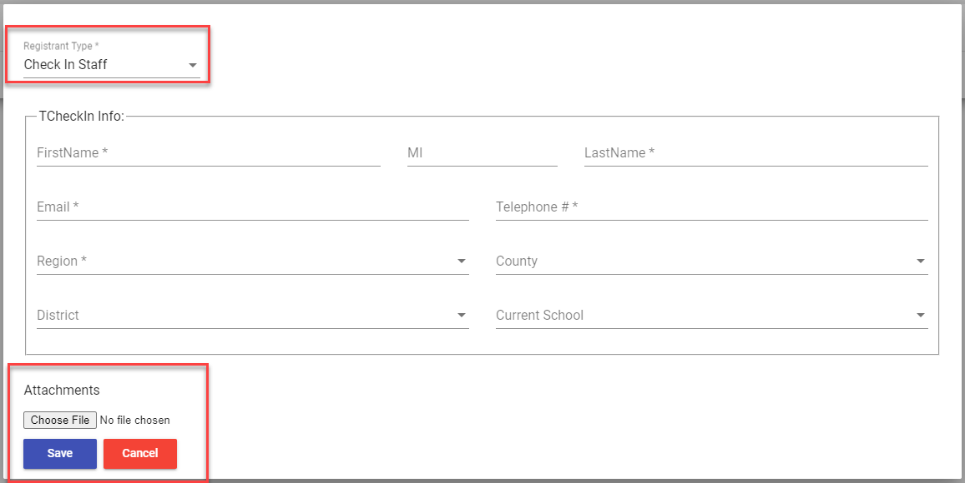
Regional Tournament Registration:
“Others” (6)
Notes:
To registering Check-In Staff:
Select “Check In Staff” from the “Registrant Type” dropdown menu.
Enter all required information, ensuring that fields marked with an asterisk (*) are completed.
Double-check the information for accuracy before proceeding.
Click ‘Save’ to successfully record the Check-In Staff registration in the system.
For a deeper understanding of the Check-In Staff role and responsibilities, refer to Slide 12. This slide provides a detailed explanation to help you grasp their function in the tournament process.

Slide 43
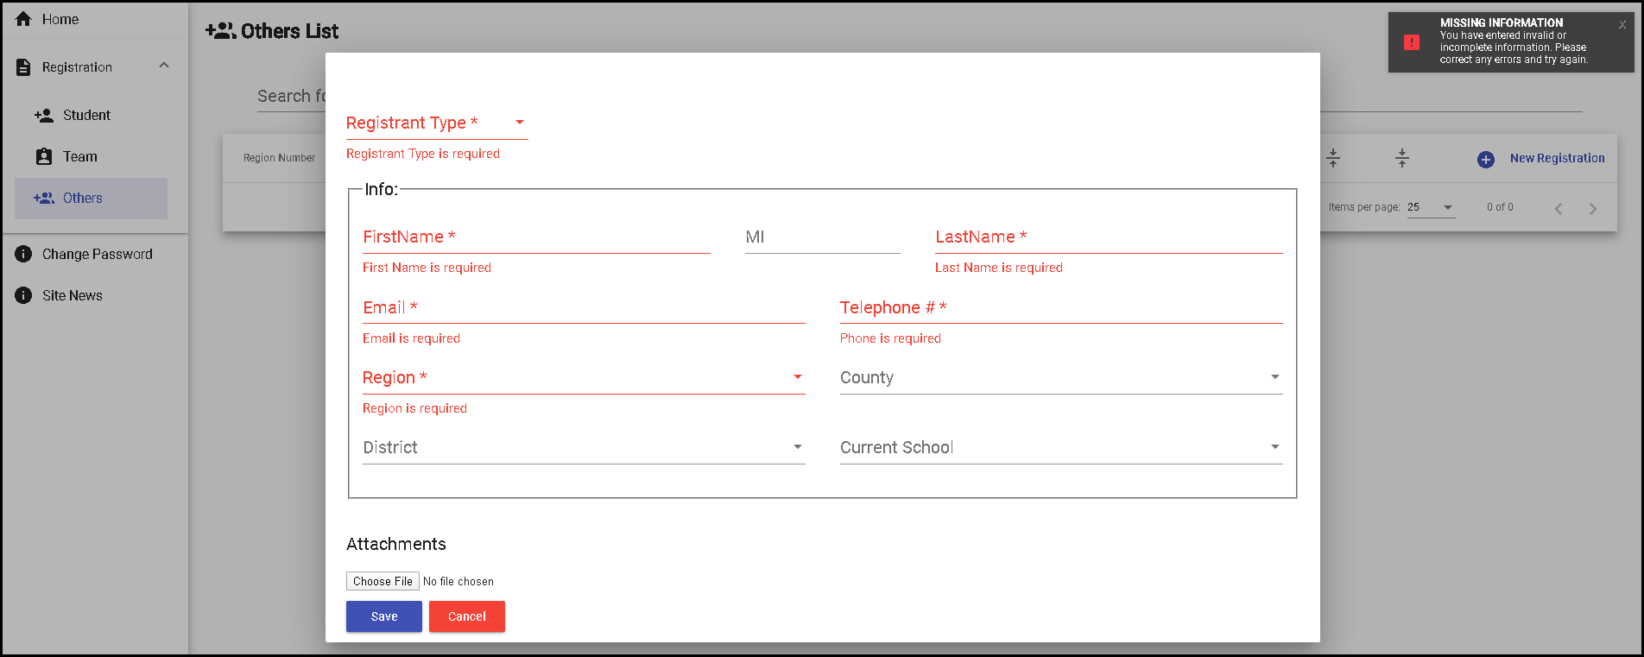
Regional Tournament Registration:
“Others” (7)
Notes:
Quick Note:
If any required information (those with an asterisk) is missing, the system won’t let you save the registrant.
You'll see an error warning like this if required fields are incomplete. Remember, those fields with the asterisk are the ones that need your attention!

Slide 44
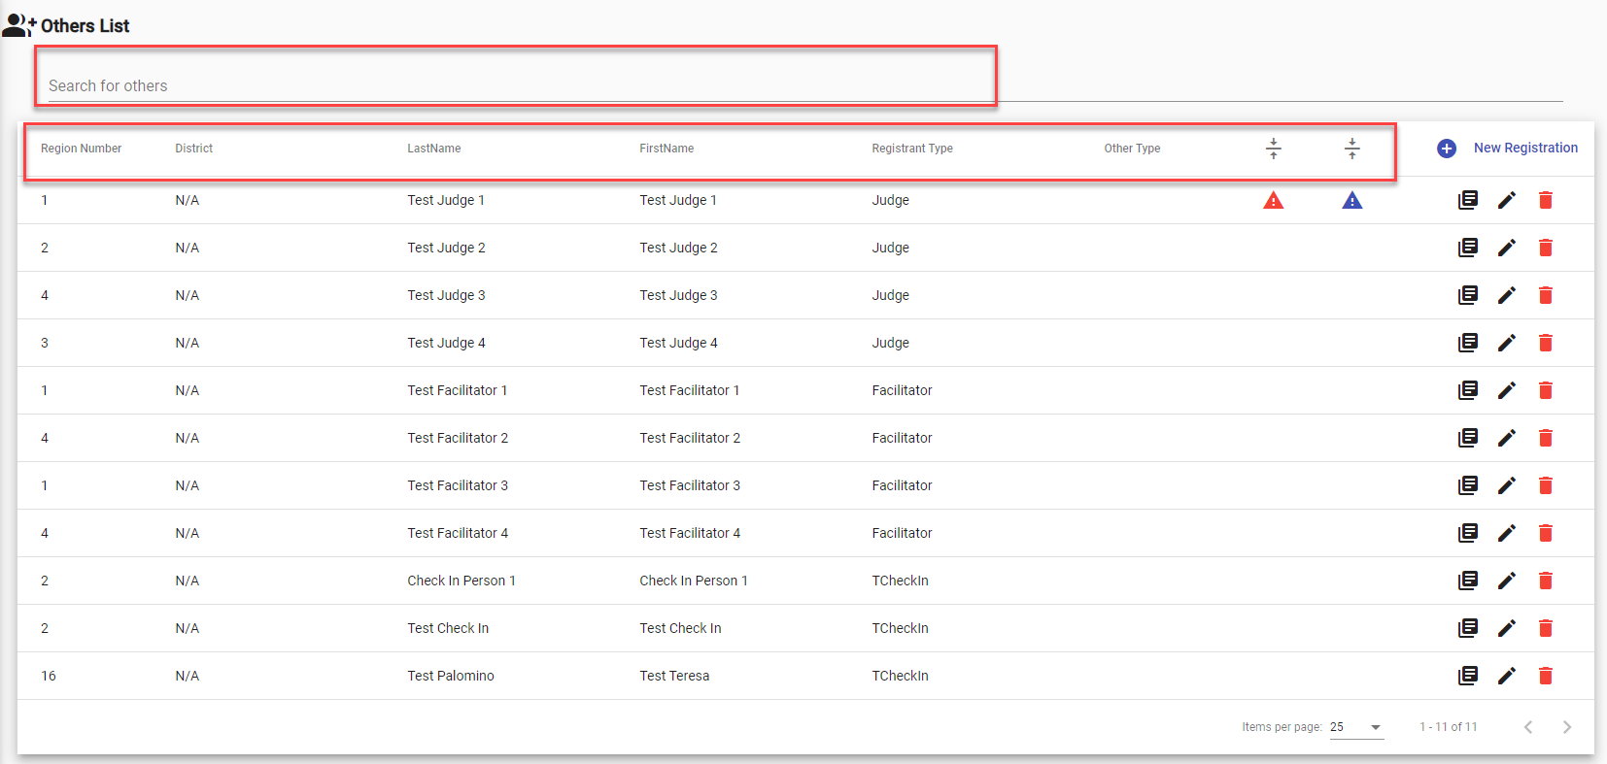
Regional Tournament Registration:
“Others” (8)
Notes:
Once all Judges, Facilitators, Others, and Check-in Staff are successfully registered, they will appear in the Others List table.
Important Note:
Users will only see the “Others” assigned to their specific Regional Subgrantees, Direct Funded Districts, or District. However, the Host Region Tournament Admin will have access to view and edit ALL “Other” registrations.
Pro Tip:
Every column in the Others List is sortable, making it easy to organize. Plus, there’s a handy ‘Search for Others’ field to quickly find specific registrations.

Slide 45
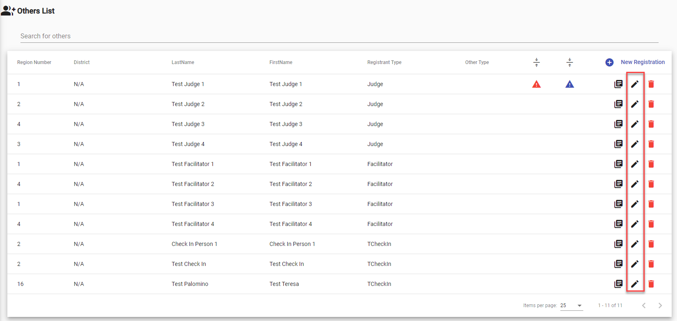
Regional Tournament Registration:
“Others” (9)
Notes:
To edit a form for a Judge, Facilitator, Other, or Check-in Staff, simply click the pencil icon next to their name. From there, you can make any necessary changes to their form.

Slide 46
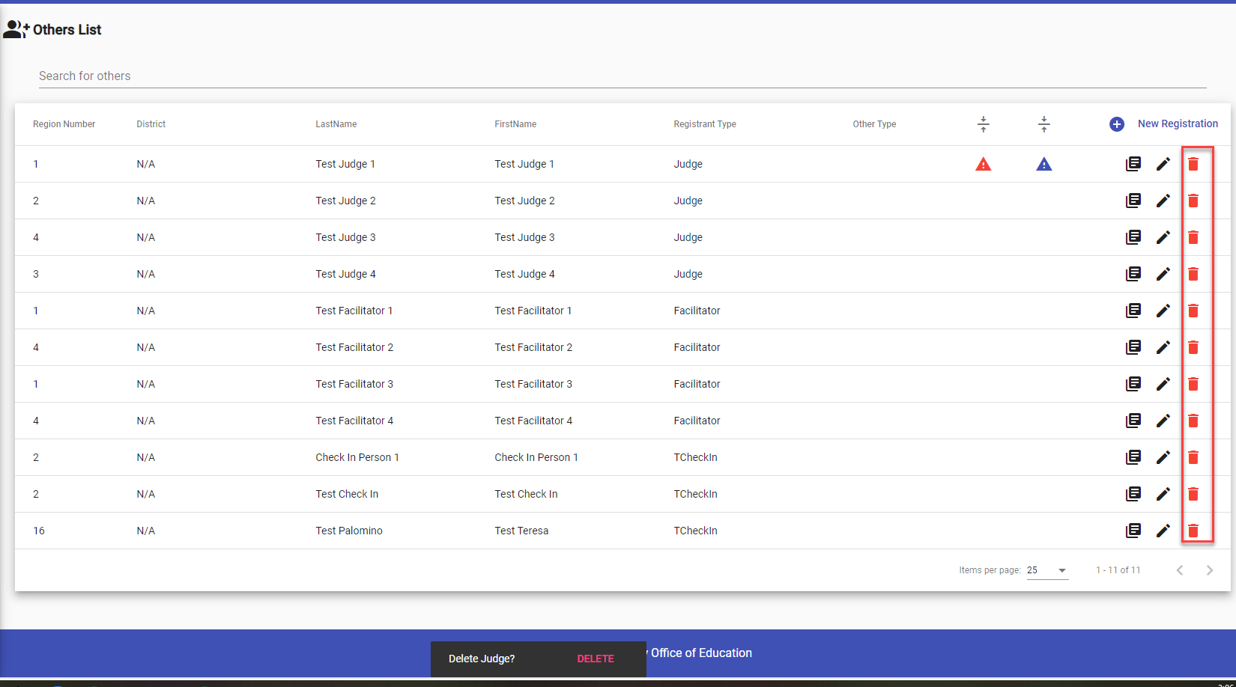
Regional Tournament Registration:
“Others” (10)
Notes:
To delete a Judge, Facilitator, Other, or Check-in Staff form, click the trashcan icon. A confirmation pop-up will appear to make sure you don’t accidentally delete any registrations.
If you’re sure, click Delete to proceed with removing the registration.

Slide 47

Regional Tournament Registration Complete!
Notes:
Once all Students, Debate Teams, Judges, Facilitators, and Others are successfully entered into the system, the Registration Process is complete!
Congratulations on finishing the registration process! 🎉

Slide 48
Check for Understanding (2)
True or False: A Region User can register debate teams prior to registering individual students?
Notes:
It is time to check for understanding. Using the chat feature, please respond to the following question: True or False: A Region User can register debate teams prior to registering individual students?
The correct answer is False. Region users must first register individual students, as the system relies on information from these registrations to create debate teams.

Slide 49

Break Time!

Slide 50
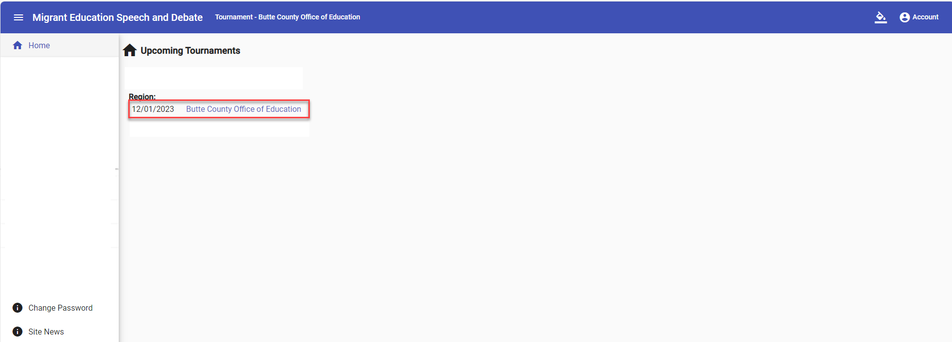
Regional Tournament: Judges Account
Judge Account
Notes:
Let’s talk about Judge Accounts:
A Region User is responsible for creating Judge accounts in the online Speech and Debate system. Once the account is created, the system will automatically send the Judge an email with their login credentials.
When the Judge logs in, they’ll only have access to the specific Region they were registered for. This ensures that Judges can only perform tasks related to their assigned Region, keeping everything organized and secure.
To access the Regional Tournament, the Judge should select the Region’s Tournament Name. For example, this Judge has access to the Butte COE’s Regional Tournament.

Slide 51
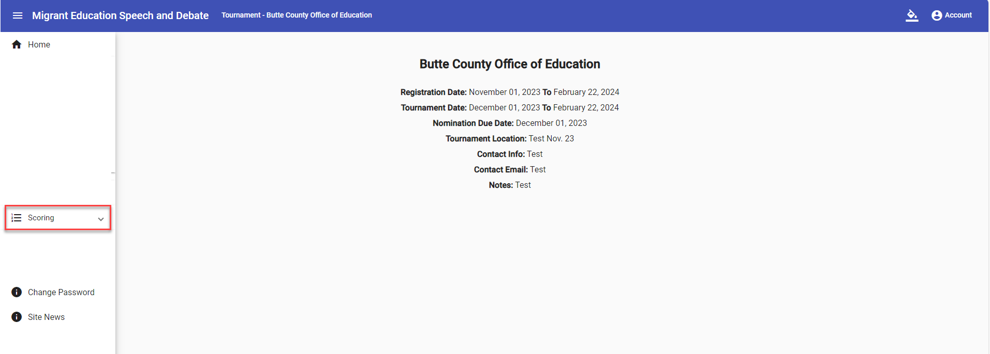
Regional Tournament: Judges Account (2)
Judge Account
51
Notes:
Once the Judge selects the tournament, they’ll be taken to the tournament’s homepage. From there, they can easily find the Scoring tab in the left-hand menu to get started.

Slide 52
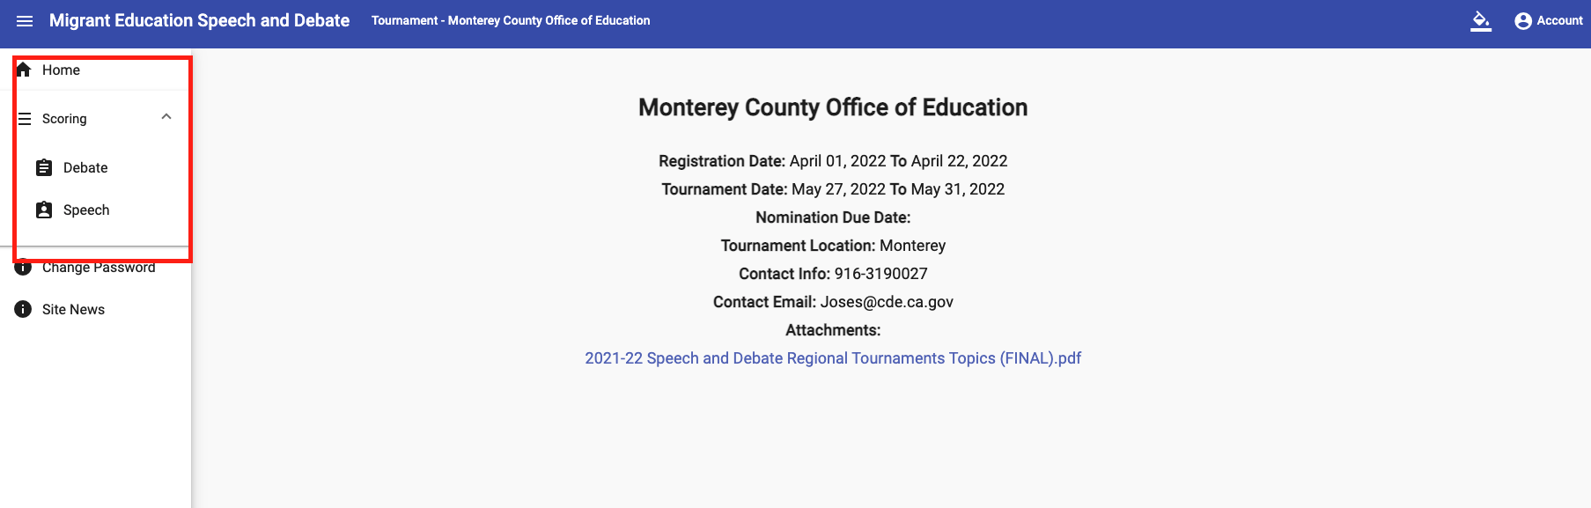
Regional Tournament: Judges Account (3)
Judge Account
52
Notes:
The Scoring tab has two submenus: Debate and Speech. Judges will need to select the correct event for scoring.
Before the tournament, the State Tournament Speech and Debate lead will notify each Judge of their assigned role, including whether they’ll be judging Debate or Speech, and whether they’ll be judging in English or Spanish.

Slide 53
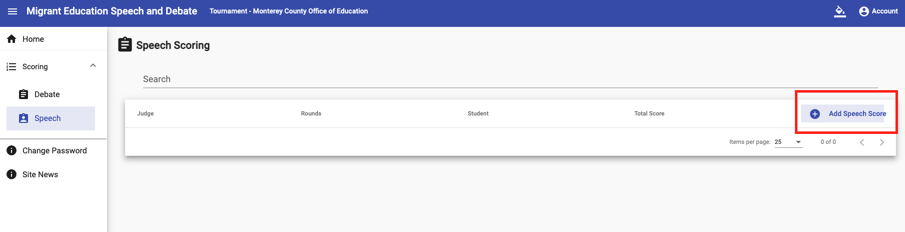
Regional Tournament: Scoring Speech
Screenshot of Region 6
12th Grade Speech Tournament
53
Notes:
Let’s dive into the Speech scoring features within a regional tournament.
First, the Speech Judge will select the ‘Speech’ submenu. Then, to begin scoring, they’ll click on ‘+Add Speech Score’.

Slide 54
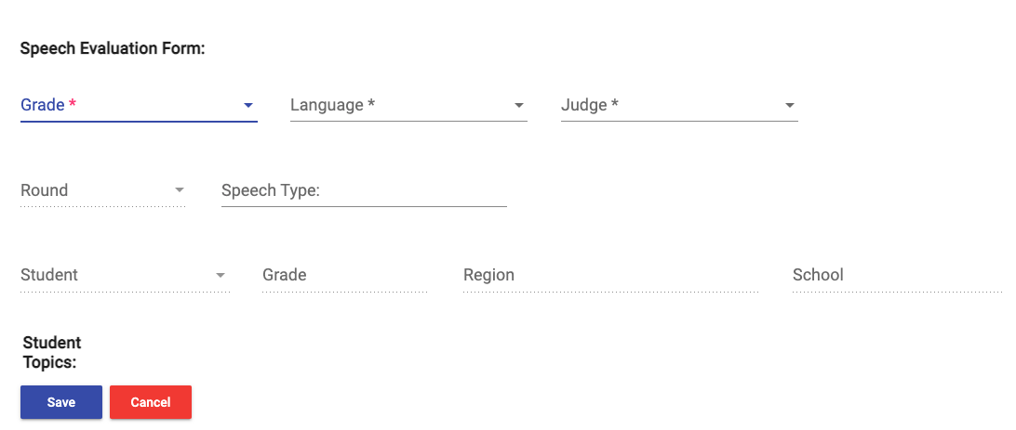
Regional Tournament: Scoring Speech (2)
54
Notes:
This is the first part of the Speech Evaluation Form that will appear on the Judge’s screen.

Slide 55
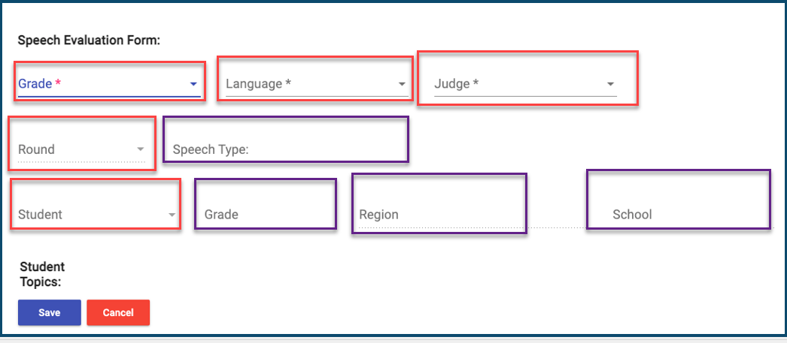
Regional Tournament: Scoring Speech (3)
55
Notes:
First, you'll need to indicate whether you're a ‘Middle School’ (6-8th grades) or ‘High School’(9-12 grades) judge. Then, choose the language you're scoring in.
Important: Only the Judge’s name associated with the scoring sheet will appear. If your name is missing, please reach out to your tournament administrator.
Next, select the round you’re scoring. For speech, there are only four rounds:
Rounds 1 and 4 are prepared speeches.
Rounds 2 and 3 are extemporaneous speeches.
Quick reminder: Subgrantees don’t need to have all four rounds to begin scoring.
Once you select the student, their information will prepopulate from their registration.

Slide 56
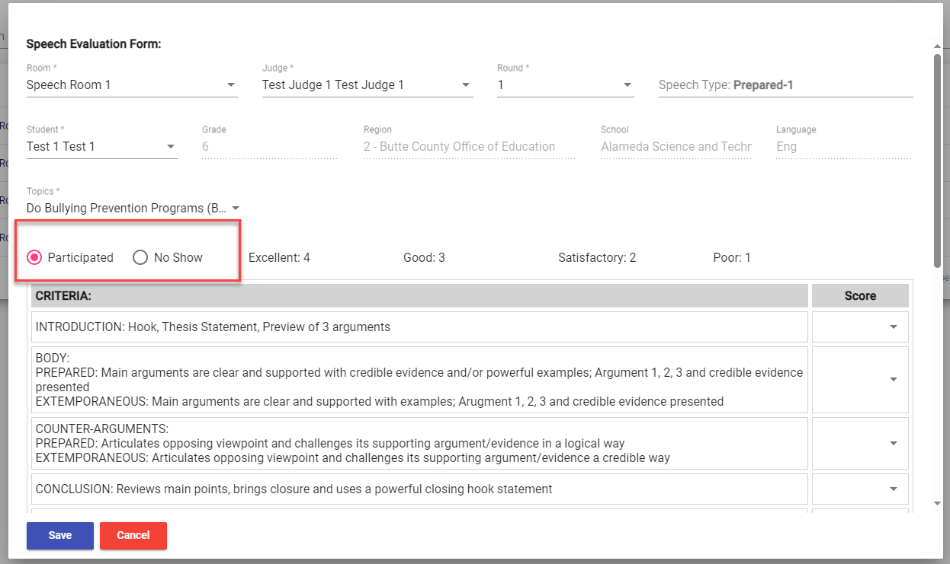
Regional Tournament: Scoring Speech (4)
56
Notes:
Next, you’ll need to indicate whether the student is participating or did not show up for this round.
If the student did not show up, simply select the "No Show" option and save the form.
If the student is participating, select the "Participated" option, and you’ll be ready to start the scoring process.

Slide 57
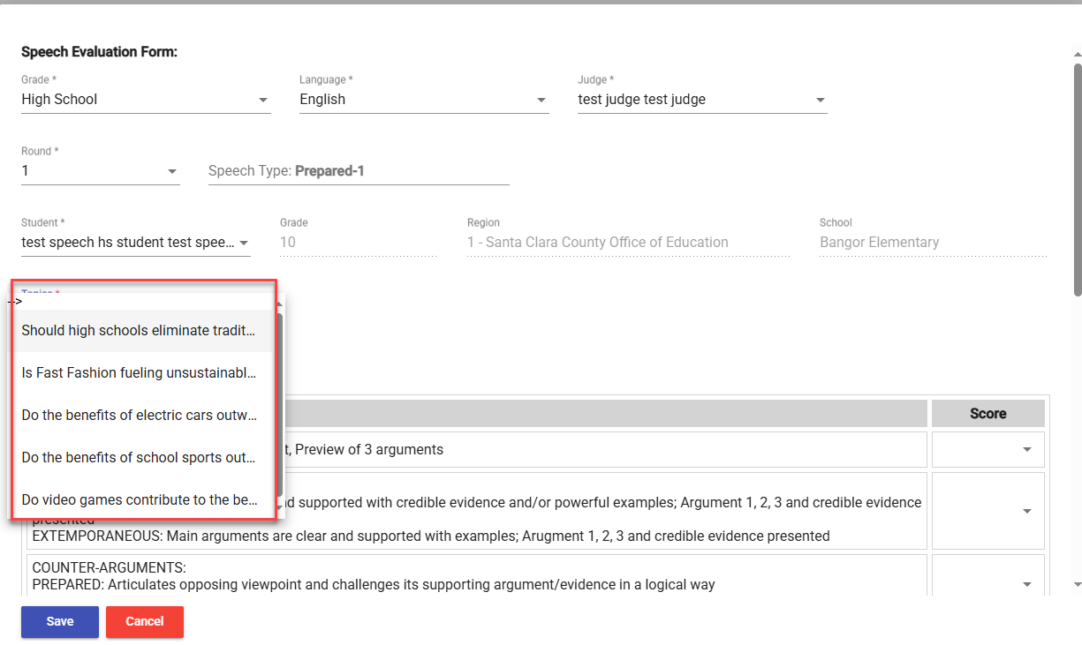
Regional Tournament: Scoring Speech (5)
57
Notes:
Next, if the round is a prepared speech round, select the topic the student has chosen. Please note that once a topic is selected, it will no longer be available for that student in the next prepared speech round.
If the round is an extemporaneous speech round, this step will not be required.

Slide 58
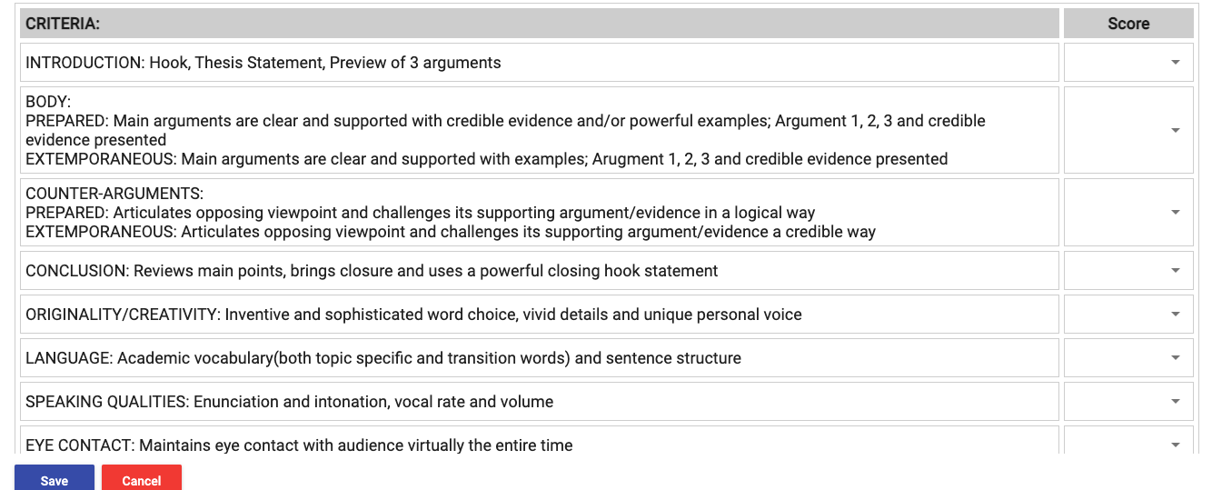
Regional Tournament: Scoring Speech (6)
58
Notes:
Once the previous information is filled out, scroll down, and you’ll see the score sheet ready for you to complete.

Slide 59

Regional Tournament: Scoring Speech (7)
59
Notes:
Next, you'll select a score for each criteria description from the dropdown menu. You can only assign 1 to 4 points for each criteria.

Slide 60

Regional Tournament: Scoring Speech (8)
60
Notes:
Once you’ve scored each criteria, the ‘Sub Total Score’ will automatically calculate. This score is before any timing penalties are applied.

Slide 61

Regional Tournament: Scoring Speech (9)
61
Notes:
Don’t worry, you won’t need to calculate any penalties yourself! However, you do need to enter the total time the student took to deliver their speech. The system will automatically check if a penalty applies.
Important: The system only accepts integers from 0 to 59 for the time entered.

Slide 62

Regional Tournament: Scoring Speech (10)
62
Notes:
Once you’ve scored all criteria and entered the time, click ‘Save’ to register the scoresheet.
Important: If any area is left blank on the scoresheet, it won’t be saved, so make sure everything is filled out before hitting ‘Save’!

Slide 63

Regional Tournament: Scoring Speech (11)
63
Notes:
After saving each speech scoresheet, your entries will appear in the "Speech Scoring" list.
As a judge, you’ll only be able to view your own scoresheets, while the tournament administrator has access to all scoresheets.

Slide 64

Regional Tournament: Scoring Debate
64
Notes:
Let’s now take a closer look at the Debate scoring features within a regional tournament.
To get started, the Debate Judge will select the ‘Debate’ submenu, then click on ‘+Add Debate Score’.

Slide 65

Regional Tournament: Scoring Debate (2)
65
Notes:
This is the first part of the Debate Evaluation Form that will appear on the Judge’s screen.

Slide 66

Regional Tournament: Scoring Debate (3)
66
Notes:
First, you’ll need to select whether you’re a ‘Middle School’ or ‘High School’ judge. Then, choose the language you’re scoring in.
Important: Only the judge’s name linked to the scoring sheet will appear. If your name isn’t listed, please contact your tournament administrator.

Slide 67

Regional Tournament: Scoring Debate (4)
67
Notes:
Next, choose the appropriate round for scoring.

Slide 68

Regional Tournament: Scoring Debate (5)
68
Notes:
Next, select a team for the affirmative position and another for the negative position. Once a team is assigned to one role, they’ll no longer be available for the other.
It’s important to double-check that this information is entered correctly!

Slide 69


Regional Tournament: Scoring Debate (6)
69
Notes:
Here’s an example of how to select teams for both the affirmative and negative positions.
Reminder: Once a team is chosen for one role, they cannot be selected for the other. It’s the judge’s responsibility to ensure this information is entered correctly.

Slide 70

Regional Tournament: Scoring Debate (7)
70
Notes:
[Teresa]
Once each team has been selected, the rest of the debate score sheet will appear, including sections for Opening Statement Time and Criteria Descriptions.

Slide 71

Regional Tournament: Scoring Debate (8)
71
Notes:
Next, enter the Opening Statement Time. The system only accepts integers from 0 to 59.
We'll go over any potential deductions in the next few slides.

Slide 72

Regional Tournament: Scoring Debate (9)
72
Notes:
Next, go through each criteria and score each team using the dropdown menu.

Slide 73

Regional Tournament: Scoring Debate (10)
73
Notes:
At the bottom of the scoresheet criteria section, the Subtotal Score will be automatically calculated by the system.

Slide 74

Regional Tournament: Scoring Debate (11)
74
Notes:
At the bottom of the scoresheet, any deductions based on the Opening Statement time will be automatically calculated, as shown on this slide.

Slide 75

Regional Tournament: Scoring Debate (12)
75
Notes:
The final ‘Total Score’ is automatically calculated based on the scores you’ve entered for each criterion, along with the Opening Statement time recorded.

Slide 76

Regional Tournament: Scoring Debate (13)
76
Notes:
The final step is to click ‘Save’ at the bottom of the scoresheet.
This is crucial to ensure your scoresheet is saved to the account.
Important: If any section of the scoresheet is left blank, it won’t be saved, so make sure everything is filled out before clicking ‘Save’.

Slide 77

Regional Tournament: Scoring Debate (14)
77
Notes:
After saving each debate scoresheet, your entries will appear in the ‘Debate Scoring’ list.
Each judge can only view their own scoresheets, while the tournament administrator has access to all scoresheets.

Slide 78
Check for Understanding (3)
True or False: A Judge will have access to the scoresheets for all students participating in both speech and debate events?
Notes:
It is time to check for understanding. Using the chat feature, please respond to the following question: True or False: A Judge will have access to the scoresheets for all students participating in both speech and debate events?
The correct answer is False. Judges will only have access to their own scoresheets.

Slide 79

Regional Tournament: Reports
79
Notes:
Now, let’s take a look at the reports available during regional tournaments.
The system automatically generates a set of reports in Excel format to help with the Regional Speech and Debate process.
Here’s a quick list of the reports you can generate:
Speech Students – Master List
Debate Students – Master List
Judge/Facilitator Assignments
Scoring Sheets – Debate
Scoring Sheets – Speech Extemporaneous
Scoring Sheets – Prepared
Important: The last two reports (Scoring Sheets – Speech Extemporaneous and Scoring Sheets – Prepared) cannot be generated until all scoring has been completed.

Slide 80

Regional Tournament: Reports (2)
80
Notes:
This screenshot shows a sample of the Speech Student Master List. It includes a comprehensive list of all speech students registered for the tournament.

Slide 81

Regional Tournament: Reports (3)
81
Notes:
This screenshot shows a sample of the Debate Student Master List. It contains a complete list of all Debate students registered for the tournament.

Slide 82

Regional Tournament: Reports (4)
82
Notes:
This screenshot shows a sample of the Judge and Facilitator List. It reflects all the assignments completed during the registration process.

Slide 83

Regional Tournament: Reports (5)
83
Notes:
In this screenshot, you can see a sample of Debate Scoring posted after 5 rounds have been completed.
There’s a maximum of 4 scoresheets per team allowed in the system, and the system automatically ranks all teams.
This report may take a few minutes to download, but it will populate by Grade and Language. You’ll receive a total of 4 reports:
Middle School English
Middle School Spanish
High School English
High School Spanish
Important: For regional subgrantee tournaments, unlike the state tournament, you do not need to meet the maximum of five rounds.

Slide 84


Regional Tournament: Reports (6)
84
Notes:
Finally, this screenshot shows Speech Scoring after all 4 rounds have been completed. The system automatically ranks students by their score.
Each list includes Grade, Language, and Contest Type. For example:
Extemporaneous Speech – Grade 10 – English
Prepared Speech – Grade 10 – English

Slide 85

Regional Tournament: Check-In Functionality
85
Notes:
Let’s shift gears and talk about Check-In functionality. Earlier, we touched on assigning staff to the check-in role. Now, let’s dive into how they’ll actually check in students and staff on the day of the tournament.
The Check-In feature is designed specifically for use on the day of the Regional Tournament. It pulls data directly from the student and judge registrant information, making the process smooth and efficient.
You’ll find the Check-In tab on the left-hand side of the interface.

Slide 86
Regional Tournament: Check-In Functionality (2)
86
Notes:
In the Check-In section, users assigned to the check-in role can easily check in students, judges, and other staff members.

Slide 87

Regional Tournament: Check-In Functionality (3)
87
Notes:
There’s also a handy ‘Search’ functionality to help you quickly locate a registrant. You can even filter by Speech or Debate event for more specific results.

Slide 88

Regional Tournament: Check-In Functionality (4)
88
Notes:
The Check-In functionality offers multiple users a visual and concise way to track who has actually arrived for the tournament on the morning of. It’s also organized by different registrant types.
Important: Multiple users can update this table simultaneously. Once a registrant has been checked in, the red box will turn blue and display ‘Checked-In’.

Slide 89

State Tournament: Registration
89
Notes:
Now, let’s shift to registering for the State Tournament. The process is similar to the registration steps for a Regional Tournament. To register for the State Tournament, the Region User will simply select the State Tournament from the home page.

Slide 90

State Tournament: Registration (2)
90
Notes:
To start the registration process, open the Registration dropdown menu:
To register students, select the Students option.
To register teams, select the Teams option.
To register staff, select the Others option.
For a detailed, step-by-step guide, please see previous slides on how to register students, teams, and staff.

Slide 91

System Resources
https://www.lacoe.edu/Technology/MEP-Online-Systems
Notes:
Here’s a screenshot of the LACOE Resources website. On this site, you’ll find a variety of helpful resources, including the recording of this presentation and a copy of this PowerPoint. The link is provided on this slide for easy access.

Slide 92
Questions about Speech and Debate? Please contact:
Teresa Palomino, Education Programs Consultant
Phone: 916-319-0678 | Email: tpalomino@cde.ca.gov
Speech and Debate Online System Service Desk
Email: MEPSupport@LACOE.edu
Notes:
If you have any additional questions, don’t hesitate to reach out to me. For specific inquiries related to the Speech and Debate system, please contact the LACOE Service Desk at MEPSupport@LACOE.edu.

Slide 93
Thank you!

