Slide 1

Social and Emotional Learning
An Introduction
Notes:
The presentation notes include general information for the presentation facilitator, recommended script in bold, and activity options in italics.
This is not a “fully scripted” presentation, so plan to prepare additional talking points, examples, and anecdotes to suit your participants.

Slide 2
FOR THE PRESENTATION FACILITATOR:
Slides 3-34 and 44-46 are intended for use with a general audience. In the speaker notes you will find recommendations for customizing learning activities for your participants.
Slides 35-43 provide four options for concluding the presentation, for participants to think about what they can do next to promote SEL. Choose the conclusion that works best and delete/hide any slides you will not use.
Notes:
Delete or hide this slide before presenting.

Slide 3

Welcome
Notes:
Take a few minutes for a welcoming activity appropriate for the group and time available. This can be as simple as turning to a partner and asking “What’s New?” But if there is sufficient time, choose a question or activity that will prime group members to learn something new, such as taking turns answering within a small group:
What is one important skill or piece of knowledge you have learned “on the job” as opposed to the coursework or training you had before you started?
If presenting to parents and caregivers, a similar question works -- What wisdom have you gained from the experience of taking care of your child, rather than what you may have read or been told?
Once participants have answered this question with a partner or a small group, ask the full group if anyone will share aloud a theme or commonality that arose from their conversation. Draw connections among responses as possible.
As your answers to this question have shown, we all continue to learn through our experiences. And [some/most/all] of what I’m hearing connects to our topic today: social and emotional learning, or SEL. Whether or not you have learned about SEL formally before, you will likely find that many of the skills you’ve gained to become an effective [list multiple roles of participants in the room] are social and emotional skills, which we all continue to develop over our lifetimes.
If you’re looking for something different to open your presentation, additional SEL-related welcome activities can be found in the SEL 3 Signature Practices Playbook:
https://schoolguide.casel.org/uploads/2018/12/CASEL_SEL-3-Signature-Practices-Playbook-V3.pdf
Why do a welcoming activity? Participants arrive with a wide range of understanding of SEL and you want to create an environment in which all feel welcome to contribute, even if they do not know much about the topic yet. You also want to connect people to one another to reduce their anxiety and create a sense of belonging.

Slide 4
Guiding Questions:
What is SEL?
Why does SEL matter?
How can schools promote SEL for students?
Notes:
These are the questions that we will be looking at together in the next [time allotted for the presentation].
Decide if you want to take participant questions along the way or at the end of the presentation and let participants know. If you have a large group, you may want to put index cards on tables so that participants can write down questions, and you can collect and answer those that are most relevant to the needs of the whole group. If participants ask questions that you don’t have an answer for, record it and get back to them.

Slide 5

What are your hopes and dreams for your child and/or the children in our community?
Notes:
In order to learn new ideas people need to care about it - it needs to be personal.
Before we get into those questions, let’s consider a more personal question. What are your hopes and dreams for the children in our community? (Adjust this question as needed, e.g. the students at this school, your children, the children you support)
Take a moment to write down 1 or 2 hopes.
…
Now turn to a nearby partner and tell them what you wrote about.
Ask participants to volunteer to share key ideas from their discussion. Record these on chart paper. If conducting this presentation virtually, use a virtual whiteboard or shared Google document for participants to share responses.
Alternative questions:
What do we want all our students to know and be able to do when they leave our school?
What do students and adults need in order to learn and thrive here?

Slide 6
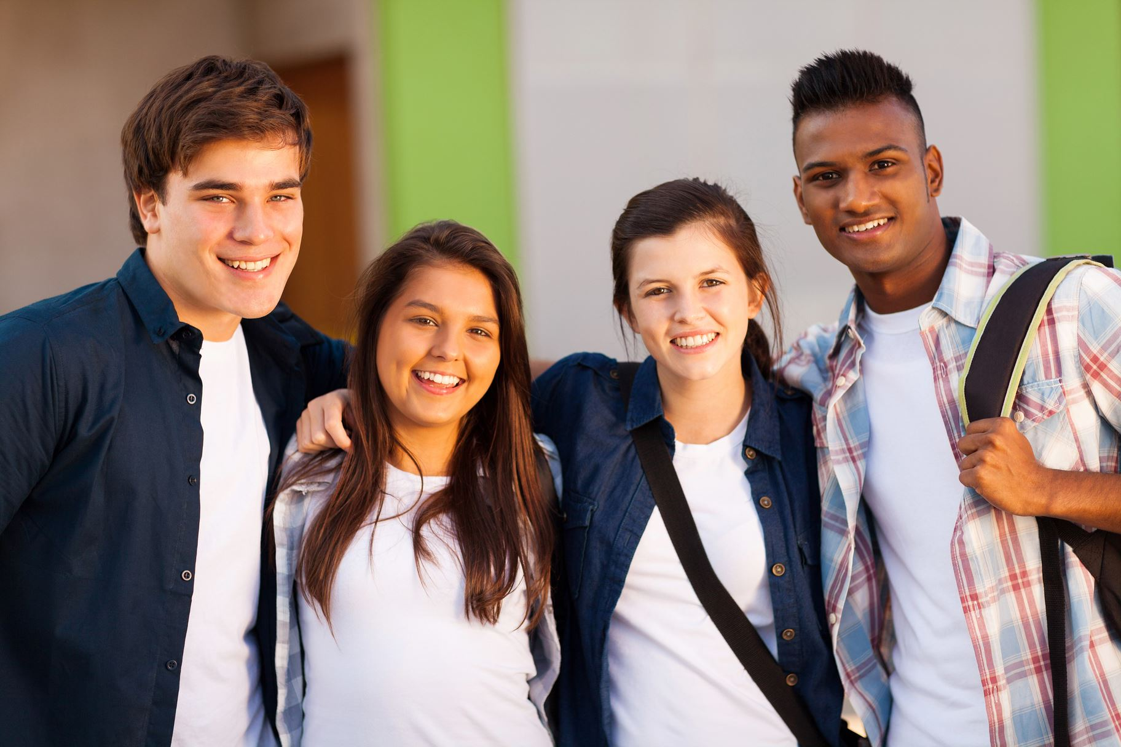
What’s possible with SEL?
Notes:
As you participate in this presentation today, I’d like you all to think about how SEL can be part of our approach to achieving those hopes and dreams. Let’s begin with a video to gain a picture of what SEL is and how it looks in a school setting.
LINK: https://youtu.be/Y-XNp3h3h4A
Watch the video linked above
In trios discuss connections between what you saw in the video and your current goals, roles, and responsibilities
Ask for a few participants to share with the group
If this video is not the right fit for your audience, there are more to choose from in our video library at https://schoolguide.casel.org/video-library/

Slide 7

WHY SEL?

Slide 8

All learning is social.
All learning is emotional.
Notes:
What does this statement mean to you?
Have several participants answer the question aloud.
Draw connections from participant responses to what research shows on the following slide.
Possible responses:
Students can’t learn when their social and emotional needs aren’t met.
Students learn not just through lesson delivery, but through the interactions they have with teachers and peers.
Students who have positive relationships with teachers are more likely to learn from them.
In order to learn, students need to have self-awareness, self-management, social awareness, relationship skills, and responsible decision-making skills

Slide 9
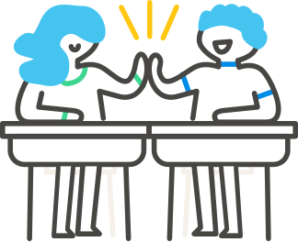

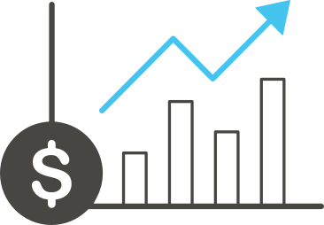
Improvement in students’ social and emotional skills, attitudes, relationships, academic performance, and perceptions of classroom and school climate
Decades of
research studies demonstrate the following benefits….
Decline in students’ anxiety, behavior problems, and substance use
Long-term improvements in students’ skills, attitudes, prosocial behavior, and academic performance
Wise financial investment according to cost-benefit research
Notes:
There’s clear evidence that when students participate in school-based SEL programs, they are more likely to do better in school and beyond school in the long term.
If you would like to include more detail in your presentation about the research supporting SEL, see CASEL’s other foundational presentation The Case for SEL, https://schoolguide.casel.org/resource/the-case-for-sel/

Slide 10

SEL is relevant for all students in all schools and affirms diverse cultures and backgrounds.
SEL is a strategy for systemic improvement and not just an intervention for at-risk students.
SEL is a way to uplift student voice and promote agency and civic engagement.
SEL supports adults in strengthening practices that promote equity.
Districts must engage students, families, and communities as authentic partners in social and emotional development.
SEL as a Lever for Equity
Notes:
SEL also matters for equity. Systemic implementation of SEL both fosters and depends on an equitable learning environment, where all students and adults feel respected, valued, and affirmed in their individual interests, talents, social identities, cultural values and backgrounds.
While SEL alone will not solve longstanding and deep-seated inequities in the education system, it can help schools promote understanding, examine biases, reflect on and address the impact of racism, build cross-cultural relationships, and cultivate adult and student practices that close opportunity gaps and create a more inclusive school community.
Ask participants to discuss:
What are some of the things that are happening in our community that are helping students get what they need to succeed?
In what ways could SEL help us create a more supportive, more inclusive school environment that works for every student?
If participants have difficulty with this question, return to it again later after showing the video of Marcus Garvey Elementary later in the session.

Slide 11

WHAT IS SEL?

Slide 12


Social and emotional learning (SEL) is an integral part of education and human development. SEL is the process through which all young people and adults acquire and apply the knowledge, skills, and attitudes to develop healthy identities, manage emotions and achieve personal and collective goals, feel and show empathy for others, establish and maintain supportive relationships, and make responsible and caring decisions.
SEL advances educational equity and excellence through authentic school-family-community partnerships to establish learning environments and experiences that feature trusting and collaborative relationships, rigorous and meaningful curriculum and instruction, and ongoing evaluation. SEL can help address various forms of inequity and empower young people and adults to co-create thriving schools and contribute to safe, healthy, and just communities.
SEL is…
casel.org
Notes:
Depending on the background knowledge of your group, select one of these options for engaging with the CASEL SEL definition:
Read the definition aloud. Pause. Ask participants to think and select a word or phrase that resonates with them today. Think silently why they selected that word/phrase. Turn and share in partners. At the end of 3 – 5 minutes ask for a few participants to share out (no more than 3). When one person shares out a word/phrase ask if any others selected the same one. This builds a sense of community and shared experience without taking time for everyone to share out loud.
If participants are familiar with CASEL’s definition of SEL from past work, you might extend/exchange the prompt to ask them what they notice that is new or different within the definition, since it was updated in October 2020. How do these updates change the way they are thinking about SEL in context?
CASEL’s definition and framework descriptions were updated to reflect continuous learning from SEL research, practice and policy. Four key points in the updated definition of SEL are:
An explicit commitment to equity and excellence that emphasizes Identity, agency, belonging
Highlights spaces & places where SEL can be promoted
Speaks to the need to infuse SEL into curriculum/instruction, OST, discipline, student support services, PL
Reflects the role of ongoing assessment for continuous improvement

Slide 13
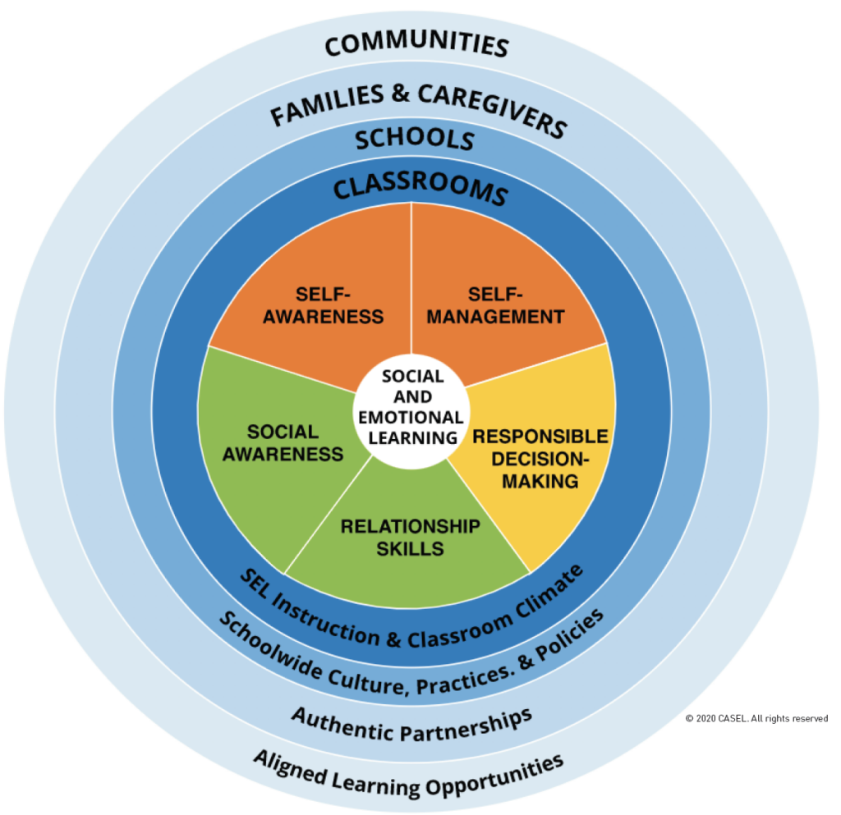
The
CASEL 5...
Five broad and interrelated areas of competence:
Self-awareness
Self-management
Social awareness
Relationship skills
Responsible decision-making
Notes:
The CASEL 5 is a framework that shows at a glance what is meant by social and emotional learning. It can be applied at developmental stages from childhood to adulthood and across cultural contexts. Many school districts, states, and countries have used the CASEL 5 to establish preschool to high school learning standards that articulate what students should know and be able to do for academic success, school and civic engagement, health and wellness, and fulfilling careers.
These five competencies are all interconnected, and part of SEL is making sense of and learning to coordinate all of the competencies together.
OPTIONAL ACTIVITY:
Pass out copies of CASEL’s SEL Framework (https://casel.org/wp-content/uploads/2020/12/CASEL-SEL-Framework-11.2020.pdf, also available in Spanish at https://casel.org/wp-content/uploads/2020/10/SEL-Framework-Spanish.pdf )
Use CASEL’s Group Reflection Protocol (https://casel.org/wp-content/uploads/2021/02/Reflection-Protocol-CASEL-Wheel.pdf) to dive deeper first individually, then with small groups, then with the full group, just completing just the sections on Defining SEL and The CASEL 5: Core Competency Areas. (You may choose to do the final part of the protocol later in the presentation).

Slide 14
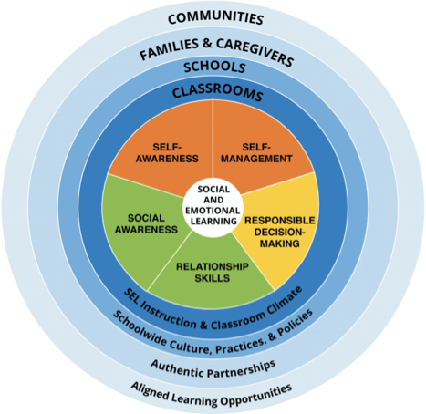
SELF-AWARENESS
The abilities to understand one’s own emotions, thoughts, and values and how they influence behavior across contexts. This includes capacities to recognize one’s strengths and limitations with a well-grounded sense of confidence and purpose.
Such as:
Integrating personal and social identities
Identifying personal, cultural, and linguistic assets
Identifying one’s emotions
Demonstrating honesty and integrity
Linking feelings, values, and thoughts
Examining prejudices and biases
Experiencing self-efficacy
Having a growth mindset
Developing interests and a sense of purpose
Notes:
Use this slide as you briefly describe what self-awareness is, giving anecdotal examples that will resonate with your audience.
The bulleted examples you’ll see here are not exhaustive lists, they provide examples of what is intended by that competency.

Slide 15
Reflection: Self-Awareness
The statements below describe some ways you might see self-awareness in your personal experiences.
I use self-reflection to understand the factors that contribute to my emotions and how my emotions impact me.
I recognize and reflect on ways in which my identity is shaped by other people and my race, culture, experiences, and environments.
I believe I will continue to learn and develop skills to better support all young people to succeed.
What comes to mind when you read these statements?
Notes:
To build investment in SEL, make space for participants to think for themselves about how SEL is relevant in their lives. After you describe each of the 5 competencies, consider using these “Reflection” slides for that purpose.
In a virtual setting, encourage participants to share reflections using the chat function
In a physical setting, ask participants to write down thoughts for each reflection slide, and share some thoughts with a partner or small group after all 5 reflections.
To conclude, ask a few participants to share with the whole group “What was it like to reflect on your own experiences with SEL? What was it like to tell someone else about it?”
As you transition, prompt participants to think about how it could benefit students to discuss and practice social and emotional skills at school.
Once participants have reflected on how SEL shows up in their life, consider offering a second prompt:
How does this area of SEL competence show up for our students/your children/the young people we serve?

Slide 16
SELF-MANAGEMENT
The abilities to manage one’s emotions, thoughts, and behaviors effectively in different situations and to achieve goals and aspirations. This includes the capacities to delay gratification, manage stress, and feel motivation and agency to accomplish personal and collective goals.
Such as:
Managing one’s emotions
Identifying and using stress-management strategies
Exhibiting self-discipline and self-motivation
Setting personal and collective goals
Using planning and organizational skills
Showing the courage to take initiative
Demonstrating personal and collective agency
Notes:
Use this slide as you briefly describe what self-management is, giving anecdotal examples that will resonate with your audience.

Slide 17
Reflection: Self-Management
The statements below describe some ways you might see self-management in your personal experiences.
I can calm myself when I feel stressed or nervous.
I take action to impact change on issues that are important to me and the larger community.
I balance my work life with personal renewal time.
What comes to mind when you read these statements?
Notes:
To build investment in SEL, make space for participants to think for themselves about how SEL is relevant in their lives. After you describe each of the 5 competencies, consider using these “Reflection” slides for that purpose.
In a virtual setting, encourage participants to share reflections using the chat function
In a physical setting, ask participants to write down thoughts for each reflection slide, and share some thoughts with a partner or small group after all 5 reflections.
To conclude, ask a few participants to share with the whole group “What was it like to reflect on your own experiences with SEL? What was it like to tell someone else about it?”
As you transition, prompt participants to think about how it could benefit students to discuss and practice social and emotional skills at school.
Once participants have reflected on how SEL shows up in their life, consider offering a second prompt:
How does this area of SEL competence show up for our students/your children/the young people we serve?

Slide 18
SOCIAL AWARENESS
The abilities to understand the perspectives of and empathize with others, including those from diverse backgrounds, cultures, and contexts. This includes the capacities to feel compassion for others, understand broader historical and social norms for behavior in different settings, and recognize family, school, and community resources and supports.
Such as:
Taking others’ perspectives
Recognizing strengths in others
Demonstrating empathy and compassion
Showing concern for the feelings of others
Understanding and expressing gratitude
Identifying diverse social norms, including unjust ones
Recognizing situational demands and opportunities
Understanding the influences of organizations
and systems on behavior
Notes:
Use this slide as you briefly describe what social awareness is, giving anecdotal examples that will resonate with your audience.

Slide 19
Reflection: Social Awareness
The statements below describe some ways you might see social awareness in your personal experiences.
I pay attention to the feelings of others and recognize how my words and behavior impact them.
I ask others about their experience and perspective before offering my version of events.
I appreciate and honor the cultural differences within my school community / workplace.
What comes to mind when you read these statements?
Notes:
To build investment in SEL, make space for participants to think for themselves about how SEL is relevant in their lives. After you describe each of the 5 competencies, consider using these “Reflection” slides for that purpose.
In a virtual setting, encourage participants to share reflections using the chat function
In a physical setting, ask participants to write down thoughts for each reflection slide, and share some thoughts with a partner or small group after all 5 reflections.
To conclude, ask a few participants to share with the whole group “What was it like to reflect on your own experiences with SEL? What was it like to tell someone else about it?”
As you transition, prompt participants to think about how it could benefit students to discuss and practice social and emotional skills at school.
Once participants have reflected on how SEL shows up in their life, consider offering a second prompt:
How does this area of SEL competence show up for our students/your children/the young people we serve?

Slide 20
RELATIONSHIP SKILLS
The abilities to establish and maintain healthy and supportive relationships and to effectively navigate settings with diverse individuals and groups. This includes the capacities to communicate clearly, listen actively, cooperate, work collaboratively to problem solve and negotiate conflict constructively, navigate settings with differing social and cultural demands and opportunities, provide leadership, and seek or offer help when needed.
Such as:
Communicating effectively
Developing positive relationships
Demonstrating cultural competency
Practicing teamwork and collaborative problem-solving
Resolving conflicts constructively
Resisting negative social pressure
Showing leadership in groups
Seeking or offering support and help when needed
Standing up for the rights of others
Notes:
Use this slide as you briefly describe what relationship skills are, giving anecdotal examples that will resonate with your audience.

Slide 21
Reflection: Relationship Skills
The statements below describe some ways you might see relationship skills in your personal experiences.
I stay focused when listening to others and carefully consider their meaning.
I try to get to know the people around me.
I openly admit my mistakes to myself and others and work to make things right.
What comes to mind when you read these statements?
Notes:
To build investment in SEL, make space for participants to think for themselves about how SEL is relevant in their lives. After you describe each of the 5 competencies, consider using these “Reflection” slides for that purpose.
In a virtual setting, encourage participants to share reflections using the chat function
In a physical setting, ask participants to write down thoughts for each reflection slide, and share some thoughts with a partner or small group after all 5 reflections.
To conclude, ask a few participants to share with the whole group “What was it like to reflect on your own experiences with SEL? What was it like to tell someone else about it?”
As you transition, prompt participants to think about how it could benefit students to discuss and practice social and emotional skills at school.
Once participants have reflected on how SEL shows up in their life, consider offering a second prompt:
How does this area of SEL competence show up for our students/your children/the young people we serve?

Slide 22
RESPONSIBLE DECISION-MAKING
The abilities to make caring and constructive choices about personal behavior and social interactions across diverse situations. This includes the capacities to consider ethical standards and safety concerns, and to evaluate the benefits and consequences of various actions for personal, social, and collective well-being.
Such as:
Demonstrating curiosity and open-mindedness
Learning how to make a reasoned judgment after analyzing information, data, and facts
Identifying solutions for personal and social problems
Anticipating and evaluating the consequences of one’s actions
Recognizing how critical thinking skills are useful both inside and outside of school
Reflecting on one’s role to promote personal, family, and community well-being
Evaluating personal, interpersonal, community, and institutional impacts
Notes:
Use this slide as you briefly describe what responsible decision-making is, giving anecdotal examples that will resonate with your audience.

Slide 23
Reflection: Responsible Decision-Making
The statements below describe some ways you might see responsible decision-making in your personal experiences.
I involve those who are impacted to explore a problem collaboratively before choosing a solution.
I consider how my choices will be viewed through the lens of the young people I support and the community around them.
I take time for self-reflection and group reflection on progress toward goals and the process used.
What comes to mind when you read these statements?
Notes:
To build investment in SEL, make space for participants to think for themselves about how SEL is relevant in their lives. After you describe each of the 5 competencies, consider using these “Reflection” slides for that purpose.
In a virtual setting, encourage participants to share reflections using the chat function
In a physical setting, ask participants to write down thoughts for each reflection slide, and share some thoughts with a partner or small group after all 5 reflections.
To conclude, ask a few participants to share with the whole group “What was it like to reflect on your own experiences with SEL? What was it like to tell someone else about it?”
As you transition, prompt participants to think about how it could benefit students to discuss and practice social and emotional skills at school.
Once participants have reflected on how SEL shows up in their life, consider offering a second prompt:
How does this area of SEL competence show up for our students/your children/the young people we serve?

Slide 24
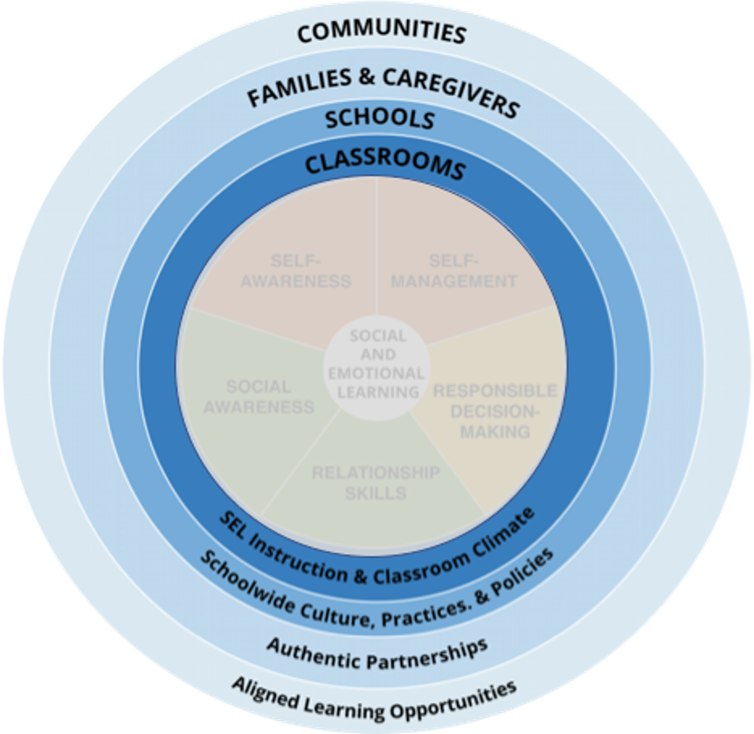
The Key Settings
Our framework takes a systemic approach that emphasizes the importance of establishing equitable learning environments and coordinating practices across key settings of classrooms, schools, families, and communities to enhance all students’ social, emotional, and academic learning.
Notes:
As you reflected on the statements, you probably thought about ways the 5 SEL competencies are relevant in your professional life, but also probably in your personal life outside school. The same is true for young people -- they are building social and emotional competencies in many different settings.
These competencies are not learned quickly through a presentation, a reading, or a video -- they are developed through our interactions, relationships, and environments -- inside and outside of school.
This is why CASEL’s framework also emphasizes the role of settings and authentic school-family-community partnerships that coordinate practices across environments where students live and learn.

Slide 25
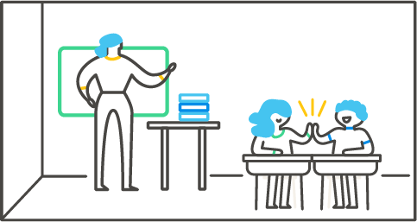
Classrooms
Classroom-based approaches include:
A supportive classroom environment
Integration of SEL and instruction
Explicit SEL instruction
High-quality SEL instruction is SAFE
Sequenced
Active
Focused
Explicit
Notes:
Promoting SEL for students in classrooms involves:
A supportive classroom climate where students feel emotionally safe, part of a community of learners, motivated and challenged.
Integration of SEL into academic instruction that weaves deep academic learning with opportunities for students practice SEL by working to understand their own emotions, empathize with diverse perspectives, cultivate trusting relationships, solve problems constructively, and make decisions while considering the needs of others.
Explicit SEL instruction that provides consistent opportunities to cultivate, practice, and reflect on social and emotional competencies in ways that are developmentally appropriate and culturally responsive.
(Evidence-based programs can support one or all three areas of the SEL-focused classroom.)
High-quality SEL instruction has four elements:
Sequenced – following a coordinated set of training approaches to foster the development of competencies
Active – emphasizing active forms of learning to help students practice and master new skills
Focused – implementing curriculum that intentionally emphasizes the development of SEL competencies
Explicit – defining and targeting specific skills, attitudes, and knowledge
Recent research suggests a fifth element, to make the acronym SAFER.
Responsive -- the right fit for the school’s context and community, strengthened through input from students, families, and other school community members, includes students’ cultural references in instruction

Slide 26
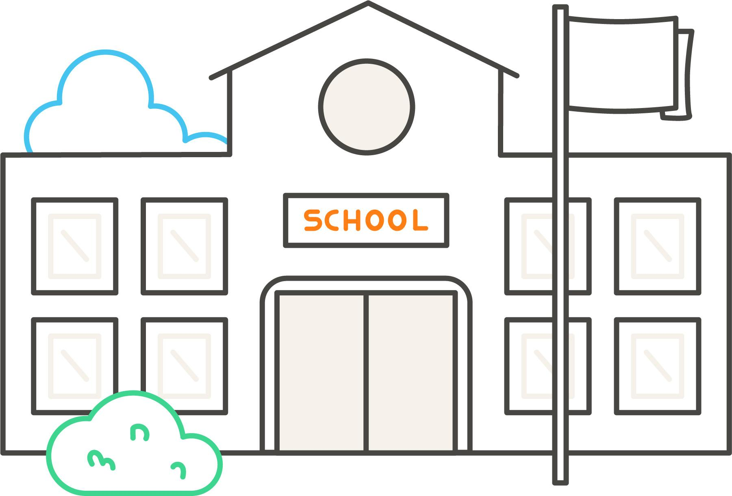
Schools
Schoolwide practices and structures that promote SEL:
Foster a supportive school climate
Adopt an evidence-based program for SEL
Integrate student supports with SEL
Establish discipline policies that promote SEL
Elevate student voice
Notes:
Foster a supportive school climate
Schoolwide norms, shared agreements, routines, and procedures support school’s SEL vision
Assess school climate through observational data, surveys, etc.
Plan climate improvement efforts based on data
Adopt an evidence-based program for SEL
Sequenced, Active, Focused, Explicit
Can focus on schoolwide practices and structures (organizational approaches) as well as or rather than classroom instruction (lesson-based programs).
Aligned to SEL goals and culturally and linguistically responsive
Ongoing implementation support for staff
Implemented with fidelity at all grade levels
Integrate student supports with SEL
Continuum of supports to meet academic, social, emotional, and behavioral needs of all students
Common language and alignment among related programs and supports
Establish discipline policies that promote SEL
Provide opportunities for students to reflect, problem-solve, and build positive relationships
Account for developmental stages, cultural backgrounds, individual differences
Data shows they are used consistently and equitably
Teachers supported to use student-centered discipline
Elevate student voice
Engage students as leaders, problem-solvers, and decision-makers
Elevate student perspectives to shape SEL initiatives, instructional practices, and school climate
Students initiate and lead activities, solutions, and projects to improve their classroom, school, and community

Slide 27
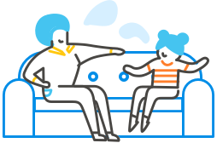
Families & Caregivers
Communication is two-way - Ask families and caregivers about their views and experiences to shape the school’s approach to SEL
Invite them to contribute to the development of the vision and goals, selection of programs, reflection on data
Position them as experts about their children and their community
Notes:
When schools and families work together, they can build strong connections that reinforce social and emotional skill development. In fact, research suggests that evidence-based SEL programs are more effective when they extend into the home (Albright & Weissberg, 2010).
Schools, in turn, can build upon and learn from the strategies that families are already using to support SEL through authentic family partnerships.
Families are far more likely to form partnerships with schools when the school’s norms, values, and cultural representations reflect their own experiences (Atunez, 2000), so it is important for teams to foster a culturally responsive and welcoming school environment and authentically engage families as partners in promoting students’ SEL.

Slide 28

Communities
Community organizations offer students more opportunities to practice SEL skills they are learning at home and during the school day.
Community partners might include:
Out-of-school time providers
Community-based nonprofit organizations
Health care providers
Universities and colleges
Local businesses
Other institutions that can connect students to their broader communities

Slide 29

HOW CAN SCHOOLS
PROMOTE SEL?
Notes:
Transition from “Why” to the “How” part of the presentation

Slide 30
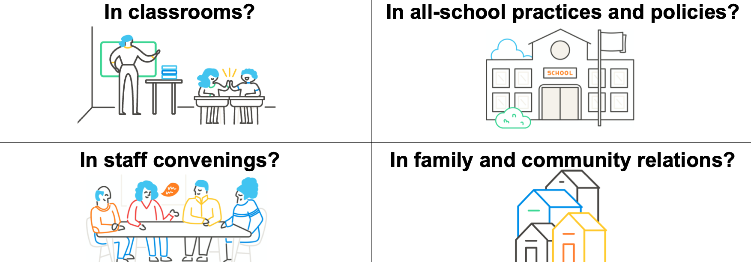
What does SEL look like when it’s schoolwide?
Notes:
Give participants time to process what they have heard so far and apply it by imagining how SEL might look in different school settings.
Ask participants to turn to 2-3 people sitting nearest them, or divide into breakout rooms with 3-4 people per room. In groups, discuss how SEL can be present in these 4 squares.
To debrief, as a whole group (do a vote and call on a few participants to explain their choice):
-Which square was easiest to imagine?
-Which was the most interesting to discuss?

Slide 31
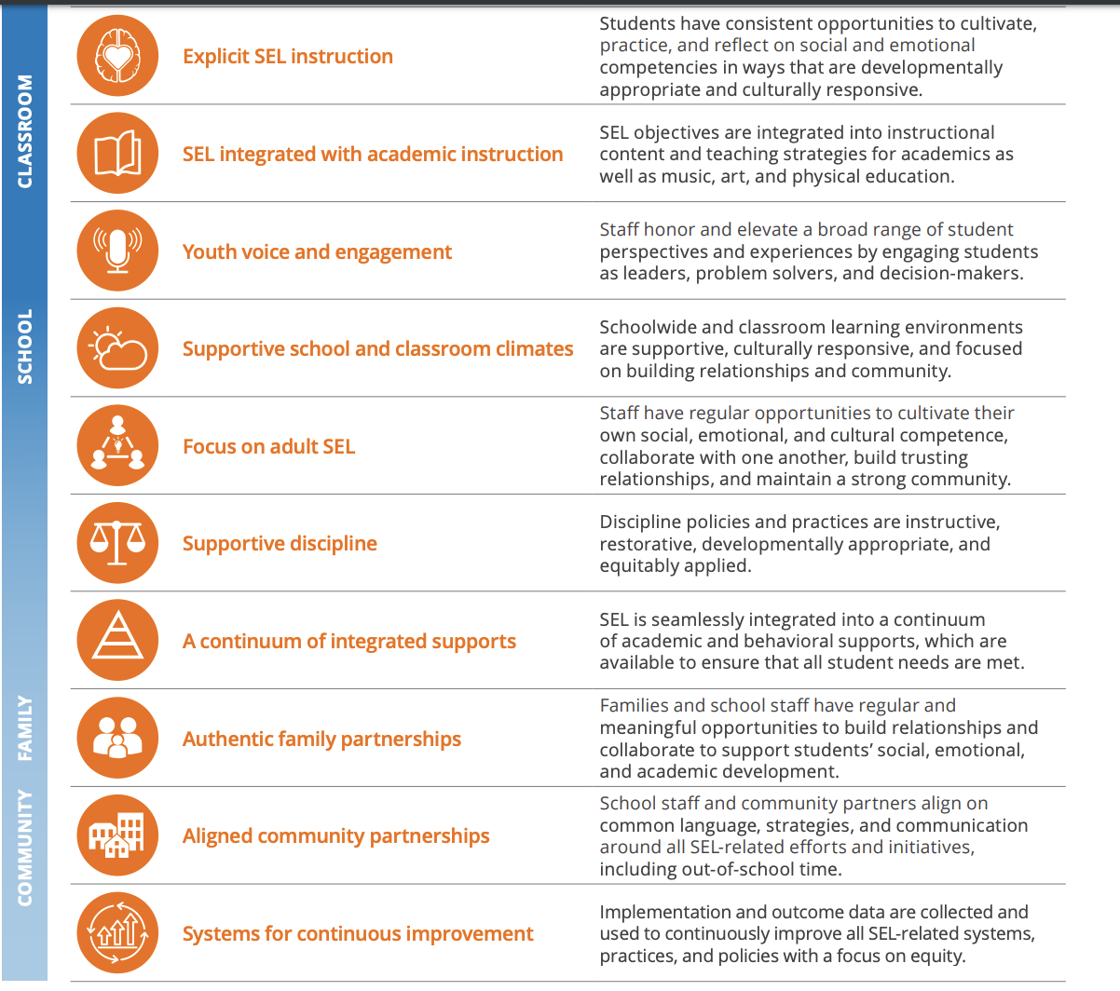
Indicators of Schoolwide SEL
Notes:
Schoolwide SEL is a systemic approach to infusing social and emotional learning into every part of the school day -- across all classrooms, during all parts of the school day and out-of-school time, among administrators and staff, and in partnership with families and communities.
The 10 indicators of schoolwide SEL describe what you could expect to see in a school with high-quality, systemic SEL implementation.
They are not a “checklist” or a “to-do” list, because they are interconnected and shouldn’t be approached as separate, isolated tasks. Think of it as a landscape.
Recommended: Share the 10 Indicators of Schoolwide SEL handout with participants as a print handout or link in chat – find it at https://schoolguide.casel.org/resource/new-indicators-of-schoolwide-sel/)

Slide 32
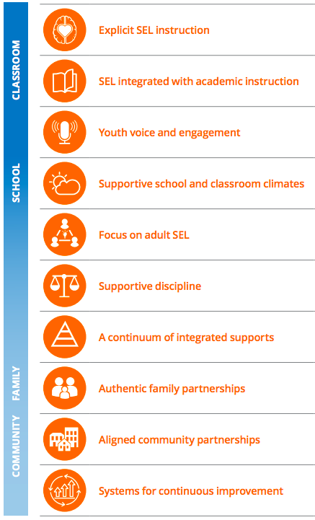
Ten Indicators of Schoolwide SEL
Notes:
Let’s take a closer look at the indicators of schoolwide SEL.
Since young people interact socially and emotionally constantly in all settings, educators should be thinking about ways to integrate SEL into all aspects of the school experience and all settings where young people learn, not just a single class, learning block or series of assemblies.
Schoolwide SEL is a long-term process that can take up to 3 to 5 years to be fully implemented. You wouldn’t expect to see evidence of all these indicators after a single year of SEL implementation, but over time as the larger picture emerges, these are some of facets that a school community could expect to see.

Slide 33
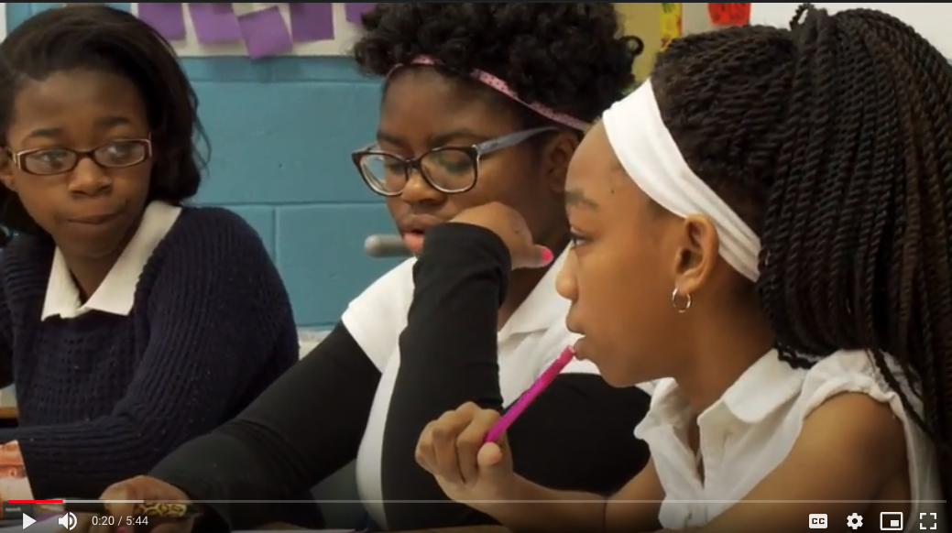
Marcus Garvey Elementary School
Chicago Public Schools
Notes:
Credit: Chicago Public Schools
Video link: https://drive.google.com/file/d/1ZMFbwgOaVElGiqvhUul8DDS_0B_WmVvE/view?usp=sharing
One school that has implemented SEL for many years is Marcus Garvey Elementary, a K-8 school. They were one of the earliest adopters of SEL in Chicago Public Schools and have spent years building a schoolwide model of SEL.
As you watch, think about the 10 indicators you just saw and how they are present at Marcus Garvey.
Looking for a different video? See our video library at https://schoolguide.casel.org/video-library/

Slide 34
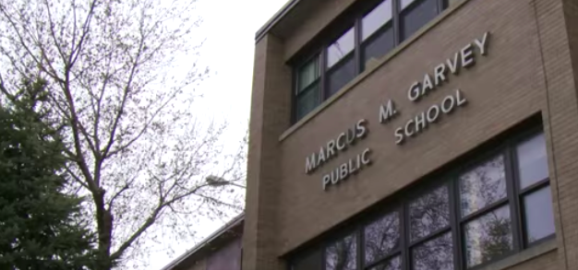
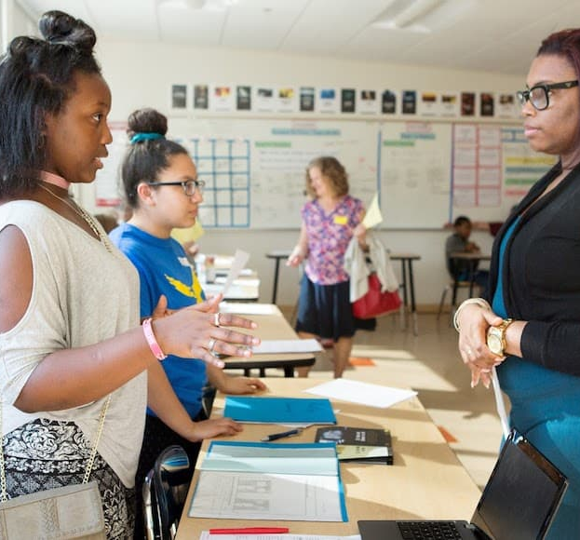
Applying the Indicators of Schoolwide SEL
At Marcus Garvey Elementary:
What indicators of schoolwide SEL were most apparent? Why?
What work do you think the school did that made that indicator show up?
In our school:
Which indicators are strongest here? Why?
Which ones are you unsure about? Why?
Notes:
Use this slide to guide small group or whole group conversations about the video.

Slide 35
FOR THE
PRESENTATION FACILITATOR:
Conclusion Option #1:
If you are presenting to a school community in which participants have many different roles...
Notes:
Choose from among the 4 conclusion options and delete/hide the slides you will not use.
This activity is meant for a general audience. The purpose is to move participants to imagine how SEL could benefit the school community, potentially connecting to some of the hopes and dreams that were shared at the beginning of the presentation.
Delete or hide this slide before presenting.

Slide 36
How would our school feel, look, and sound if we made SEL an integral part of the way we do things?
FEELS LIKE
SOUNDS LIKE
LOOKS LIKE
Notes:
If you used the first part of the Group Reflection Protocol for SEL (https://casel.org/wp-content/uploads/2021/02/Reflection-Protocol-CASEL-Wheel.pdf) earlier in your presentation (see slide 9), complete the rest of the protocol now (the sections on the Key Settings and Identifying Next Steps).
If you did not use that protocol, use this slide as you share directions for a collaborative activity.
If in a physical setting, set up several pieces of chart paper around the room so that participants can gather in groups of 4-6 around each paper. On each, draw the Y-chart you see on screen. Ask each group to take some time to discuss the question and take notes on the chart paper.
If in a virtual setting, do the same activity using Jamboard or a similar product to create a space for people to write their thoughts to each question: what would it feel like? Look like? Sound like?
As conversations wind down and groups have written thoughts in all spaces on the chart, ask everyone to look at what others have written, and star the words and phrases that feel most personally important to them. After allowing several minutes for this silent activity, ask a few participants to share aloud what they notice.
Think about what you would like participants to do after this presentation. Complete a survey? Sign up for a committee? Nominate students for an SEL advisory council? Try to give one clear, simple action step that participants can complete immediately or shortly after the session.

Slide 37
FOR THE
PRESENTATION FACILITATOR:
Conclusion Option #2:
If you are presenting to teachers...
Notes:
Choose from among the 4 conclusion options and delete/hide the slides you will not use.
This activity is meant for classroom teachers. It gives a closer look at what an SEL-infused classroom might look like, and provides an opportunity for teachers to reflect on what they are already doing to promote SEL.
By presenting SEL as building on strong teaching practices that teachers are already familiar with, you communicate that you are not introducing something totally new, but rather giving teachers permission and support (and time!) to focus on the things they already know are important, such as building relationships and community, strengthening communication and collaboration, and helping students process emotions and make good decisions.
Delete or hide this slide before presenting.

Slide 38
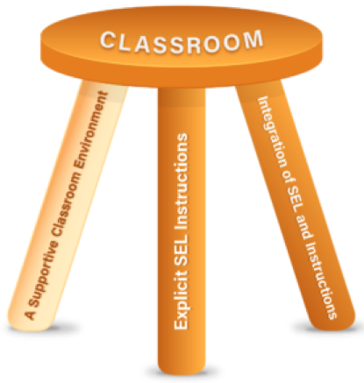
Classroom SEL
A 3-Legged Stool
Supportive
Environment
Integration of SEL
throughout instruction
Explicit SEL instruction
Notes:
When we think about SEL in the classroom, there are 3 main ways to promote SEL -- through the environment we create, through the way we teach our regular academic content, and by explicitly teaching social and emotional skills.
Thinking of Classroom SEL as a three-legged stool is helpful, as it illustrates the importance of each of these three elements for students to learn - without any one, the stool would not be able to stand. These elements work together and build on one another.
When we foster a supportive classroom environment we are working to ensure students feel emotionally safe, part of a community of learners, motivated and challenged.
Throughout academic instruction, we can build into our lesson plans opportunities for students to practice and strengthen their SEL skills while they are learning math, science, social studies, art, and so on.
And finally, explicit SEL instruction is critical for providing consistent opportunities for students to cultivate, practice, and reflect on social and emotional competencies in ways that are developmentally appropriate and culturally responsive.

Slide 39
SEL in the Classroom
Self-Assessment
How does this align with what we are already focused on?
What stands out to you?
Notes:
Pass out the SEL in the Classroom Self-assessment (find it here https://schoolguide.casel.org/resource/sel-in-the-classroom-self-assessment). Give time for participants to complete the assessment individually, then discuss at their tables or in breakout rooms how this reinforces practices that are already in place and encouraged. Invite full group discussion on what feels familiar as well as what might need to change to enable teachers to embody these practices more consistently and completely.
Be sure to listen fully to any concerns or doubts expressed -- for example, if someone says there is not enough time for ____, or they feel pressure to teach in ways that contradict what they saw in the assessment, that is important feedback that school leaders will need to address outside of this presentation.
To conclude,
Bringing SEL into the classroom will take effort, but it should line up well with what we already want to do and are doing to increase engagement and academic achievement and create caring classroom environments.
Think about what you would like participants to do after this presentation. Complete a survey? Sign up for a committee? Nominate students for an SEL advisory council? Try out one practice from the self-assessment and prepare to discuss it at their next grade-level team meeting? Try to give one clear, simple action step that participants can complete immediately or shortly after the session.

Slide 40
FOR THE
PRESENTATION FACILITATOR:
Conclusion Option #3:
If you are presenting to parents and caregivers...
Notes:
Choose from among the 4 conclusion options and delete/hide the slides you will not use.
Delete or hide this slide before presenting.

Slide 41
What’s next?
What does SEL look like within your family? When have you found yourself supporting your child to use these skills?
What would you like to see happen in this school as we work to implement SEL schoolwide?
How would you like to be included and invited as we implement SEL?
Notes:
While there are many resources available about what families can do at home to support their children with SEL, it’s important to demonstrate that you are prioritizing two-way communication and authentic partnership by starting with listening, not telling. You can share strategies and resources later or upon request.
Use prompts to generate discussion and learn from them about how they are understanding the relevance of SEL and what is important to them in SEL implementation.
Take notes in a space where participants can see what you are writing, and check in to verify that you are capturing their meaning accurately. (“Does this summarize what you shared?”)
Focus on listening, and encourage participants to respond to each other (“Does anyone want to add to that idea?”)
Thank them for joining the group and participating, explain how you will use their feedback, and when they can expect to hear from you again.
Think about what you would like participants to do after this presentation. Complete a survey? Sign up for a committee or discussion group? Share information with other families and caregivers? Try to give one clear, simple action step that participants can complete immediately or shortly after the session.

Slide 42
FOR THE
PRESENTATION FACILITATOR:
Conclusion Option #4:
If you are using the CASEL Guide to Schoolwide SEL...
Notes:
This conclusion can be used in addition to any of the other 3. This gives 2 concrete next steps that align with the process described in the CASEL Guide to Schoolwide SEL: Creating an SEL Team and Developing a Shared Vision.
Delete or hide this slide before presenting.

Slide 43
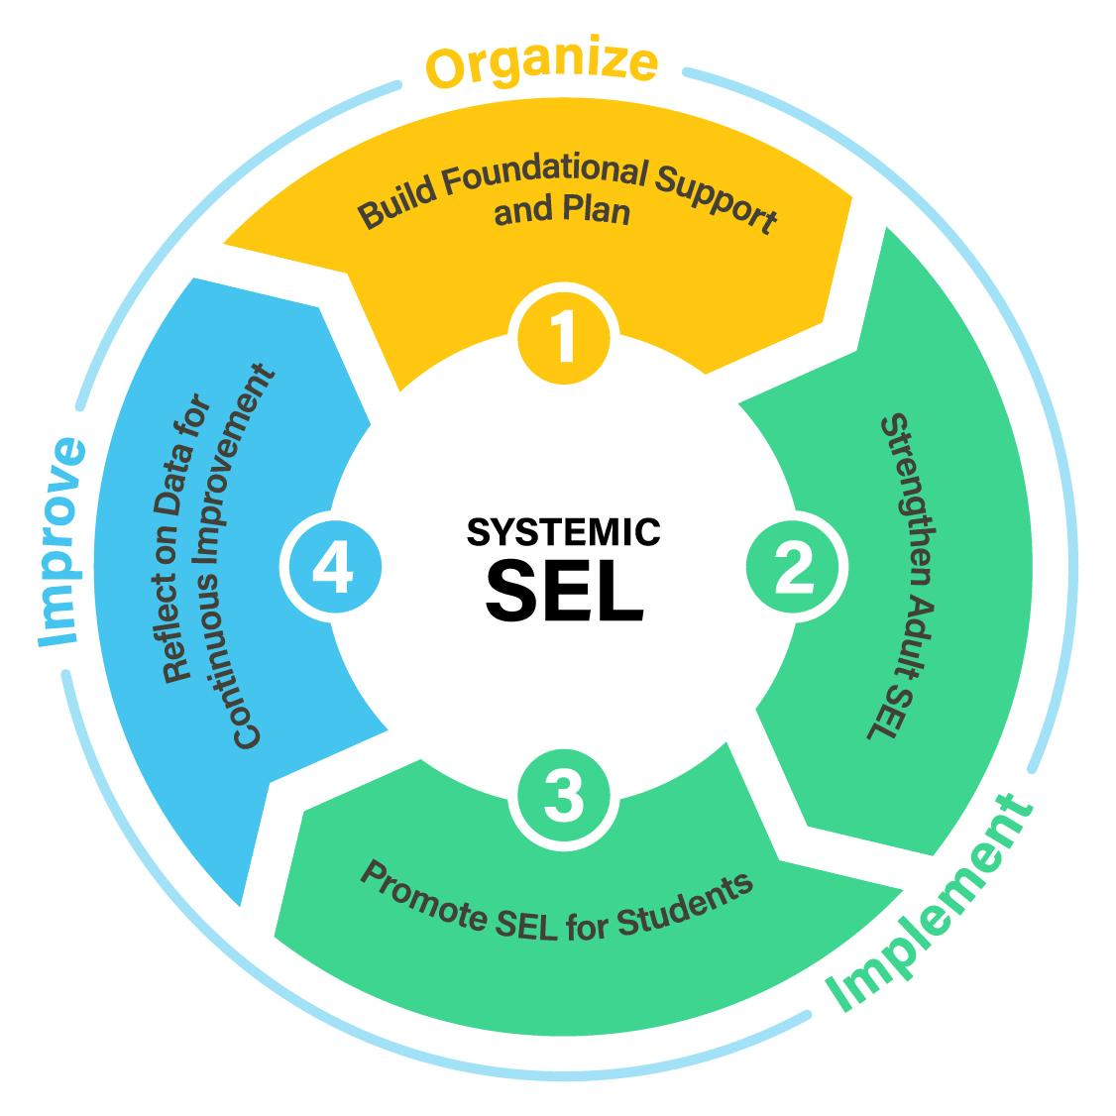
A Process for Schoolwide SEL
Notes:
This is a direction we want to move in as a school community, and we want to proceed with your support and include your perspective and ideas throughout the process. This diagram shows a cycle for implementing systemic SEL. Right now we’re in the “Organize” stage…
Share any details about what has already taken place, what is planned, and what should happen next.
CASEL recommends that schools begin by creating an SEL team and/or developing a shared vision as you begin the systemic SEL cycle, then proceed through the planning steps detailed in Focus Area 1B in the CASEL Guide to Schoolwide SEL.
IF YOU NEED TO CREATE AN SEL TEAM or RECRUIT MORE MEMBERS -- Consult the Create a Team section on the CASEL Guide to Schoolwide SEL. Share role descriptions of different members of the team (see CASEL’s recommended role descriptions here) and tell participants how they can join. It’s also important to follow up directly with individuals who will be pivotal for the team’s success (see guidance on assembling a team here)
IF YOU ARE LAUNCHING THE PROCESS OF DEVELOPING A SHARED VISION for SCHOOLWIDE SEL -- Close your presentation by using a survey tool to get participant thoughts on the questions in the Develop a Shared Vision tool.
What do we want all our students to know and be able to do when they leave our school?
What kind of skill-building is most important in supporting our students to reach their full potential?
What do we want our school community to feel like, sound like, and look like?
What do students and adults need in order to learn and thrive here?
Explain to participants how the SEL team will use their responses to draft a vision statement, and when they can expect to see the draft.

Slide 44
CLOSING ACTIVITY:
Recommended for all audiences
Notes:
Delete or hide this slide before presenting.

Slide 45
How has your understanding of SEL changed?
Notes:
This closing is an important part of learning and experiencing SEL, so make sure you allow for enough time at the end.
An Optimistic Closure helps participants make sense of their new learning and leave the meeting feeling connected to one another. This can be as simple as Turn to Your Partner and asking “What is something you learned that you want to think more about and why?” or use the prompt on the slide.
Additional Optimistic Closure activities are available in the SEL 3 Signature Practices Playbook.
https://schoolguide.casel.org/uploads/2018/12/CASEL_SEL-3-Signature-Practices-Playbook-V3.pdf

Slide 46
Thank You!
Notes:
Thank your audience, share briefly what will happen next and when they can expect to hear from you again about SEL.
Think about what you would like participants to do after this presentation. Complete a survey? Sign up for a committee? Nominate students for an SEL advisory council? Share information with someone else? Try to give one clear, simple action step that participants can complete immediately or shortly after the session.

