Slide 1
SEL Implementation Assessment Guidance

Slide 2

What you will Need
60-90 minutes
Team of: an administrator, educators representing varying grade levels/subject areas, counselors, psychologists, coaches, and other support staff in order to get multiple perspectives
Rubric: Each member has a hard copy.
Identify a Facilitator: Read off the item & number and facilitates the scoring process.
Identify a Recorder: Records scores on a hard copy rubric.

Slide 3
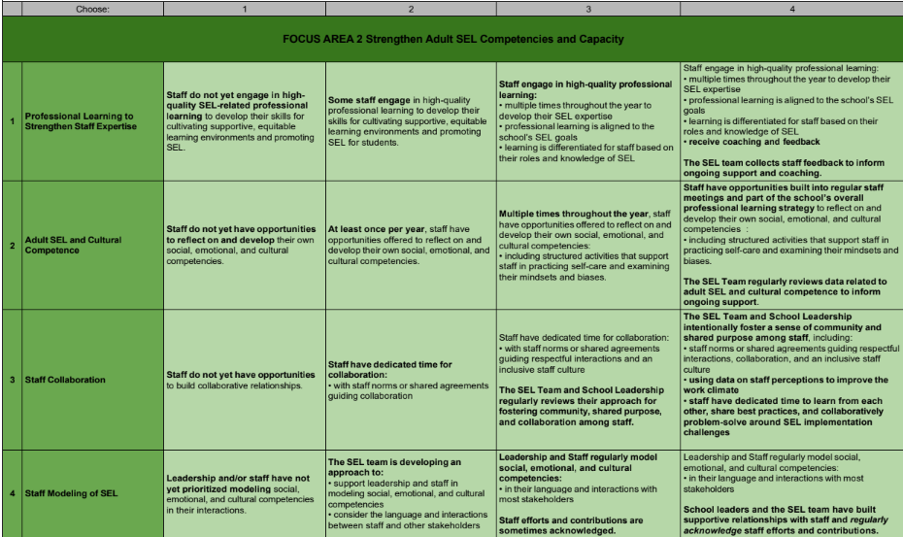

1
Has a clean hard copy of the rubric to record scores from the Facilitator.
Provides the final results to the site administrator & leadership team to reflect upon.
Recorder’s Role
2

Slide 4

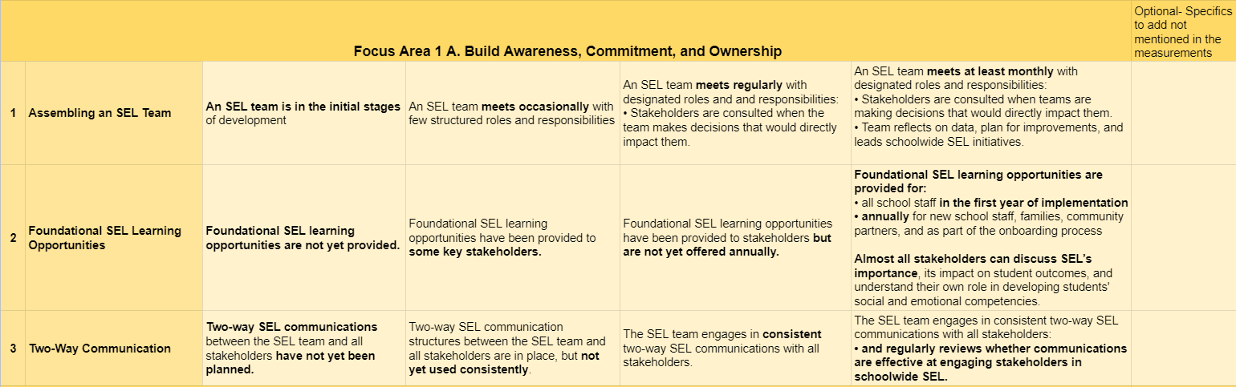
Facilitator’s Role
1
Read each item & number aloud, one row at a time.
2
Allow time for team members to score each item individually on their paper after you read it aloud.
3
Lead the team in the process for agreement (reaching consensus) in scoring
Check out Facilitation Tips in this video

Slide 5

Facilitator’s Role- Scoring & Reaching Consensus
Use this process to help your team agree upon a score for each item (row) for each of the following Focus Areas.
Step 1
Step 2
Support Individual Scoring
Read one item (row) aloud
  Remind them to consider the current stage of implementation at the school.
Prompt them to circle the score (1-4) for that item on their rubric hard copy.
Support Team Scoring
Ask members to hold up fingers at the same time for their circled score on that item. If it’s:
Unanimous = Score Agreement
1-Point Difference = Use the score majority
The Recorder then circles the Team’s score onto hard copy.
2+ Point Difference (e.g. 4’s and 2’s): Go to Consensus Process
CONSENSUS PROCESS
Ask member(s) with the lowest rating to explain their reasoning. If explanation changes understanding, vote again with fingers.
If nothing changes, the team engages in thumbs up/down/sideways activity for the numbers being debated:
•Thumbs Up: YES
•Sideways: I can live with that number
•Thumbs Down: NO WAY
Majority thumbs up or sideways on a number=Use the Score. The Recorder then circles the Team’s score onto hard copy.

Slide 6

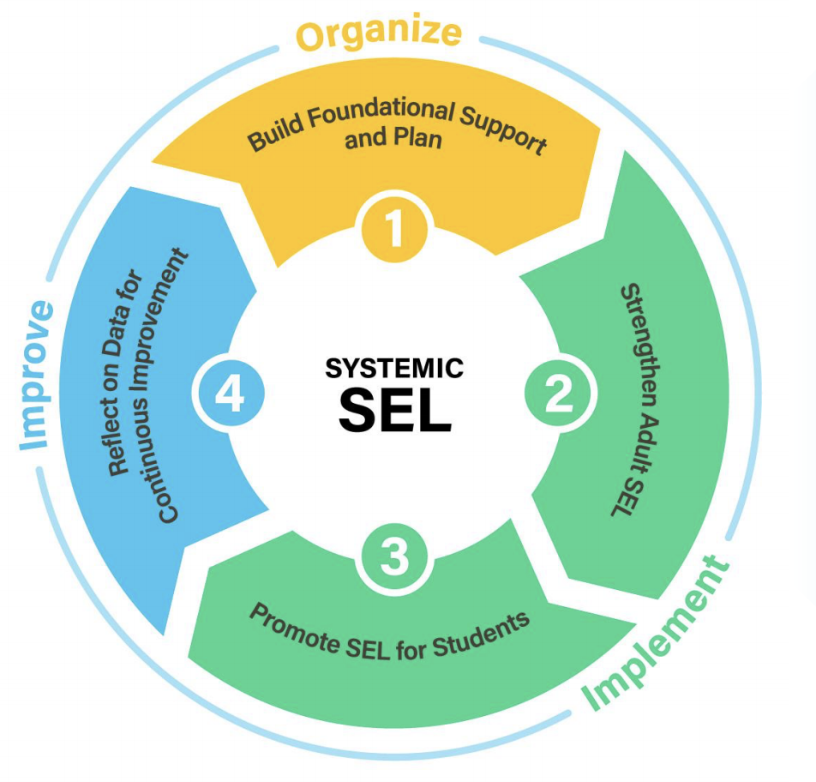
What is in the Assessment?
The SEL Implementation Assessment is based on CASEL’s 4 Focus Areas for SEL implementation.
Area
1A: 3 items
1B: 3 items
Area 4:
2 items
Area 2:
4 items
Area 3:
11 items
Notes:
Systemic SEL has been identified by 4 overarching focus areas:
Yellow: Building Foundational Support & Plan. This focuses on teams & their structure for addressing SEL specifically: their vision & plan
Green Implementation 2: Adult SEL
Green Implementation 3: Student SEL. Robust because it addresses:
explicit instruction,
integrated practices,
being culturally responsive,
climate & culture,
elevating student voice,
student-centered discipline policies,
tiers of support for SEL, and
family & community partnerships
Blue: Continuous Improvement considerations: Which should be woven into all 3 focus areas above

Slide 7
Ready to Begin?
Each member has a hard copy of the rubric.
The Recorder has the clean team copy to record team scores.
The Facilitator is ready to read each item & number, one row at a time. Use the following slides, if helpful.
LET’S GO!

Slide 8
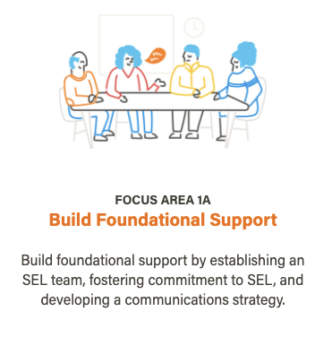
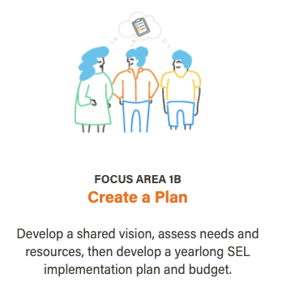


Focus Areas 1A & 1B
Developing a strong foundation for SEL helps ensure that efforts are sustained long term. This requires engaging the entire school community and developing a coordinated plan for implementation.
6 total items

Slide 9
1A: Build Foundational Support
The use of the word "stakeholders" is used throughout this survey to describe students, families, staff, community partners, and out-of-school time providers who are representative of the school community.
Notes:
Clarify 2 words you’ll see throughout:
Stakeholders refers to: stu, staff, families, community partners, Out of school time providers
“SEL Team” can refer to any existing leadership team:
PBIS team, MTSS team, Leadership Team, etc that is already established and is looking to expand SEL into its system.
It does not imply that a separate SEL Team needs to be established.
Optional Text Box:
Where you can note that you may be doing certain portions of the work under one number, but not ALL. For example:
Your team must mark a 1 because you have a team that meets occasionally, but the team doesn’t have any structured roles or responsibilities.
You may want to note in the Optional text box that your team meets occasionally (noted in the 2)
It honors the work that you are doing in this focus area

Slide 10
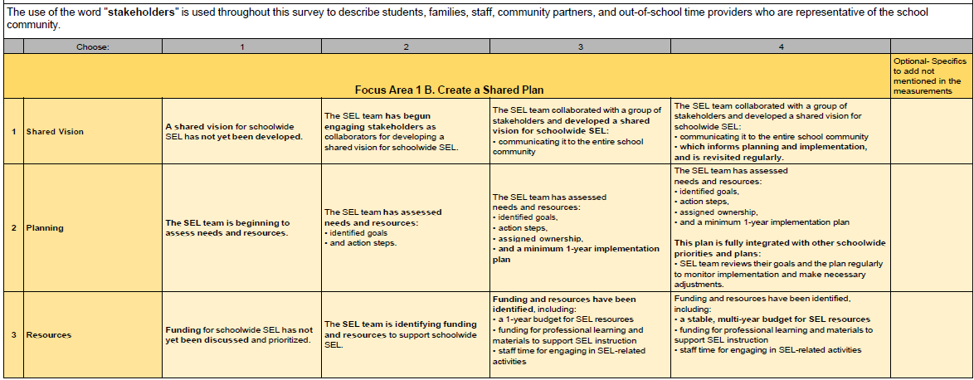
1B: Plan

Slide 11


Focus Area 2
4 items

Slide 12
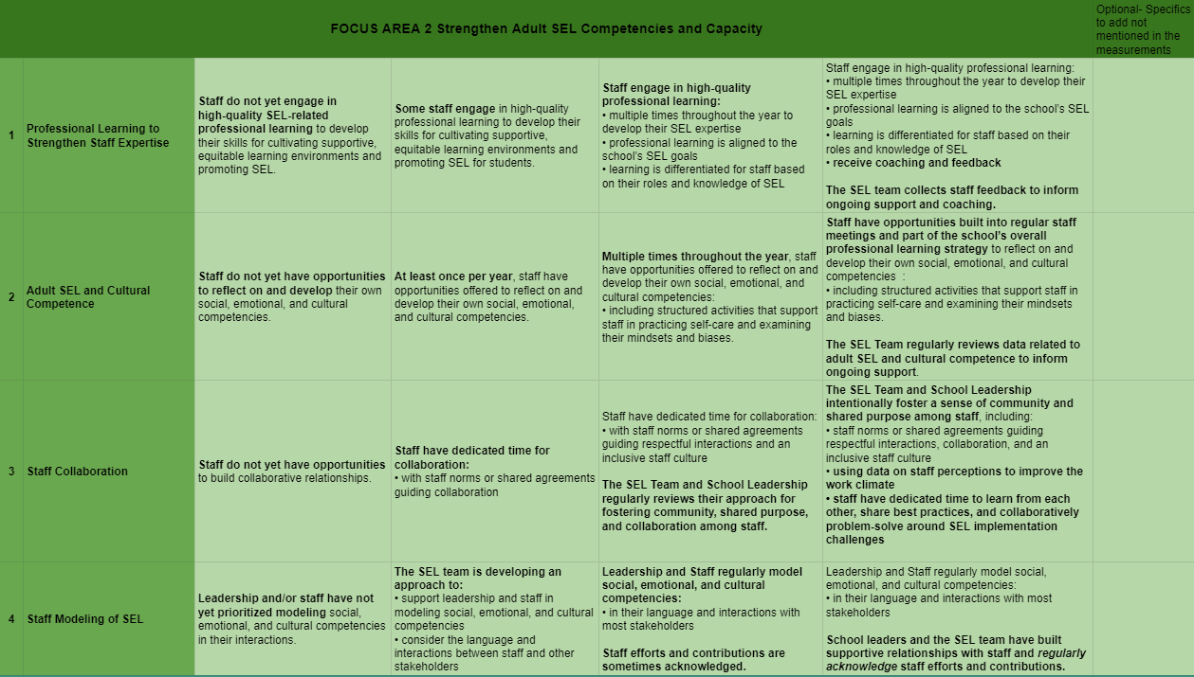
2: Strengthen Adult SEL

Slide 13

Focus Area 3
11 items

Slide 14
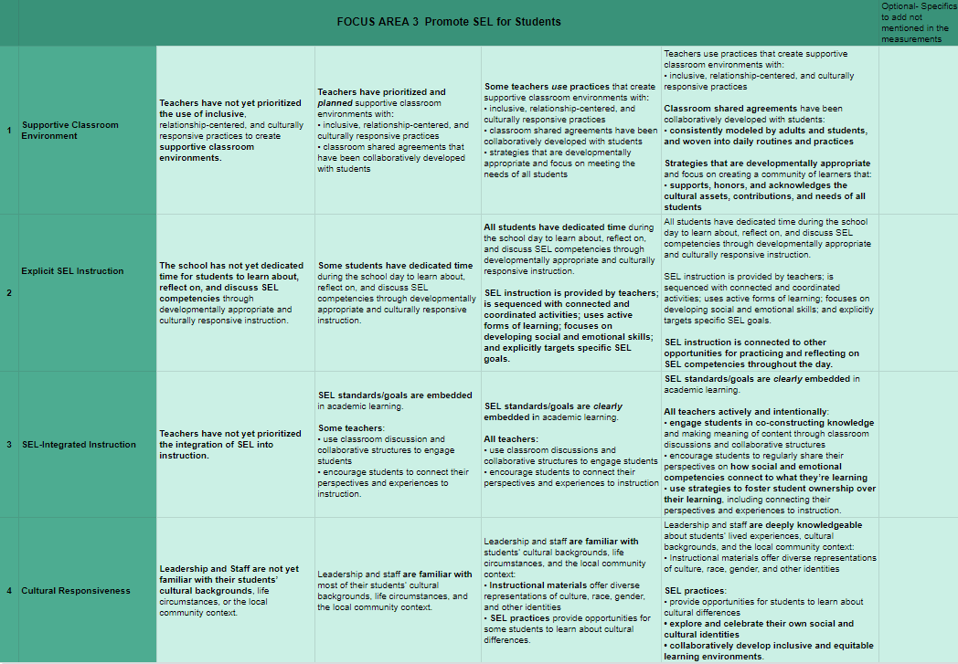
3: Promote SEL for Students

Slide 15
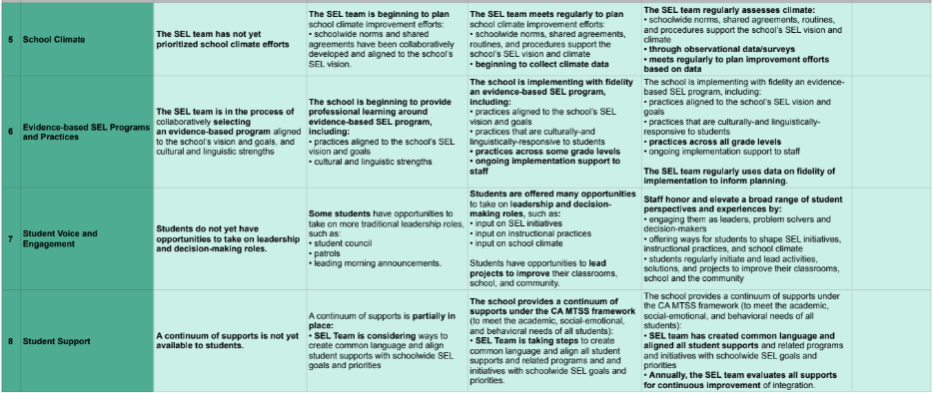
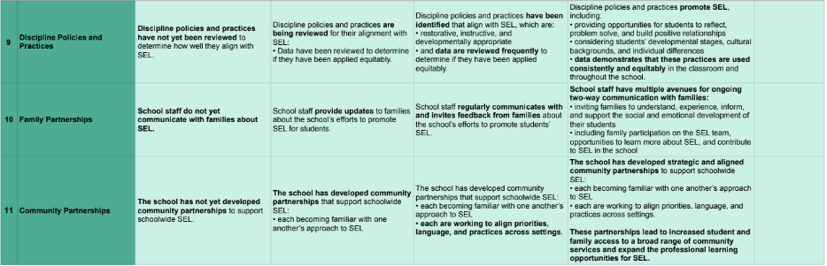
Continued: Promote SEL for Students

Slide 16

Focus Area 4
2 items

Slide 17
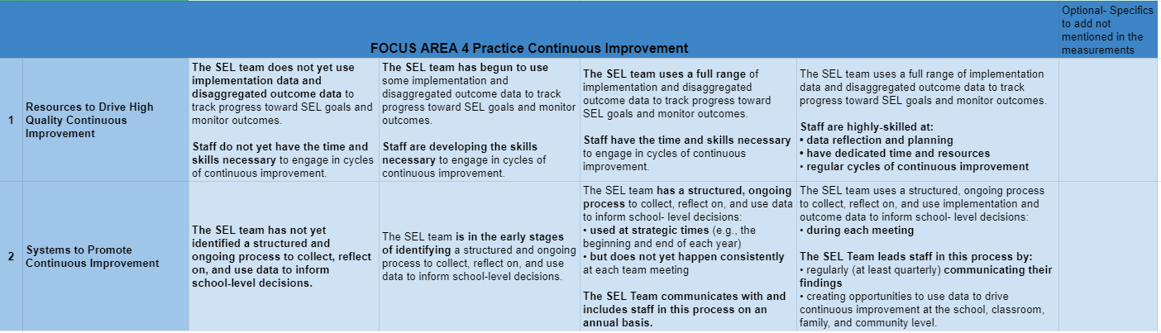
4: Continuous Improvement

Slide 18
Now What?
As a team, look at the results.
Discuss:
What are your school’s areas of strength (scoring 3’s and 4’s)?
What are your school’s areas of need (1’s and 2’s)?
What could be ONE item to focus efforts on for improvement?
Recorder, note the areas of strength & need on the results hard copy.

